Slide 1
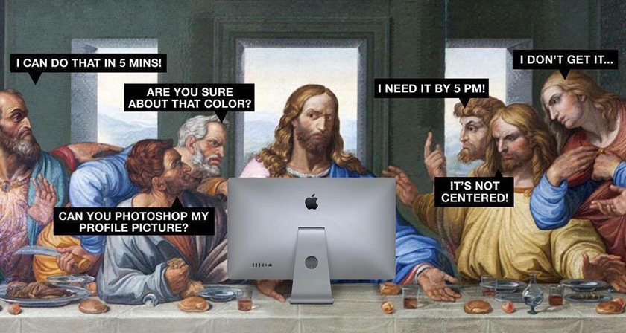

Designer brief
CAWL Regional platform

Slide 2
OBJECTIVES
It’s a new product that is to be released alongside the partner platform mid june 2026
Allow Credit Agricole employees and teams to have access to CAWL resources
Reuse the structure as the new design of the partner platform

Slide 3

Main menu
Accueil (reuse similar dashboard structure)
Ressources marketing (reuse same page as partner platform)
Ressources commerciales (reuse same page as partner platform)
Formations (reuse same page as ressources in partner platform)
Ressources techniques (reuse same page as partner platform)
***
Configurateur d’offre (reuse same page as partner platform)
Etat des services (reuse same page as partner platform)
Contacts assistance (reuse same page as partner platform)
Tutoriel plateforme (reuse same structure as partner platform - not sold yet)

