Slide 1
Real Presences
The Eucharist in the Anglican Tradition

Slide 2
Part 1: The Medieval Mass
Part 2: Cranmer’s Communion Liturgies
Part 3: Devotional Applications

Slide 3
Medieval Mass: Key Features
Absolute Centre of Medieval religious life.
Not uniform. Different rites for different dioceses (York and Sarum)
Christ is the elements (Transubstantiation)
Frequent celebration (usually daily)- infrequent lay reception (usually only once a year.

Slide 4
Medieval Mass: Key Features
Emphasis on visible performance rather than understanding content.
  Latin and “secret prayers”
Stark division between clergy and laypeople.
  Rood screens, communion in one kind.
  Representative “I” rather than communal we

Slide 5
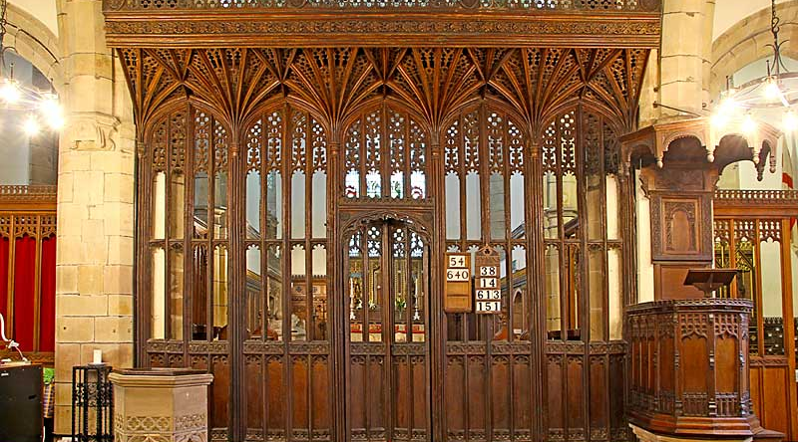
Rood Screen
All Saints Strelley, Nottinghamshire

Slide 6
The Sacrifice of the Mass
“Receive, O Holy Trinity, this oblation, which I, an unworthy sinner, offer in honour of thee, of the blessed Virgin and all the saints, for my sins and offences, and for the salvation of the living, and the rest of all the faithful dead.”
“Let this new sacrifice be acceptable to the omnipotent God.”
From the Sarum Rite

Slide 7
Versions of the Book of Common Prayer
1549: First, very conservative effort at reform. (Cranmer)
  Vernacular, no more sacrifice of the mass. Saints, prayers for the dead, basic Sarum structure retained.
1552: Edward VI Prayerbook. (Mostly Cranmer)
  Most Reformed version. Order highly revised. Never really used.
1559: Elizabethan Prayerbook.
  Basically 1552 with some very slight “moderate” revisions.
1662: Restoration Prayerbook
  Mostly 1559. Compromise in both directions.

Slide 8
Of Ceremonies
….some think it a great matter of conscience to depart from a piece of the least of their Ceremonies, they be so addicted to their old customs; and again on the other side, some be so newfangled, that they would innovate all things, and so despise the old, that nothing can like them, but that is new.
…it was thought expedient, not so much to have respect how to please and satisfy either of these parties, as how to please God, and profit them both.

Slide 9
d THE SUPPER c
of the Lorde, and the holy Communion,
commonly called
the Masse.

Slide 10
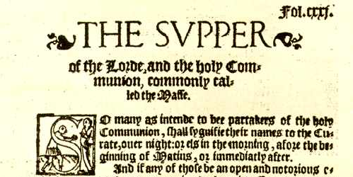

Slide 11
Major “Performative” Changes
Everyday Language – could be understood by everybody.
Uniformity – all England required to follow same text.
Little emphasis on bodily action by Priest.
Communion table placed at centre of the church.
Laypeople receive wine. No elevation of elements. Bread is everyday leavened bread “such as is eaten at table.”
Priest cannot communicate unless there are “a good number” to do so with him.
Priest uses “we” instead of the singular “I”

Slide 12
Major Structural and Content Changes
Ministry of the Word and Prayers more interwoven with the consecration and reception of the elements.
Gloria moved from the introduction to the end of the surface. (No longer singing to the elements).
All references to saints, Virgin Mary, and prayers for dead removed.
Eucharistic prayer edited so reception happens directly after the gospel narrative.
Prayer of oblation heavily edited and moved after reception

Slide 13
“Oblation”
Almighty God our heavenly father, which of thy tender mercy didst give thine only son Jesus Christ, to suffer death upon the cross for our redemption, who made there (by his one oblation of himself once offered) a full, perfect and sufficient sacrifice, oblation, and satisfaction, for the sins of the whole world, and did institute, and in his holy Gospel command us to continue, a perpetual memory of that his precious death…

Slide 14
Sarum “Sacrifice”
“accept [the consecrated bread and wine], even as thou didst vouchsafe to accept the gifts of thy righteous servant Abel, and the sacrifice of our Patriarch Abraham, and that which thy High Priest Melchisedech offered to thee, a holy sacrifice, an immaculate host.”

Slide 15
BCP “Sacrifice”
“O Lord and Heavenly Father, we thy humble servants entirely desire thy fatherly goodness, mercifully to accept this our Sacrifice of praise and thanksgiving:”
“…here we offer and present unto thee, O lord, our selves, our souls, and bodies, to be a reasonable holy, and lively Sacrifice unto thee: humbly beseeching thee that all we which be partakers of this holy Communion, may be fulfilled with thy grace and heavenly benediction”

Slide 16
Devotional Applications

Slide 17
1. Liturgical Vigilance
Liturgy is never inert. It shapes us for good or for ill.
Our strongly worded confession reminds us of our tendency to sin.
Our worship should be shaped by our willingness to repent of our sins, especially as those sins infect our worship.
We should not seek out what makes us comfortable, but rather what makes us better Christians and what brings glory to God.

Slide 18
2. Respect for different liturgical voices
“And in these our doings we condemn no other nations, nor prescribe any thing but to our own people only: For we think it convenient that every country should use such Ceremonies as they shall think best to the setting forth of God's honour and glory, and to the reducing of the people to a most perfect and godly living, without error or superstition; and that they should put away other things, which from time to time they perceive to be most abused, as in men's ordinances it often chanceth diversely in divers countries.”

Slide 19
3. Reverence for the material world and the human body
“it shall suffice that the bread be such, as is usual to bee eaten at the Table with other meats, but the best and purest wheat bread, that conveniently may be gotten.”
For Cranmer, the material pleasure we take in the elements is encouraged.
It gives us a bodily analogy for understanding the pleasure we ought to take in Christ

Slide 20
Devotional Applications
4. Reverence for the spiritual body of the church
5. Gratitude for the Cross and God’s gracious continuing nourishment of his Church.
6. Intellectual engagement with the liturgy.
7. Gift of the Eucharist “spills over” into our lives.

Slide 21
Spiritual Dangers of the Anglican Tradition
“Liturgicalism” – the right liturgy will save you
  1. Traditional way is best
  2. Innovation is best
Becoming “sacramentalish” – treating the sacrament with indifference or failing to receive regularly.
“mental” engagement only.
Overemphasizing difference with Roman Catholics instead of difference with the world.
Lack of personal confession.

Slide 22
Almighty and ever-living God, we heartily thank you for your promise to feed us, who have faithfully received these holy mysteries, with the spiritual food of the most precious body and blood of your Son our Saviour Jesus Christ; and so assure us by your favour and goodness towards us, that we are true members united in his mystical body, which is the blessed company of all faithful people; and are also heirs, through hope, of your everlasting kingdom, by the merits of the most precious death and suffering of your dear son. And we humbly ask you, heavenly Father, to assist us with your grace, that we may continue in that holy fellowship, and do all those good works that you have prepared for us to walk in; through Jesus Christ our Lord, to whom. with you and the Holy Spirit, be all honour and glory, now and forever.

Slide 23
Suggestions for Further Reading
Brian Cummings, The Book of Common Prayer: The Texts of 1549, 1559, and 1662 (Oxford UP).
Stephen Platten and Christopher Woods (eds.), Comfortable Words: Polity, Piety and the Book of Common Prayer (SCM Press).
Prudence Dailey (ed.), The Book of Common Prayer: Past, Present and Future (Continuum).

