Slide 1
Lesson 14, Daniel 9, part 3

Slide 2
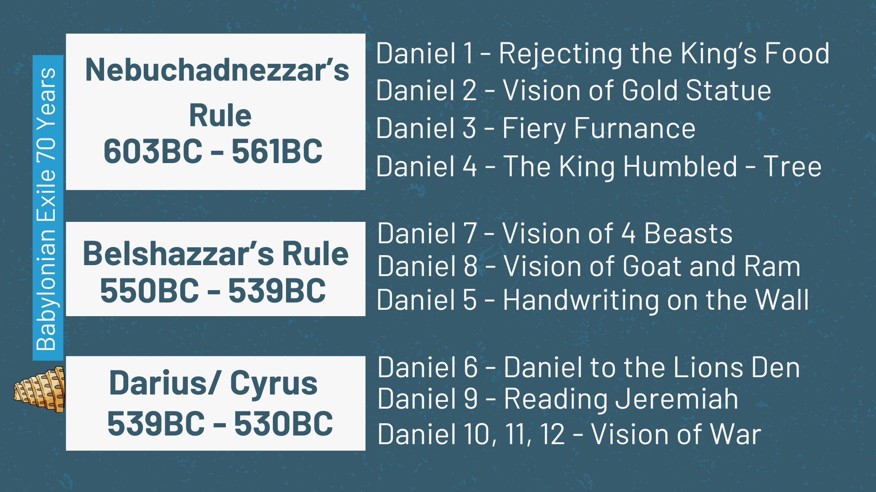

Slide 4
Now while I was speaking and praying, and confessing my sin and the sin of my people Israel, and presenting my supplication before the Lord my God in behalf of the holy mountain of my God, while I was still speaking in prayer, then the man Gabriel, whom I had seen in the vision previously, came to me in my extreme weariness about the time of the evening offering. He gave me instruction and talked with me and said, “O Daniel, I have now come forth to give you insight with understanding.
Daniel 9:20–27

Slide 5
“At the beginning of your supplications the command was issued, and I have come to tell you, for you are highly esteemed; so give heed to the message and gain understanding of the vision. “Seventy weeks have been decreed for your people and your holy city, to finish the transgression, to make an end of sin, to make atonement for iniquity, to bring in everlasting righteousness, to seal up vision and prophecy and to anoint the most holy place.
Daniel 9:20–27

Slide 6
“So you are to know and discern that from the issuing of a decree to restore and rebuild Jerusalem until Messiah the Prince there will be seven weeks and sixty-two weeks; it will be built again, with plaza and moat, even in times of distress. “Then after the sixty-two weeks the Messiah will be cut off and have nothing, and the people of the prince who is to come will destroy the city and the sanctuary. And its end will come with a flood; even to the end there will be war; desolations are determined.
Daniel 9:20–27

Slide 7
“And he will make a firm covenant with the many for one week, but in the middle of the week he will put a stop to sacrifice and grain offering; and on the wing of abominations will come one who makes desolate, even until a complete destruction, one that is decreed, is poured out on the one who makes desolate.”
Daniel 9:20–27

Slide 9
1. The Angel of the Vision

Slide 10
And coming in, he said to her, “Greetings, favored one! The Lord is with you.” But she was very perplexed at this statement, and kept pondering what kind of salutation this was. The angel said to her, “Do not be afraid, Mary; for you have found favor with God. “And behold, you will conceive in your womb and bear a son, and you shall name Him Jesus. “He will be great and will be called the Son of the Most High; and the Lord God will give Him the throne of His father David; and He will reign over the house of Jacob forever, and His kingdom will have no end.”
Luke 1:28–33
NASB95

Slide 11
2. The Purpose of the
70 7’s.

Slide 12
24 “Seventy weeks have been decreed for your people and your holy city, to finish the transgression, to make an end of sin, to make atonement for iniquity, to bring in everlasting righteousness, to seal up vision and prophecy and to anoint the most holy place.
Daniel 9:24
NASB95

Slide 13
24 and He Himself bore our sins in His body on the cross, so that we might die to sin and live to righteousness; for by His wounds you were healed.
1 Peter 2:24
NASB95

Slide 14
21 He made Him who knew no sin to be sin on our behalf, so that we might become the righteousness of God in Him.
2 Corinthians 5:21
NASB95

Slide 15
In this is love, not that we loved God, but that He loved us and sent His Son to be the propitiation for our sins.
1 John 4:10
NASB95

Slide 16
But now apart from the Law the righteousness of God has been manifested, being witnessed by the Law and the Prophets, even the righteousness of God through faith in Jesus Christ for all those who believe; for there is no distinction;
Romans 3:21–22
NASB95

Slide 17
1 God, after He spoke long ago to the fathers in the prophets in many portions and in many ways, 2 in these last days has spoken to us in His Son, whom He appointed heir of all things, through whom also He made the world.
Hebrews 1:1–2
NASB95

Slide 18
3. The 3 sets of sevens

Slide 19
24 “Seventy weeks have been decreed for your people and your holy city
Daniel 9:24
NASB95

Slide 20
The Lord then spoke to Moses at Mount Sinai, saying, “Speak to the sons of Israel and say to them, ‘When you come into the land which I shall give you, then the land shall have a sabbath to the Lord. ‘Six years you shall sow your field, and six years you shall prune your vineyard and gather in its crop, but during the seventh year the land shall have a sabbath rest, a sabbath to the Lord; you shall not sow your field nor prune your vineyard.
Leviticus 25:1–4
NASB95

Slide 21
‘You, however, I will scatter among the nations and will draw out a sword after you, as your land becomes desolate and your cities become waste. ‘Then the land will enjoy its sabbaths all the days of the desolation, while you are in your enemies’ land; then the land will rest and enjoy its sabbaths. ‘All the days of its desolation it will observe the rest which it did not observe on your sabbaths, while you were living on it.
Leviticus 26:33–35
NASB95

Slide 22
40 ‘If they confess their iniquity and the iniquity of their forefathers, in their unfaithfulness which they committed against Me, and also in their acting with hostility against Me— 41 I also was acting with hostility against them, to bring them into the land of their enemies—or if their uncircumcised heart becomes humbled so that they then make amends for their iniquity, 42 then I will remember My covenant with Jacob, and I will remember also My covenant with Isaac, and My covenant with Abraham as well, and I will remember the land. 43 ‘For the land will be abandoned by them, and will make up for its sabbaths while it is made desolate without them. They, meanwhile, will be making amends for their iniquity, because they rejected My ordinances and their soul abhorred My statutes.
Leviticus 26:40–43
NASB95

Slide 23
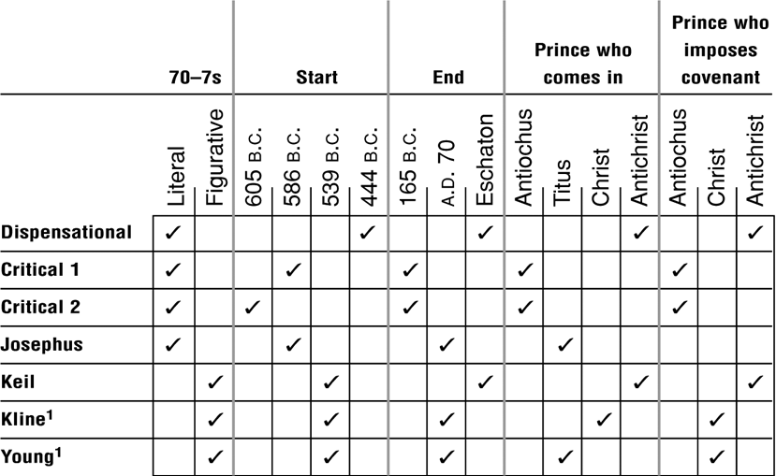

Slide 24
3 I did not eat any tasty food, nor did meat or wine enter my mouth, nor did I use any ointment at all until the entire three weeks were completed.
Daniel 10:3
NASB95

Slide 25
‘You are also to count off seven sabbaths of years for yourself, seven times seven years, so that you have the time of the seven sabbaths of years, namely, forty-nine years. ‘You shall then sound a ram’s horn abroad on the tenth day of the seventh month; on the day of atonement you shall sound a horn all through your land. ‘You shall thus consecrate the fiftieth year and proclaim a release through the land to all its inhabitants. It shall be a jubilee for you, and each of you shall return to his own property, and each of you shall return to his family.
Leviticus 25:8–10
NASB95

Slide 26
25 “So you are to know and discern that from the issuing of a decree to restore and rebuild Jerusalem until Messiah the Prince there will be seven weeks and sixty-two weeks; it will be built again, with plaza and moat, even in times of distress.
Daniel 9:25
NASB95

Slide 27
25 “So you are to know and discern that from the issuing of a decree to restore and rebuild Jerusalem until Messiah the Prince there will be seven weeks and sixty-two weeks; it will be built again, with plaza and moat, even in times of distress. 26 “Then after the sixty-two weeks the Messiah will be cut off and have nothing, and the people of the prince who is to come will destroy the city and the sanctuary. And its end will come with a flood; even to the end there will be war; desolations are determined.
Daniel 9:25–26
NASB95

Slide 28
NASB: Messiah the Prince there will be seven weeks and sixty-two weeks;
NIV: Anointed one, the ruler, comes, there will be seven “sevens”, and sixty-two “sevens”.
ESV: coming of an anointed one, a prince, there shall be seven weeks. Then for sixty-two weeks it shall...

Slide 29
26 “Then after the sixty-two weeks the Messiah will be cut off and have nothing, and the people of the prince who is to come will destroy the city and the sanctuary. And its end will come with a flood; even to the end there will be war; desolations are determined. 27 “And he will make a firm covenant with the many for one week, but in the middle of the week he will put a stop to sacrifice and grain offering; and on the wing of abominations will come one who makes desolate, even until a complete destruction, one that is decreed, is poured out on the one who makes desolate.”
Daniel 9:26–27

Slide 30
“Then after the sixty-two weeks the Messiah will be cut off and have nothing, and the people of the prince who is to come will destroy the city and the sanctuary. And its end will come with a flood; even to the end there will be war; desolations are determined.
Daniel 9:26
NASB95

Slide 31
8 By oppression and judgment He was taken away; And as for His generation, who considered That He was cut off out of the land of the living For the transgression of my people, to whom the stroke was due?
Isaiah 53:8
NASB95

Slide 32
12 Therefore, I will allot Him a portion with the great, And He will divide the booty with the strong; Because He poured out Himself to death, And was numbered with the transgressors; Yet He Himself bore the sin of many, And interceded for the transgressors.
Isaiah 53:12
NASB95

Slide 33
13 When He said, “A new covenant,” He has made the first obsolete. But whatever is becoming obsolete and growing old is ready to disappear.
Hebrews 8:13
NASB95

Slide 34
15 “Therefore when you see the abomination of desolation which was spoken of through Daniel the prophet, standing in the holy place (let the reader understand), 16 then those who are in Judea must flee to the mountains.
Matthew 24:15–16
NASB95

Slide 35
14 “But when you see the abomination of desolation standing where it should not be (let the reader understand), then those who are in Judea must flee to the mountains.
Mark 13:14
NASB95

Slide 36
20 “But when you see Jerusalem surrounded by armies, then recognize that her desolation is near. 21 “Then those who are in Judea must flee to the mountains, and those who are in the midst of the city must leave, and those who are in the country must not enter the city; 22 because these are days of vengeance, so that all things which are written will be fulfilled.
Luke 21:20–22

