Slide 1
10 Commandments: Why God can Command us.

Slide 3
I am the LORD your God
who brought you out of Egypt
out of the house of slavery

Slide 4
Reason 1
My Greatness

Slide 5
“I am the LORD your God, who brought you out of the land of Egypt, out of the house of slavery.
Exodus 20:2

Slide 6
Authority
Sovereignty
Self-Sufficient
Eternality
Almighty
Unchangeablness

Slide 7
I am the LORD your God
who brought you out of Egypt
out of the house of slavery

Slide 8
The heavens are Yours, the earth also is Yours; The world and all it contains, You have founded them.
Psalm 89:11

Slide 9
Reason 2
My Goodness

Slide 10
“I am the LORD your God, who brought you out of the land of Egypt, out of the house of slavery.
Exodus 20:2
NASB95

Slide 11
I am the LORD your God
who brought you out of Egypt
out of the house of slavery

Slide 12
‘You yourselves have seen what I did to the Egyptians, and how I bore you on eagles’ wings, and brought you to Myself.
Exodus 19:4–6

Slide 13
‘Now then, if you will indeed obey My voice and keep My covenant, then you shall be My own possession among all the peoples, for all the earth is Mine;
Exodus 19:4–6

Slide 14
and you shall be to Me a kingdom of priests and a holy nation.’ These are the words that you shall speak to the sons of Israel.”
Exodus 19:4–6

Slide 15
Reason 3
My Redemption

Slide 16
“I am the LORD your God, who brought you out of the land of Egypt, out of the house of slavery.
Exodus 20:2
NASB95

Slide 17
I am the LORD your God
who brought you out of Egypt
out of the house of slavery

Slide 18
But as many as received Him, to them He gave the right to become children of God, even to those who believe in His name,
John 1:12

Slide 19
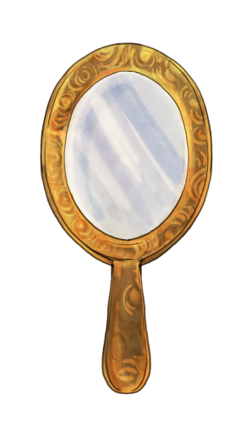

Slide 21
for until the Law sin was in the world, but sin is not imputed when there is no law. Nevertheless death reigned from Adam until Moses, even over those who had not sinned in the likeness of the offense of Adam, who is a type of Him who was to come.
Romans 5:13–14

Slide 22
For when Gentiles who do not have the Law do instinctively the things of the Law, these, not having the Law, are a law to themselves, in that they show the work of the Law written in their hearts, their conscience bearing witness and their thoughts alternately accusing or else defending them,
Romans 2:14–15

