Slide 1

Daniel: Introduction

Slide 2
1. The Shape of Daniel

Slide 3

1 Dream Statue representing four kingdoms 2 2 Worship the golden statue or perish in a pit 3 3 Judgment on Nebuchadnezzar 4 3 Judgment on Belshazzar 5 2 Worship Darius or perish in a pit 6 1 Dream of four beasts representing four kingdoms7

Slide 4
1 No one can serve two masters 2 for either he will hate the one 3 and love the other, 3 or he will be devoted to one 2 and despise the other. 1 You cannot serve God and wealth

Slide 5
2. The Date of Daniel

Slide 6
1 In the third year of the reign of Jehoiakim king of Judah, Nebuchadnezzar king of Babylon came to Jerusalem and besieged it.
Daniel 1:1
NASB95

Slide 7
21 And Daniel continued until the first year of Cyrus the king.
Daniel 1:21
NASB95

Slide 8
28 So this Daniel enjoyed success in the reign of Darius and in the reign of Cyrus the Persian.
Daniel 6:28
NASB95

Slide 9
1 In the third year of Cyrus king of Persia a message was revealed to Daniel, who was named Belteshazzar; and the message was true and one of great conflict, but he understood the message and had an understanding of the vision.
Daniel 10:1
NASB95

Slide 10
3. The Genre of Daniel

Slide 11
The Stories are ______________ Stories, not ____________________ historical.

Slide 12
The Stories are Theological Stories, not historicalistorical.

Slide 13
The Visions are Apocalyptic, not ________________literal.

Slide 14
The Visions are Apocalyptic, not literal.

Slide 15
Apocalyptic Literature is for ___________t

Slide 16
Apocalyptic Literature is for Comfort

Slide 17
Apocalyptic Literature is an Image of the ________________ future.

Slide 18
Apocalyptic Literature is an Image of the future.

Slide 19
Apocalyptic Literature is to be ________________transformed.

Slide 20
Apocalyptic Literature is to be transformed.

Slide 21
21 “The shaggy goat represents the kingdom of Greece, and the large horn that is between his eyes is the first king. 22 “The broken horn and the four horns that arose in its place represent four kingdoms which will arise from his nation, although not with his power.
Daniel 8:21–22
NASB95

Slide 22
The Genre is ______________, not _____________ prophetic

Slide 23
The Genre is wisdom, not prophetic prophetic

Slide 24
4 youths in whom was no defect, who were good-looking, showing intelligence in every branch of wisdom, endowed with understanding and discerning knowledge, and who had ability for serving in the king’s court; and he ordered him to teach them the literature and language of the Chaldeans.
Daniel 1:4
NASB95

Slide 25
Intelligence 9 times
Wisdom 3 times
Understanding 22 times
Discerning 11 times

Slide 26
3 “Those who have insight will shine brightly like the brightness of the expanse of heaven, and those who lead the many to righteousness, like the stars forever and ever. 4 “But as for you, Daniel, conceal these words and seal up the book until the end of time; many will go back and forth, and knowledge will increase.”
Daniel 12:3–4
NASB95

Slide 27
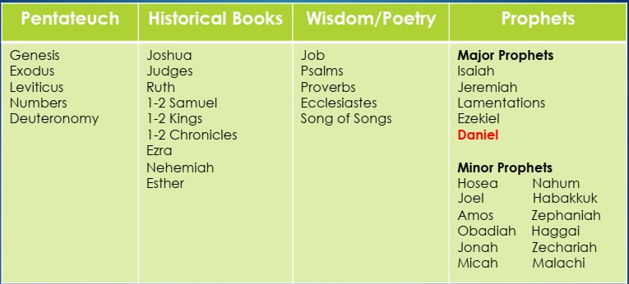

Slide 28
15 “Therefore when you see the abomination of desolation which was spoken of through Daniel the prophet, standing in the holy place (let the reader understand),
Matthew 24:15
NASB95

Slide 29
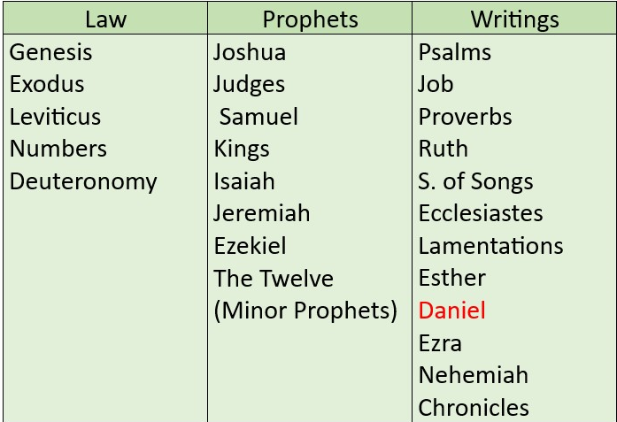

Slide 30
49 “For this reason also the wisdom of God said, ‘I will send to them prophets and apostles, and some of them they will kill and some they will persecute, 50 so that the blood of all the prophets, shed since the foundation of the world, may be charged against this generation, 51 from the blood of Abel to the blood of Zechariah, who was killed between the altar and the house of God; yes, I tell you, it shall be charged against this generation.’
Luke 11:49–51
NASB95

Slide 31
4. The Lessons of Daniel

Slide 32
1 “Now at that time Michael, the great prince who stands guard over the sons of your people, will arise. And there will be a time of distress such as never occurred since there was a nation until that time; and at that time your people, everyone who is found written in the book, will be rescued.
Daniel 12:1–3
NASB95

Slide 33
2 “Many of those who sleep in the dust of the ground will awake, these to everlasting life, but the others to disgrace and everlasting contempt.
Daniel 12:1–3
NASB95

Slide 34
3 “Those who have insight will shine brightly like the brightness of the expanse of heaven, and those who lead the many to righteousness, like the stars forever and ever.
Daniel 12:1–3
NASB95

