Slide 1
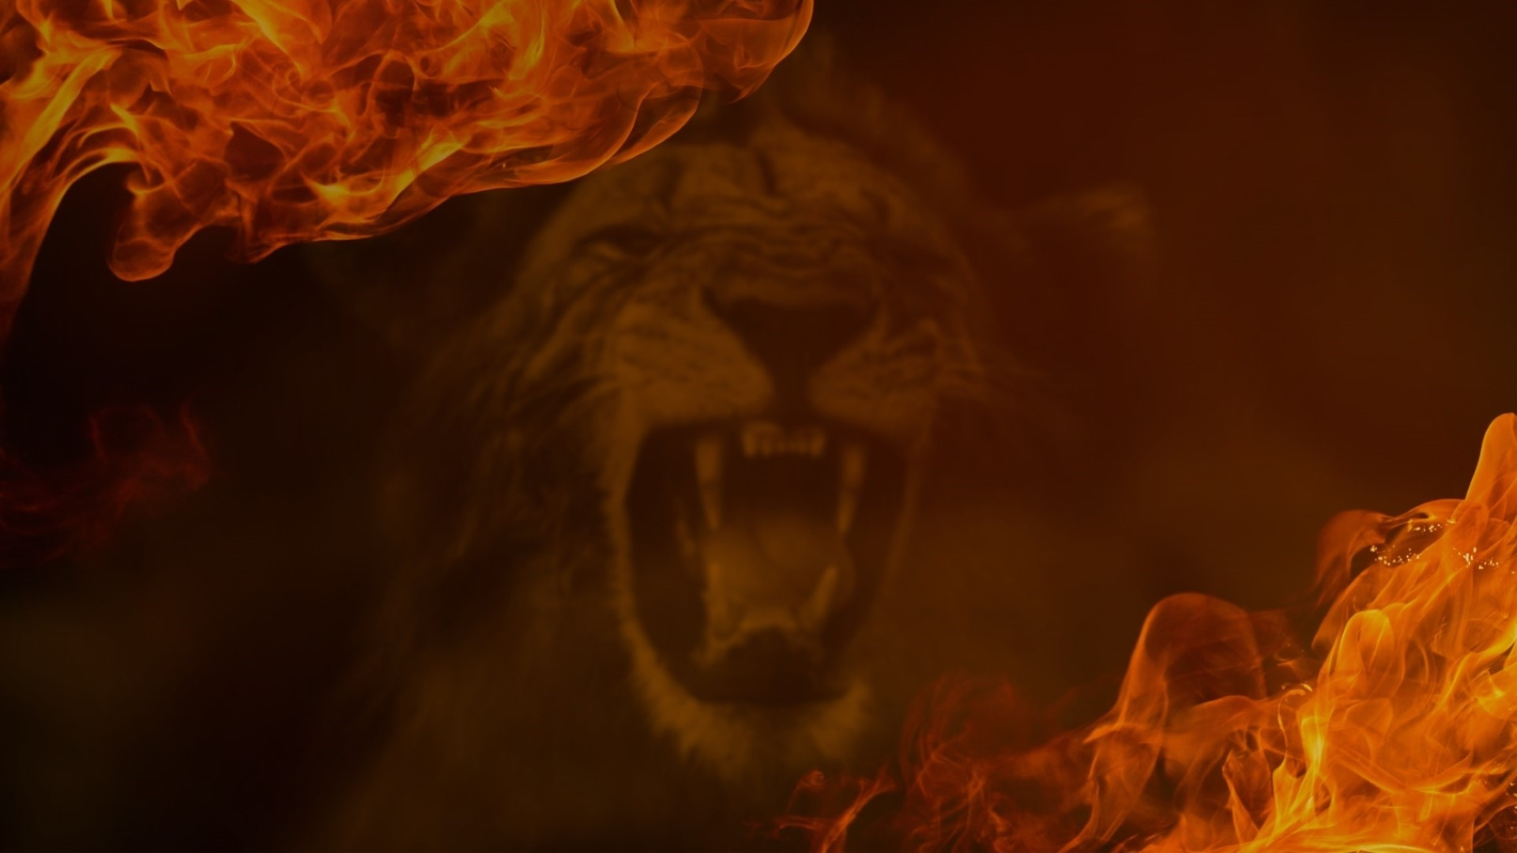
Lesson 13, Daniel 9 part 2

Slide 2
1. Setting of Daniel’s Prayer (1-3)

Slide 3
Nebuchadnezzar comes to the Throne 605 BC
Cyrus Issued Decree for Jews to return 539 BC
Jeremiah 29
Jeremiah 25
Nebuchadnezzar takes Jews to Babylon 597 BC

Slide 4
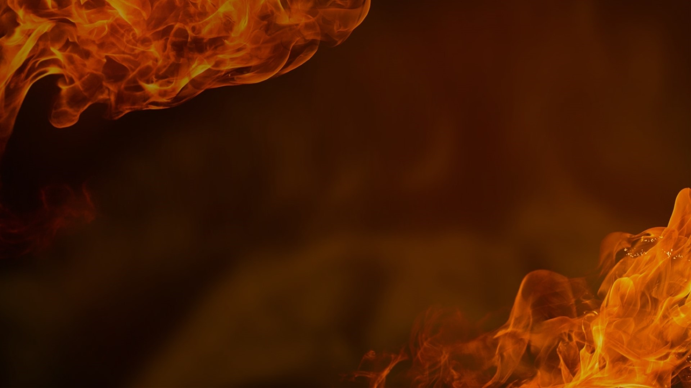
1 In the first year of Darius the son of Ahasuerus, of Median descent, who was made king over the kingdom of the Chaldeans— 2 in the first year of his reign, I, Daniel, observed in the books the number of the years which was revealed as the word of the Lord to Jeremiah the prophet for the completion of the desolations of Jerusalem, namely, seventy years.
Daniel 9:1–3
NASB95

Slide 5
3 So I gave my attention to the Lord God to seek Him by prayer and supplications, with fasting, sackcloth and ashes.
Daniel 9:1–3
NASB95

Slide 6
2. Confessions of Daniel’s Prayer (4-14)

Slide 7
4 I prayed to the Lord my God and confessed and said, “Alas, O Lord, the great and awesome God, who keeps His covenant and lovingkindness for those who love Him and keep His commandments,
Daniel 9:4

Slide 8
4 I prayed to the Lord my God and confessed and said, “Alas, O Lord, the great and awesome God, who keeps His covenant and lovingkindness for those who love Him and keep His commandments,
Daniel 9:4

Slide 9
5 we have sinned, committed iniquity, acted wickedly and rebelled, even turning aside from Your commandments and ordinances.
Daniel 9:5

Slide 10
10 nor have we obeyed the voice of the Lord our God, to walk in His teachings which He set before us through His servants the prophets.
Daniel 9:10

Slide 11
11 “Indeed all Israel has transgressed Your law and turned aside, not obeying Your voice; so the curse has been poured out on us, along with the oath which is written in the law of Moses the servant of God, for we have sinned against Him.
Daniel 9:11

Slide 12
13 “As it is written in the law of Moses, all this calamity has come on us; yet we have not sought the favor of the Lord our God by turning from our iniquity and giving attention to Your truth.
Daniel 9:13

Slide 13
4 I prayed to the Lord my God and confessed and said, “Alas, O Lord, the great and awesome God, who keeps His covenant and lovingkindness for those who love Him and keep His commandments,
Daniel 9:4

Slide 14
6 “Moreover, we have not listened to Your servants the prophets, who spoke in Your name to our kings, our princes, our fathers and all the people of the land.
Daniel 9:6

Slide 15
10 nor have we obeyed the voice of the Lord our God, to walk in His teachings which He set before us through His servants the prophets.
Daniel 9:10

Slide 16
7 “Righteousness belongs to You, O Lord, but to us open shame, as it is this day—to the men of Judah, the inhabitants of Jerusalem and all Israel, those who are nearby and those who are far away in all the countries to which You have driven them, because of their unfaithful deeds which they have committed against You.
Daniel 9:7

Slide 17
9 “To the Lord our God belong compassion and forgiveness, for we have rebelled against Him;
Daniel 9:9

Slide 18
15 “And now, O Lord our God, who have brought Your people out of the land of Egypt with a mighty hand and have made a name for Yourself, as it is this day—we have sinned, we have been wicked.
Daniel 9:15

Slide 19
17 “So now, our God, listen to the prayer of Your servant and to his supplications, and for Your sake, O Lord, let Your face shine on Your desolate sanctuary.
Daniel 9:17

Slide 20
18 “O my God, incline Your ear and hear! Open Your eyes and see our desolations and the city which is called by Your name; for we are not presenting our supplications before You on account of any merits of our own, but on account of Your great compassion.
Daniel 9:18

Slide 21
5 we have sinned, committed iniquity, acted wickedly and rebelled, even turning aside from Your commandments and ordinances.
Daniel 9:5

Slide 22
8 “Open shame belongs to us, O Lord, to our kings, our princes and our fathers, because we have sinned against You.
Daniel 9:8

Slide 23
9 “To the Lord our God belong compassion and forgiveness, for we have rebelled against Him;
Daniel 9:9

Slide 24
6 “Moreover, we have not listened to Your servants the prophets, who spoke in Your name to our kings, our princes, our fathers and all the people of the land.
Daniel 9:6

Slide 25
10 nor have we obeyed the voice of the Lord our God, to walk in His teachings which He set before us through His servants the prophets.
Daniel 9:10

Slide 26
7 “Righteousness belongs to You, O Lord, but to us open shame, as it is this day—to the men of Judah, the inhabitants of Jerusalem and all Israel, those who are nearby and those who are far away in all the countries to which You have driven them, because of their unfaithful deeds which they have committed against You.
Daniel 9:7

Slide 27
11 “Indeed all Israel has transgressed Your law and turned aside, not obeying Your voice; so the curse has been poured out on us, along with the oath which is written in the law of Moses the servant of God, for we have sinned against Him. 12 “Thus He has confirmed His words which He had spoken against us and against our rulers who ruled us, to bring on us great calamity; for under the whole heaven there has not been done anything like what was done to Jerusalem.
Daniel 9:11–14

Slide 28
13 “As it is written in the law of Moses, all this calamity has come on us; yet we have not sought the favor of the Lord our God by turning from our iniquity and giving attention to Your truth. 14 “Therefore the Lord has kept the calamity in store and brought it on us; for the Lord our God is righteous with respect to all His deeds which He has done, but we have not obeyed His voice.
Daniel 9:11–14

Slide 29
3. Request of Daniel’s Prayer (15-19)

Slide 30
15 “And now, O Lord our God, who have brought Your people out of the land of Egypt with a mighty hand and have made a name for Yourself, as it is this day—we have sinned, we have been wicked.
Daniel 9:15

Slide 31
16 “O Lord, in accordance with all Your righteous acts, let now Your anger and Your wrath turn away from Your city Jerusalem, Your holy mountain; for because of our sins and the iniquities of our fathers, Jerusalem and Your people have become a reproach to all those around us.
Daniel 9:16

Slide 32
17 “So now, our God, listen to the prayer of Your servant and to his supplications, and for Your sake, O Lord, let Your face shine on Your desolate sanctuary.
Daniel 9:17

Slide 33
24 The Lord bless you, and keep you; 25 The Lord make His face shine on you, And be gracious to you; 26 The Lord lift up His countenance on you, And give you peace.’
Numbers 6:24–26

Slide 34
3 O God, restore us And cause Your face to shine upon us, and we will be saved.
Psalm 80:3

Slide 35
7 O God of hosts, restore us And cause Your face to shine upon us, and we will be saved.
Psalm 80:7

Slide 36
19 O Lord God of hosts, restore us; Cause Your face to shine upon us, and we will be saved.
Psalm 80:19

Slide 37
18 “O my God, incline Your ear and hear! Open Your eyes and see our desolations and the city which is called by Your name; for we are not presenting our supplications before You on account of any merits of our own, but on account of Your great compassion.
Daniel 9:18

Slide 38
22 The Lord’s lovingkindnesses indeed never cease, For His compassions never fail. 23 They are new every morning; Great is Your faithfulness.
Lamentations 3:22–23

Slide 39
19 “O Lord, hear! O Lord, forgive! O Lord, listen and take action! For Your own sake, O my God, do not delay, because Your city and Your people are called by Your name.”
Daniel 9:19

Slide 40
Application:

Slide 41
6 “Moreover, we have not listened to Your servants the prophets, who spoke in Your name to our kings, our princes, our fathers and all the people of the land.
Daniel 9:6

Slide 42
7 “Righteousness belongs to You, O Lord, but to us open shame, as it is this day—to the men of Judah, the inhabitants of Jerusalem and all Israel, those who are nearby and those who are far away in all the countries to which You have driven them, because of their unfaithful deeds which they have committed against You.
Daniel 9:7

Slide 43
9 “To the Lord our God belong compassion and forgiveness, for we have rebelled against Him;
Daniel 9:9

Slide 44
14 “Therefore the Lord has kept the calamity in store and brought it on us; for the Lord our God is righteous with respect to all His deeds which He has done, but we have not obeyed His voice.
Daniel 9:14

Slide 45
15 “And now, O Lord our God, who have brought Your people out of the land of Egypt with a mighty hand and have made a name for Yourself, as it is this day—we have sinned, we have been wicked.
Daniel 9:15

Slide 46
16 “O Lord, in accordance with all Your righteous acts, let now Your anger and Your wrath turn away from Your city Jerusalem, Your holy mountain; for because of our sins and the iniquities of our fathers, Jerusalem and Your people have become a reproach to all those around us.
Daniel 9:16

Slide 47
17 “So now, our God, listen to the prayer of Your servant and to his supplications, and for Your sake, O Lord, let Your face shine on Your desolate sanctuary.
Daniel 9:17

Slide 48
18 “O my God, incline Your ear and hear! Open Your eyes and see our desolations and the city which is called by Your name; for we are not presenting our supplications before You on account of any merits of our own, but on account of Your great compassion.
Daniel 9:18

Slide 49
19 “O Lord, hear! O Lord, forgive! O Lord, listen and take action! For Your own sake, O my God, do not delay, because Your city and Your people are called by Your name.”
Daniel 9:19

