Slide 1

Lesson 17, Daniel 12

Slide 2
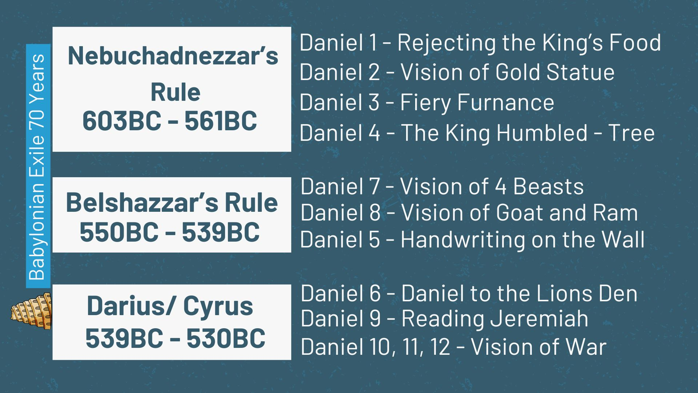

Slide 3
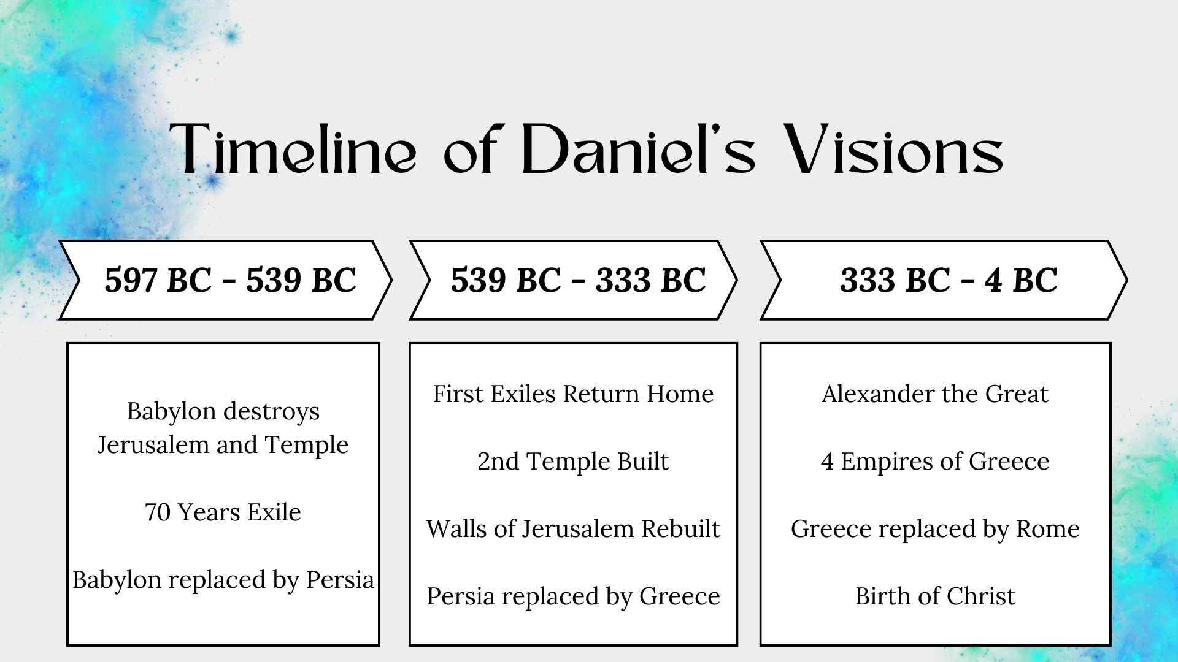

Slide 4
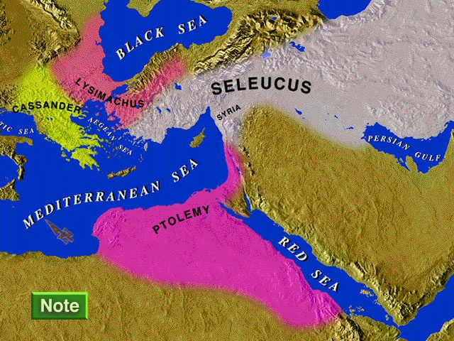

Slide 5
1. Question 1 - How Long until the end of these wonders? (verse 5-7)

Slide 6

Then I, Daniel, looked and behold, two others were standing, one on this bank of the river and the other on that bank of the river.
Daniel 12:5
NASB95

Slide 7
“Now at that time Michael, the great prince who stands guard over the sons of your people, will arise. And there will be a time of distress such as never occurred since there was a nation until that time; and at that time your people, everyone who is found written in the book, will be rescued.
Daniel 12:1
NASB95

Slide 8
2. Question 2 - What will be the outcome? (8-13)

Slide 9
As for me, I heard but could not understand; so I said, “My lord, what will be the outcome of these events?”
Daniel 12:8
NASB95

Slide 10
“Many will be purged, purified and refined, but the wicked will act wickedly; and none of the wicked will understand, but those who have insight will understand.
Daniel 12:10
NASB95

Slide 11
“From the time that the regular sacrifice is abolished and the abomination of desolation is set up, there will be 1,290 days. “How blessed is he who keeps waiting and attains to the 1,335 days!
Daniel 12:11–12
NASB95

Slide 12
Now these things happened to them as an example, and they were written for our instruction, upon whom the ends of the ages have come.
1 Corinthians 10:11
NASB95

Slide 13
Do this, knowing the time, that it is already the hour for you to awaken from sleep; for now salvation is nearer to us than when we believed.
Romans 13:11
NASB95

Slide 14
You too be patient; strengthen your hearts, for the coming of the Lord is near.
James 5:8
NASB95

Slide 15
The end of all things is near; therefore, be of sound judgment and sober spirit for the purpose of prayer.
1 Peter 4:7
NASB95

Slide 16
Children, it is the last hour; and just as you heard that antichrist is coming, even now many antichrists have appeared; from this we know that it is the last hour.
1 John 2:18
NASB95

Slide 17
“Go therefore and make disciples of all the nations, baptizing them in the name of the Father and the Son and the Holy Spirit, teaching them to observe all that I commanded you; and lo, I am with you always, even to the end of the age.”
Matthew 28:19–20
NASB95

Slide 18
I saw in the right hand of Him who sat on the throne a book written inside and on the back, sealed up with seven seals. And I saw a strong angel proclaiming with a loud voice, “Who is worthy to open the book and to break its seals?” And no one in heaven or on the earth or under the earth was able to open the book or to look into it.
Revelation 5:1–6
NASB95

Slide 19
Then I began to weep greatly because no one was found worthy to open the book or to look into it; and one of the elders said to me, “Stop weeping; behold, the Lion that is from the tribe of Judah, the Root of David, has overcome so as to open the book and its seven seals.” And I saw between the throne (with the four living creatures) and the elders a Lamb standing, as if slain, having seven horns and seven eyes, which are the seven Spirits of God, sent out into all the earth.
Revelation 5:1–6
NASB95

Slide 20
“But as for you, go your way to the end; then you will enter into rest and rise again for your allotted portion at the end of the age.”
Daniel 12:13
NASB95

Slide 21
“By smooth words he will turn to godlessness those who act wickedly toward the covenant, but the people who know their God will display strength and take action.
Daniel 11:32
NASB95

Slide 22
“Those who have insight among the people will give understanding to the many; yet they will fall by sword and by flame, by captivity and by plunder for many days.
Daniel 11:33
NASB95

Slide 23
“Some of those who have insight will fall, in order to refine, purge and make them pure until the end time; because it is still to come at the appointed time.
Daniel 11:35
NASB95

Slide 24
“How blessed is he who keeps waiting and attains to the 1,335 days!
Daniel 12:12
NASB95

Slide 25
“Those who have insight will shine brightly like the brightness of the expanse of heaven, and those who lead the many to righteousness, like the stars forever and ever.
Daniel 12:3
NASB95

Slide 26
“Many of those who sleep in the dust of the ground will awake, these to everlasting life, but the others to disgrace and everlasting contempt.
Daniel 12:2
NASB95

Slide 27
“But as for you, go your way to the end; then you will enter into rest and rise again for your allotted portion at the end of the age.”
Daniel 12:13
NASB95

