Slide 1

Lesson 16, Daniel 11

Slide 2

8 Now in the second year of their coming to the house of God at Jerusalem in the second month, Zerubbabel the son of Shealtiel and Jeshua the son of Jozadak and the rest of their brothers the priests and the Levites, and all who came from the captivity to Jerusalem, began the work and appointed the Levites from twenty years and older to oversee the work of the house of the Lord.
Ezra 3:8–10

Slide 3
9 Then Jeshua with his sons and brothers stood united with Kadmiel and his sons, the sons of Judah and the sons of Henadad with their sons and brothers the Levites, to oversee the workmen in the temple of God.
Ezra 3:8–10
NASB95

Slide 4
10 Now when the builders had laid the foundation of the temple of the Lord, the priests stood in their apparel with trumpets, and the Levites, the sons of Asaph, with cymbals, to praise the Lord according to the directions of King David of Israel.
Ezra 3:8–10
NASB95

Slide 5
4 Then the people of the land discouraged the people of Judah, and frightened them from building,
Ezra 4:4–5
NASB95

Slide 6
5 and hired counselors against them to frustrate their counsel all the days of Cyrus king of Persia, even until the reign of Darius king of Persia.
Ezra 4:4–5
NASB95

Slide 7
1 In the third year of Cyrus king of Persia a message was revealed to Daniel, who was named Belteshazzar; and the message was true and one of great conflict, but he understood the message and had an understanding of the vision.
Daniel 10:1
NASB95

Slide 8
21 “However, I will tell you what is inscribed in the writing of truth. Yet there is no one who stands firmly with me against these forces except Michael your prince.
Daniel 10:21
NASB95

Slide 9
2 “And now I will tell you the truth. Behold, three more kings are going to arise in Persia. Then a fourth will gain far more riches than all of them; as soon as he becomes strong through his riches, he will arouse the whole empire against the realm of Greece.
Daniel 11:2
NASB95

Slide 10
1. Predicting History

Slide 11
1 “In the first year of Darius the Mede, I arose to be an encouragement and a protection for him.
Daniel 11:1–4

Slide 12
2 “And now I will tell you the truth. Behold, three more kings are going to arise in Persia. Then a fourth will gain far more riches than all of them; as soon as he becomes strong through his riches, he will arouse the whole empire against the realm of Greece.
Daniel 11:1–4

Slide 13
3 “And a mighty king will arise, and he will rule with great authority and do as he pleases.
Daniel 11:1–4

Slide 14
4 “But as soon as he has arisen, his kingdom will be broken up and parceled out toward the four points of the compass, though not to his own descendants, nor according to his authority which he wielded, for his sovereignty will be uprooted and given to others besides them.
Daniel 11:1–4

Slide 15
5 “Then the king of the South will grow strong, along with one of his princes who will gain ascendancy over him and obtain dominion; his domain will be a great dominion indeed.
Daniel 11:5–8

Slide 16
6 “After some years they will form an alliance, and the daughter of the king of the South will come to the king of the North to carry out a peaceful arrangement. But she will not retain her position of power, nor will he remain with his power, but she will be given up, along with those who brought her in and the one who sired her as well as he who supported her in those times.
Daniel 11:5–8

Slide 17
7 “But one of the descendants of her line will arise in his place, and he will come against their army and enter the fortress of the king of the North, and he will deal with them and display great strength.
Daniel 11:5–8

Slide 18
8 “Also their gods with their metal images and their precious vessels of silver and gold he will take into captivity to Egypt, and he on his part will refrain from attacking the king of the North for some years.
Daniel 11:5–8

Slide 19
Around 250 B.C., Ptolemy II (the king of the South) attempted to make peace with Antiochus II (the king of the North) by sending his daughter Berenice to marry him.
Daniel

Slide 20
The plan was that Antiochus would divorce his first wife, Laodice, and disinherit her sons.
Daniel

Slide 21
Laodice discovered the plot, however, and she had Antiochus and Berenice poisoned, along with their young son.
Daniel

Slide 22
In the same year, Berenice’s father died in Egypt.
Daniel

Slide 23
He was succeeded by Berenice’s brother, “someone from her own family,” who then invaded the Seleucid kingdom and conquered its capital, Antioch, exactly as Daniel 11 had predicted.
Daniel

Slide 24
2. Phase One - Wars and Rumors of Wars (5-20)

Slide 25
Figure 19
The Kings of the South and of the North in Daniel 11
Verse | The King of the South | The King of the North
5 | Ptolemy I
6 | Ptolemy II | Antiochus II
7 |  | Seleucus II
9 | Ptolemy III
11 | Ptolemy IV | Antiochus III
14 | Ptolemy V
25 | Ptolemy VI | Antiochus IV

Slide 26
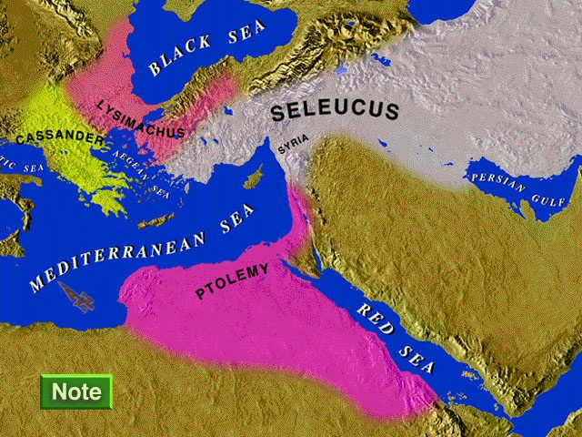

Slide 27
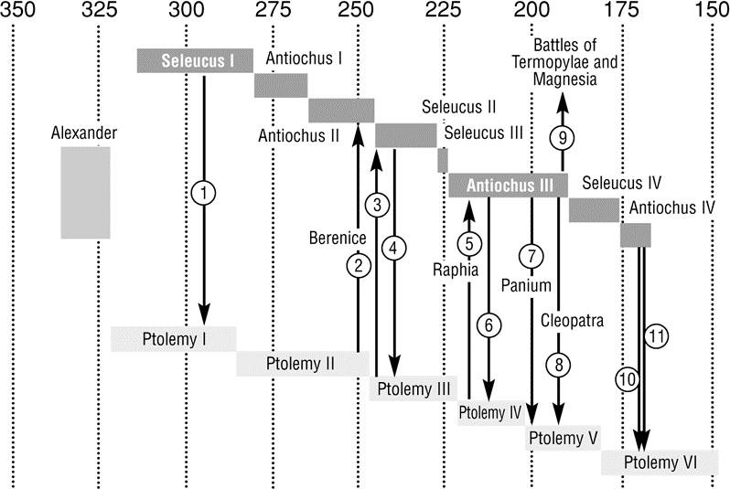

Slide 28
5 “Then the king of the South will grow strong, along with one of his princes who will gain ascendancy over him and obtain dominion; his domain will be a great dominion indeed. 6 “After some years they will form an alliance, and the daughter of the king of the South will come to the king of the North to carry out a peaceful arrangement. But she will not retain her position of power, nor will he remain with his power, but she will be given up, along with those who brought her in and the one who sired her as well as he who supported her in those times. 7 “But one of the descendants of her line will arise in his place, and he will come against their army and enter the fortress of the king of the North, and he will deal with them and display great strength.
Daniel 11:5–20

Slide 29
8 “Also their gods with their metal images and their precious vessels of silver and gold he will take into captivity to Egypt, and he on his part will refrain from attacking the king of the North for some years. 9 “Then the latter will enter the realm of the king of the South, but will return to his own land. 10 “His sons will mobilize and assemble a multitude of great forces; and one of them will keep on coming and overflow and pass through, that he may again wage war up to his very fortress.
Daniel 11:5–20

Slide 30
11 “The king of the South will be enraged and go forth and fight with the king of the North. Then the latter will raise a great multitude, but that multitude will be given into the hand of the former. 12 “When the multitude is carried away, his heart will be lifted up, and he will cause tens of thousands to fall; yet he will not prevail. 13 “For the king of the North will again raise a greater multitude than the former, and after an interval of some years he will press on with a great army and much equipment.
Daniel 11:5–20

Slide 31
14 “Now in those times many will rise up against the king of the South; the violent ones among your people will also lift themselves up in order to fulfill the vision, but they will fall down. 15 “Then the king of the North will come, cast up a siege ramp and capture a well-fortified city; and the forces of the South will not stand their ground, not even their choicest troops, for there will be no strength to make a stand. 16 “But he who comes against him will do as he pleases, and no one will be able to withstand him; he will also stay for a time in the Beautiful Land, with destruction in his hand.
Daniel 11:5–20

Slide 32
17 “He will set his face to come with the power of his whole kingdom, bringing with him a proposal of peace which he will put into effect; he will also give him the daughter of women to ruin it. But she will not take a stand for him or be on his side. 18 “Then he will turn his face to the coastlands and capture many. But a commander will put a stop to his scorn against him; moreover, he will repay him for his scorn. 19 “So he will turn his face toward the fortresses of his own land, but he will stumble and fall and be found no more. 20 “Then in his place one will arise who will send an oppressor through the Jewel of his kingdom; yet within a few days he will be shattered, though not in anger nor in battle.
Daniel 11:5–20

Slide 33
16 “But he who comes against him will do as he pleases, and no one will be able to withstand him; he will also stay for a time in the Beautiful Land, with destruction in his hand.
Daniel 11:16
NASB95

Slide 34
3. Phase Two - Antiochus IV Epiphanies. (21-35)

Slide 35
21 “In his place a despicable person will arise, on whom the honor of kingship has not been conferred, but he will come in a time of tranquility and seize the kingdom by intrigue. 22 “The overflowing forces will be flooded away before him and shattered, and also the prince of the covenant. 23 “After an alliance is made with him he will practice deception, and he will go up and gain power with a small force of people.
Daniel 11:21–35

Slide 36
24 “In a time of tranquility he will enter the richest parts of the realm, and he will accomplish what his fathers never did, nor his ancestors; he will distribute plunder, booty and possessions among them, and he will devise his schemes against strongholds, but only for a time. 25 “He will stir up his strength and courage against the king of the South with a large army; so the king of the South will mobilize an extremely large and mighty army for war; but he will not stand, for schemes will be devised against him. 26 “Those who eat his choice food will destroy him, and his army will overflow, but many will fall down slain.
Daniel 11:21–35

Slide 37
27 “As for both kings, their hearts will be intent on evil, and they will speak lies to each other at the same table; but it will not succeed, for the end is still to come at the appointed time. 28 “Then he will return to his land with much plunder; but his heart will be set against the holy covenant, and he will take action and then return to his own land. 29 “At the appointed time he will return and come into the South, but this last time it will not turn out the way it did before.
Daniel 11:21–35

Slide 38
30 “For ships of Kittim will come against him; therefore he will be disheartened and will return and become enraged at the holy covenant and take action; so he will come back and show regard for those who forsake the holy covenant. 31 “Forces from him will arise, desecrate the sanctuary fortress, and do away with the regular sacrifice. And they will set up the abomination of desolation. 32 “By smooth words he will turn to godlessness those who act wickedly toward the covenant, but the people who know their God will display strength and take action.
Daniel 11:21–35

Slide 39
33 “Those who have insight among the people will give understanding to the many; yet they will fall by sword and by flame, by captivity and by plunder for many days. 34 “Now when they fall they will be granted a little help, and many will join with them in hypocrisy. 35 “Some of those who have insight will fall, in order to refine, purge and make them pure until the end time; because it is still to come at the appointed time.
Daniel 11:21–35

Slide 40
32 “By smooth words he will turn to godlessness those who act wickedly toward the covenant, but the people who know their God will display strength and take action. 33 “Those who have insight among the people will give understanding to the many; yet they will fall by sword and by flame, by captivity and by plunder for many days.
Daniel 11:32–33

Slide 41
35 “Some of those who have insight will fall, in order to refine, purge and make them pure until the end time; because it is still to come at the appointed time.
Daniel 11:35
NASB95

Slide 42
4. Phase Three - One Greater than (36-12:4)

Slide 43
36 “Then the king will do as he pleases, and he will exalt and magnify himself above every god and will speak monstrous things against the God of gods; and he will prosper until the indignation is finished, for that which is decreed will be done. 37 “He will show no regard for the gods of his fathers or for the desire of women, nor will he show regard for any other god; for he will magnify himself above them all. 38 “But instead he will honor a god of fortresses, a god whom his fathers did not know; he will honor him with gold, silver, costly stones and treasures.
Daniel 11:36–12:4

Slide 44
39 “He will take action against the strongest of fortresses with the help of a foreign god; he will give great honor to those who acknowledge him and will cause them to rule over the many, and will parcel out land for a price. 40 “At the end time the king of the South will collide with him, and the king of the North will storm against him with chariots, with horsemen and with many ships; and he will enter countries, overflow them and pass through. 41 “He will also enter the Beautiful Land, and many countries will fall; but these will be rescued out of his hand: Edom, Moab and the foremost of the sons of Ammon.
Daniel 11:36–12:4

Slide 45
42 “Then he will stretch out his hand against other countries, and the land of Egypt will not escape. 43 “But he will gain control over the hidden treasures of gold and silver and over all the precious things of Egypt; and Libyans and Ethiopians will follow at his heels. 44 “But rumors from the East and from the North will disturb him, and he will go forth with great wrath to destroy and annihilate many.
Daniel 11:36–12:4

Slide 46
45 “He will pitch the tents of his royal pavilion between the seas and the beautiful Holy Mountain; yet he will come to his end, and no one will help him. 1 “Now at that time Michael, the great prince who stands guard over the sons of your people, will arise. And there will be a time of distress such as never occurred since there was a nation until that time; and at that time your people, everyone who is found written in the book, will be rescued. 2 “Many of those who sleep in the dust of the ground will awake, these to everlasting life, but the others to disgrace and everlasting contempt.
Daniel 11:36–12:4

Slide 47
3 “Those who have insight will shine brightly like the brightness of the expanse of heaven, and those who lead the many to righteousness, like the stars forever and ever. 4 “But as for you, Daniel, conceal these words and seal up the book until the end of time; many will go back and forth, and knowledge will increase.”
Daniel 11:36–12:4

Slide 48
1 “Now at that time Michael, the great prince who stands guard over the sons of your people, will arise. And there will be a time of distress such as never occurred since there was a nation until that time; and at that time your people, everyone who is found written in the book, will be rescued.
Daniel 12:1
NASB95

Slide 49
15 “Therefore when you see the abomination of desolation which was spoken of through Daniel the prophet, standing in the holy place (let the reader understand), 16 then those who are in Judea must flee to the mountains. 17 “Whoever is on the housetop must not go down to get the things out that are in his house. 18 “Whoever is in the field must not turn back to get his cloak. 19 “But woe to those who are pregnant and to those who are nursing babies in those days! 20 “But pray that your flight will not be in the winter, or on a Sabbath.
Matthew 24:15–20

Slide 50
20 “But when you see Jerusalem surrounded by armies, then recognize that her desolation is near. 21 “Then those who are in Judea must flee to the mountains, and those who are in the midst of the city must leave, and those who are in the country must not enter the city; 22 because these are days of vengeance, so that all things which are written will be fulfilled. 23 “Woe to those who are pregnant and to those who are nursing babies in those days; for there will be great distress upon the land and wrath to this people; 24 and they will fall by the edge of the sword, and will be led captive into all the nations; and Jerusalem will be trampled under foot by the Gentiles until the times of the Gentiles are fulfilled.
Luke 21:20–24

Slide 51
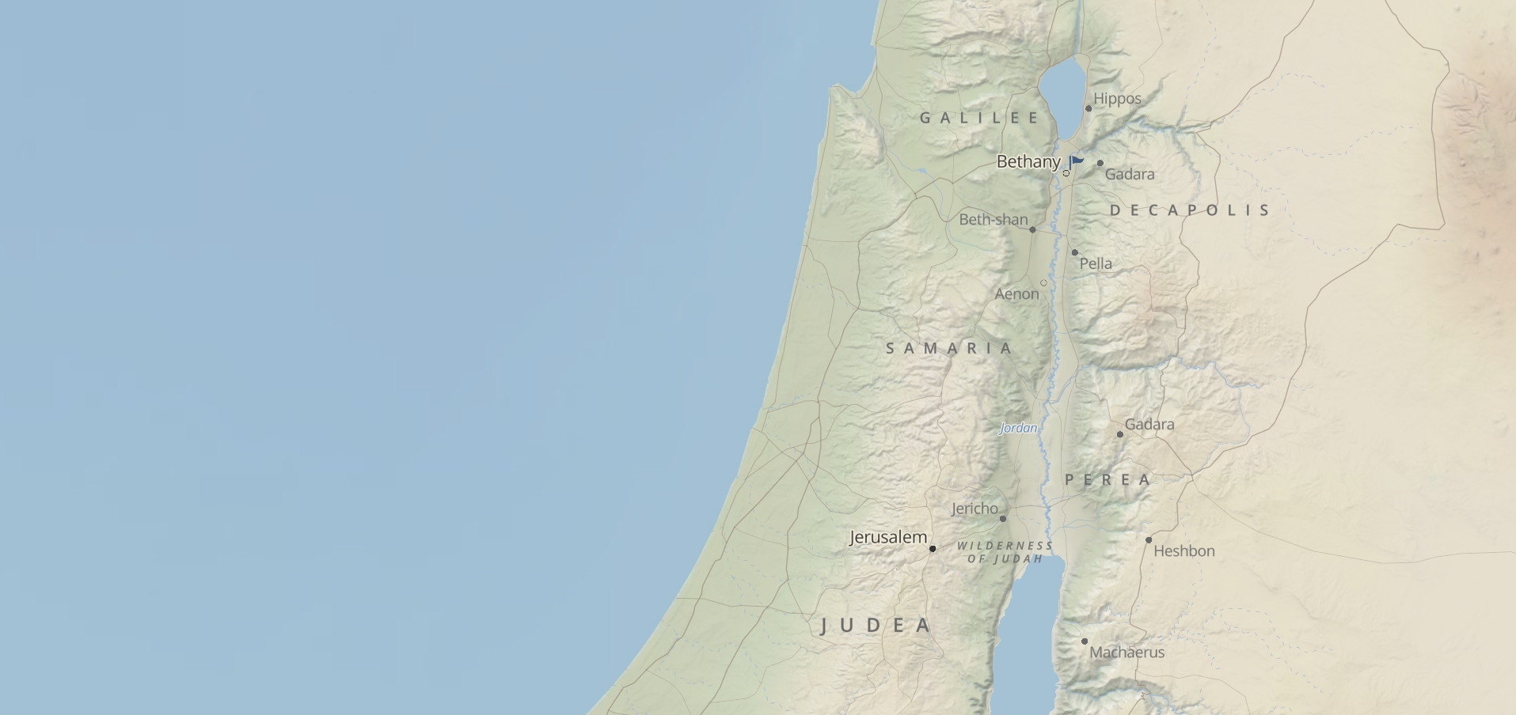

Slide 52
14 For He Himself is our peace, who made both groups into one and broke down the barrier of the dividing wall, 15 by abolishing in His flesh the enmity, which is the Law of commandments contained in ordinances, so that in Himself He might make the two into one new man, thus establishing peace, 16 and might reconcile them both in one body to God through the cross, by it having put to death the enmity.
Ephesians 2:14–16
NASB95

Slide 53
1 “Now at that time Michael, the great prince who stands guard over the sons of your people, will arise. And there will be a time of distress such as never occurred since there was a nation until that time; and at that time your people, everyone who is found written in the book, will be rescued. 2 “Many of those who sleep in the dust of the ground will awake, these to everlasting life, but the others to disgrace and everlasting contempt.
Daniel 12:1–2
NASB95

Slide 54
3 “Those who have insight will shine brightly like the brightness of the expanse of heaven, and those who lead the many to righteousness, like the stars forever and ever.
Daniel 12:3
NASB95

Slide 55
4 “But as for you, Daniel, conceal these words and seal up the book until the end of time; many will go back and forth, and knowledge will increase.”
Daniel 12:4
NASB95

Slide 56
1 After these things I looked, and behold, a door standing open in heaven, and the first voice which I had heard, like the sound of a trumpet speaking with me, said, “Come up here, and I will show you what must take place after these things.” 2 Immediately I was in the Spirit; and behold, a throne was standing in heaven, and One sitting on the throne. 3 And He who was sitting was like a jasper stone and a sardius in appearance; and there was a rainbow around the throne, like an emerald in appearance.
Revelation 4:1–10

Slide 57
4 Around the throne were twenty-four thrones; and upon the thrones I saw twenty-four elders sitting, clothed in white garments, and golden crowns on their heads. 5 Out from the throne come flashes of lightning and sounds and peals of thunder. And there were seven lamps of fire burning before the throne, which are the seven Spirits of God; 6 and before the throne there was something like a sea of glass, like crystal; and in the center and around the throne, four living creatures full of eyes in front and behind.
Revelation 4:1–10

Slide 58
7 The first creature was like a lion, and the second creature like a calf, and the third creature had a face like that of a man, and the fourth creature was like a flying eagle. 8 And the four living creatures, each one of them having six wings, are full of eyes around and within; and day and night they do not cease to say, “Holy, holy, holy is the Lord God, the Almighty, who was and who is and who is to come.” 9 And when the living creatures give glory and honor and thanks to Him who sits on the throne, to Him who lives forever and ever, 10 the twenty-four elders will fall down before Him who sits on the throne, and will worship Him who lives forever and ever, and will cast their crowns before the throne, saying,
Revelation 4:1–10

