Slide 1
Lesson 6 Daniel 5

Slide 2
Introduction:

Slide 3
“The secret things belong to the Lord our God, but the things revealed belong to us and to our sons forever, that we may observe all the words of this law.
Deuteronomy 29:29
NASB95

Slide 4
1. God frightens his enemies (1-9)

Slide 5
Nabopolassar (626 BC - 605 BC) (21 years) Nebuchadnezzar (605 BC - 562 BC) (43 years) Amel-Marduk (562 BC - 560 BC) (2 years) Neriglissar (560 BC - 556 BC) (4 years) Labashi-Marduk (556 BC) (1 year) Nabonidus (556 BC - 539 BC) (17 years) Belshazzar (552 BC - 539 BC) (13 years)

Slide 6
Until the last half of the nineteenth century the name Belshazzar was unattested except for the Book of Daniel and works dependent upon it, such as Baruch and Josephus’s writings.
Daniel by Stephen R. Miller

Slide 7
From other sources Nabonidus was known to have been the last king of Babylon, and some commentators declared Belshazzar to be a fictional character invented by the author of the book.
Daniel by Stephen R. Miller

Slide 8
Since that time abundant evidence has come to light that demonstrates not only that Belshazzar did live but that he was both the son of and coregent with Nabonidus.
Daniel by Stephen R. Miller

Slide 9
According to P.A. Beaulieu, thirty-seven archival texts dated from the first to the fourteenth year of Nabonidus now attest to Belshazzar’s historicity
Daniel by Stephen R. Miller

Slide 10
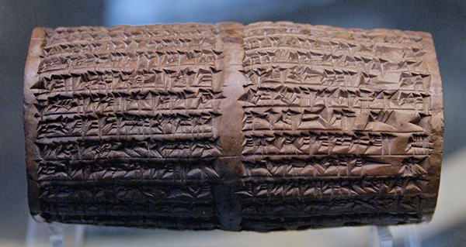

Slide 11
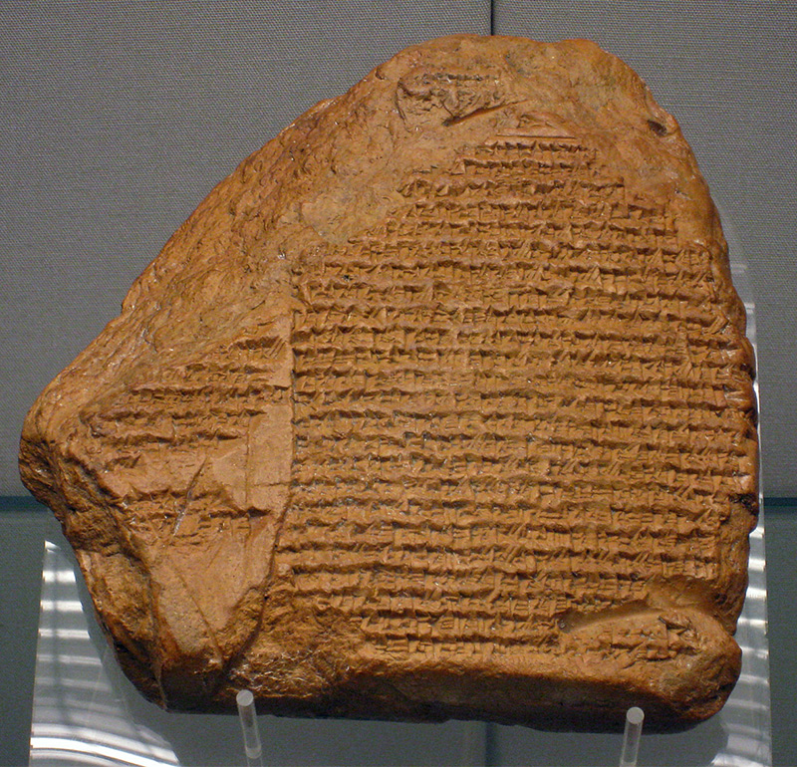

Slide 12
Why are the nations in an uproar And the peoples devising a vain thing? The kings of the earth take their stand And the rulers take counsel together Against the Lord and against His Anointed, saying, “Let us tear their fetters apart And cast away their cords from us!” He who sits in the heavens laughs, The Lord scoffs at them.
Psalm 2:1–4
NASB95

Slide 13
2. God warns his enemies (10-28)

Slide 14
PNDNCHLF

Slide 15
PND NCHLF

Slide 16
Pend
Pined
Pained
Pond
Pound
Panda

Slide 17
PNDNCHLF
Pound
Ounce
Half-Pound

Slide 18
And Jesus came up and spoke to them, saying, “All authority has been given to Me in heaven and on earth.
Matthew 28:18
NASB95

Slide 19
“All things have been handed over to Me by My Father; and no one knows the Son except the Father; nor does anyone know the Father except the Son, and anyone to whom the Son wills to reveal Him.
Matthew 11:27
NASB95

Slide 20
which He brought about in Christ, when He raised Him from the dead and seated Him at His right hand in the heavenly places,
Ephesians 1:20–22
NASB95

Slide 21
far above all rule and authority and power and dominion, and every name that is named, not only in this age but also in the one to come.
Ephesians 1:20–22
NASB95

Slide 22
And He put all things in subjection under His feet, and gave Him as head over all things to the church,
Ephesians 1:20–22
NASB95

Slide 23
For this reason also, God highly exalted Him, and bestowed on Him the name which is above every name, so that at the name of Jesus every knee will bow, of those who are in heaven and on earth and under the earth,
Philippians 2:9–10
NASB95

Slide 24
For by Him all things were created, both in the heavens and on earth, visible and invisible, whether thrones or dominions or rulers or authorities—all things have been created through Him and for Him.
Colossians 1:16
NASB95

Slide 25
and in Him you have been made complete, and He is the head over all rule and authority;
Colossians 2:10
NASB95

Slide 26
who is at the right hand of God, having gone into heaven, after angels and authorities and powers had been subjected to Him.
1 Peter 3:22
NASB95

Slide 27
3. God judges his enemies (29-31)

Slide 28
“Arise, go to Nineveh the great city and cry against it, for their wickedness has come up before Me.”
Jonah 1:2
NASB95

Slide 29
“Arise, go to Nineveh the great city and proclaim to it the proclamation which I am going to tell you.” So Jonah arose and went to Nineveh according to the word of the Lord.
Jonah 3:2–4
NASB95

Slide 30
Now Nineveh was an exceedingly great city, a three days’ walk. Then Jonah began to go through the city one day’s walk; and he cried out and said, “Yet forty days and Nineveh will be overthrown.”
Jonah 3:2–4
NASB95

