Slide 1
Lesson 11 Commandment 10

Slide 2
Backward things gets darkened heart our

Slide 3
Our darkened heart gets things backwards.

Slide 4
17 “You shall not covet your neighbor’s house; you shall not covet your neighbor’s wife, or his male servant, or his female servant, or his ox, or his donkey, or anything that is your neighbor’s.”
Exodus 20:17
ESV

Slide 5
19 “Do not lay up for yourselves treasures on earth, where moth and rust destroy and where thieves break in and steal,
Matthew 6:19–24
ESV

Slide 6
20 but lay up for yourselves treasures in heaven, where neither moth nor rust destroys and where thieves do not break in and steal.
Matthew 6:19–24
ESV

Slide 7
21 For where your treasure is, there your heart will be also.
Matthew 6:19–24
ESV

Slide 8
22 “The eye is the lamp of the body. So, if your eye is healthy, your whole body will be full of light,
Matthew 6:19–24
ESV

Slide 9
23 but if your eye is bad, your whole body will be full of darkness. If then the light in you is darkness, how great is the darkness!
Matthew 6:19–24
ESV

Slide 10
24 “No one can serve two masters, for either he will hate the one and love the other, or he will be devoted to the one and despise the other. You cannot serve God and money.
Matthew 6:19–24
ESV

Slide 11
17 “You shall not covet your neighbor’s house; you shall not covet your neighbor’s wife, or his male servant, or his female servant, or his ox, or his donkey, or anything that is your neighbor’s.”
Exodus 20:17
ESV

Slide 12
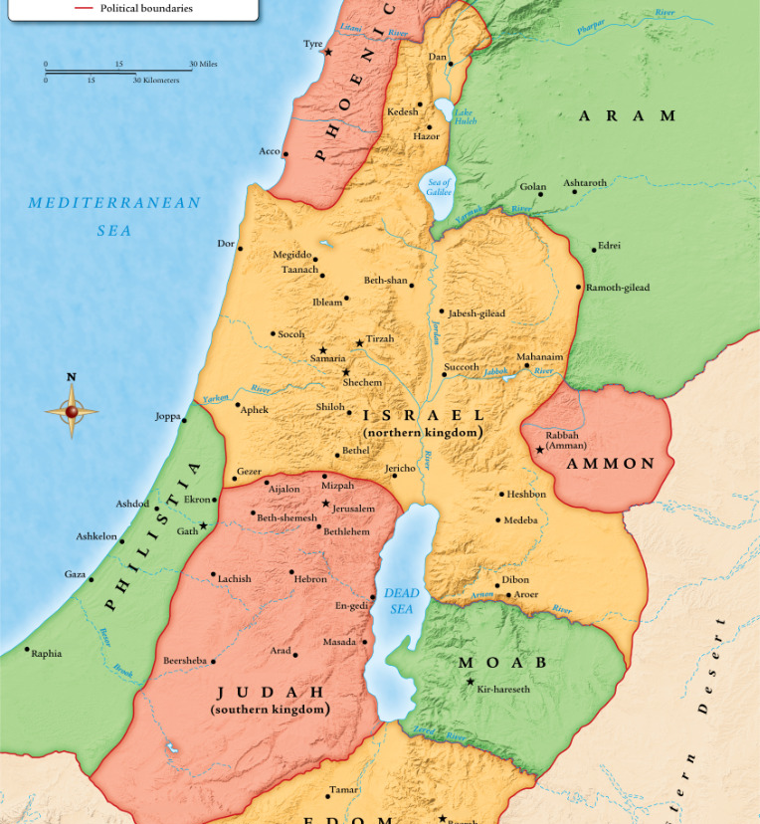

Slide 13
4 And Ahab went into his house vexed and sullen because of what Naboth the Jezreelite had said to him, for he had said, “I will not give you the inheritance of my fathers.” And he lay down on his bed and turned away his face and would eat no food.
1 Kings 21:4
ESV

Slide 14
14 But each person is tempted when he is lured and enticed by his own desire.
James 1:14–15
ESV

Slide 15
15 Then desire when it has conceived gives birth to sin, and sin when it is fully grown brings forth death.
James 1:14–15
ESV

Slide 16
8 I am the Lord; that is my name; my glory I give to no other, nor my praise to carved idols.
Isaiah 42:8
ESV

Slide 17
2 Look out for the dogs, look out for the evildoers, look out for those who mutilate the flesh.
Philippians 3:2–8
ESV

Slide 18
3 For we are the circumcision, who worship by the Spirit of God and glory in Christ Jesus and put no confidence in the flesh—
Philippians 3:2–8
ESV

Slide 19
4 though I myself have reason for confidence in the flesh also. If anyone else thinks he has reason for confidence in the flesh, I have more:
Philippians 3:2–8
ESV

Slide 20
5 circumcised on the eighth day, of the people of Israel, of the tribe of Benjamin, a Hebrew of Hebrews; as to the law, a Pharisee;
Philippians 3:2–8
ESV

Slide 21
6 as to zeal, a persecutor of the church; as to righteousness under the law, blameless.
Philippians 3:2–8
ESV

Slide 22
7 But whatever gain I had, I counted as loss for the sake of Christ.
Philippians 3:2–8
ESV

Slide 23
8 Indeed, I count everything as loss because of the surpassing worth of knowing Christ Jesus my Lord. For his sake I have suffered the loss of all things and count them as rubbish, in order that I may gain Christ
Philippians 3:2–8
ESV

Slide 24
5 Keep your life free from love of money, and be content with what you have, for he has said, “I will never leave you nor forsake you.”
Hebrews 13:5
ESV

