Slide 1

Lesson 11 Daniel 8
Daniel 8

Slide 2

Then Job answered the Lord and said, “Behold, I am insignificant; what can I reply to You? I lay my hand on my mouth. “Once I have spoken, and I will not answer; Even twice, and I will add nothing more.”
Job 40:3–5
NASB95

Slide 4
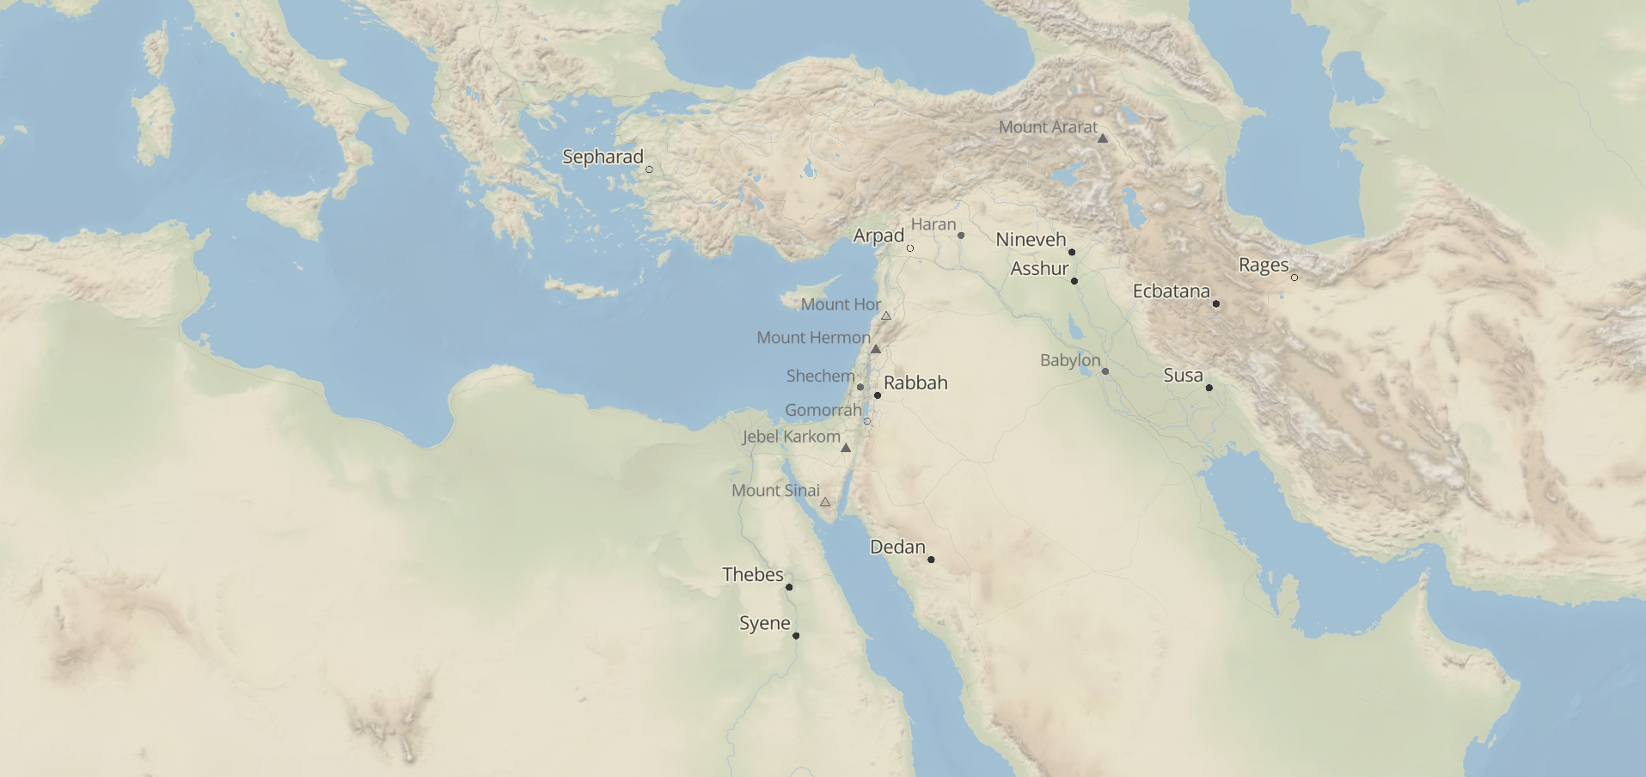

Slide 5
I looked in the vision, and while I was looking I was in the citadel of Susa, which is in the province of Elam; and I looked in the vision and I myself was beside the Ulai Canal.
Daniel 8:2

Slide 6
in those days as King Ahasuerus sat on his royal throne which was at the citadel in Susa,
Esther 1:2

Slide 7
The words of Nehemiah the son of Hacaliah. Now it happened in the month Chislev, in the twentieth year, while I was in Susa the capitol,
Nehemiah 1:1

Slide 9
Then I lifted my eyes and looked, and behold, a ram which had two horns was standing in front of the canal. Now the two horns were long, but one was longer than the other, with the longer one coming up last. I saw the ram butting westward, northward, and southward, and no other beasts could stand before him nor was there anyone to rescue from his power, but he did as he pleased and magnified himself.
Daniel 8:3–4

Slide 10
While I was observing, behold, a male goat was coming from the west over the surface of the whole earth without touching the ground; and the goat had a conspicuous horn between his eyes. He came up to the ram that had the two horns, which I had seen standing in front of the canal, and rushed at him in his mighty wrath. I saw him come beside the ram, and he was enraged at him; and he struck the ram and shattered his two horns, and the ram had no strength to withstand him.
Daniel 8:5–12

Slide 11
So he hurled him to the ground and trampled on him, and there was none to rescue the ram from his power. Then the male goat magnified himself exceedingly. But as soon as he was mighty, the large horn was broken; and in its place there came up four conspicuous horns toward the four winds of heaven.
Daniel 8:5–12

Slide 12
Out of one of them came forth a rather small horn which grew exceedingly great toward the south, toward the east, and toward the Beautiful Land. It grew up to the host of heaven and caused some of the host and some of the stars to fall to the earth, and it trampled them down.
Daniel 8:5–12

Slide 13
It even magnified itself to be equal with the Commander of the host; and it removed the regular sacrifice from Him, and the place of His sanctuary was thrown down. And on account of transgression the host will be given over to the horn along with the regular sacrifice; and it will fling truth to the ground and perform its will and prosper.
Daniel 8:5–12

Slide 14
Then I heard a holy one speaking, and another holy one said to that particular one who was speaking, “How long will the vision about the regular sacrifice apply, while the transgression causes horror, so as to allow both the holy place and the host to be trampled?” He said to me, “For 2,300 evenings and mornings; then the holy place will be properly restored.”
Daniel 8:13–14

Slide 16
“The ram which you saw with the two horns represents the kings of Media and Persia.
Daniel 8:20

Slide 17
“The shaggy goat represents the kingdom of Greece, and the large horn that is between his eyes is the first king. “The broken horn and the four horns that arose in its place represent four kingdoms which will arise from his nation, although not with his power.
Daniel 8:21–25

Slide 18
“In the latter period of their rule, When the transgressors have run their course, A king will arise, Insolent and skilled in intrigue. “His power will be mighty, but not by his own power, And he will destroy to an extraordinary degree And prosper and perform his will; He will destroy mighty men and the holy people.
Daniel 8:21–25

Slide 19
“And through his shrewdness He will cause deceit to succeed by his influence; And he will magnify himself in his heart, And he will destroy many while they are at ease. He will even oppose the Prince of princes, But he will be broken without human agency.
Daniel 8:21–25

Slide 20
“The shaggy goat represents the kingdom of Greece, and the large horn that is between his eyes is the first king.
Daniel 8:21

Slide 21
“The broken horn and the four horns that arose in its place represent four kingdoms which will arise from his nation, although not with his power.
Daniel 8:22

Slide 22
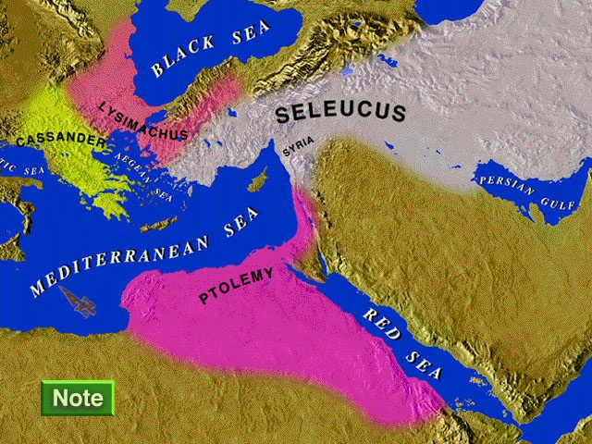

Slide 23
“In the latter period of their rule, When the transgressors have run their course, A king will arise, Insolent and skilled in intrigue.
Daniel 8:23

Slide 24
And on account of transgression the host will be given over to the horn along with the regular sacrifice; and it will fling truth to the ground and perform its will and prosper.
Daniel 8:12

Slide 25
It grew up to the host of heaven and caused some of the host and some of the stars to fall to the earth, and it trampled them down.
Daniel 8:10

Slide 26
It even magnified itself to be equal with the Commander of the host; and it removed the regular sacrifice from Him, and the place of His sanctuary was thrown down.
Daniel 8:11

Slide 27
Then I heard a holy one speaking, and another holy one said to that particular one who was speaking, “How long will the vision about the regular sacrifice apply, while the transgression causes horror, so as to allow both the holy place and the host to be trampled?”
Daniel 8:13

Slide 28
“His power will be mighty, but not by his own power, And he will destroy to an extraordinary degree And prosper and perform his will; He will destroy mighty men and the holy people.
Daniel 8:24

Slide 29
10 From them came forth a sinful root, Antiochus Epiphanes, son of King Antiochus; he had been a hostage in Rome. He began to reign in the one hundred thirty-seventh year of the kingdom of the Greeks.11 In those days certain renegades came out from Israel and misled many, saying, “Let us go and make a covenant with the Gentiles around us, for since we separated from them many disasters have come upon us.”
(Nashville: Thomas Nelson Publishers, 1989), 1 Mac 1:10-15.

Slide 30
12 This proposal pleased them, 13 and some of the people eagerly went to the king, who authorized them to observe the ordinances of the Gentiles. 14 So they built a gymnasium in Jerusalem, according to Gentile custom, 15 and removed the marks of circumcision, and abandoned the holy covenant. They joined with the Gentiles and sold themselves to do evil.
  (Nashville: Thomas Nelson Publishers, 1989), 1 Mac 1:1015.

Slide 31
41 Then the king wrote to his whole kingdom that all should be one people, 42 and that all should give up their particular customs. 43 All the Gentiles accepted the command of the king. Many even from Israel gladly adopted his religion; they sacrificed to idols and profaned the sabbath.
  (Nashville: Thomas Nelson Publishers, 1989), 1 Mac 1:4143.

Slide 32
“In the latter period of their rule, When the transgressors have run their course, A king will arise, Insolent and skilled in intrigue. “His power will be mighty, but not by his own power, And he will destroy to an extraordinary degree And prosper and perform his will;
Daniel 8:23–25

Slide 33
He will destroy mighty men and the holy people. “And through his shrewdness He will cause deceit to succeed by his influence; And he will magnify himself in his heart, And he will destroy many while they are at ease. He will even oppose the Prince of princes, But he will be broken without human agency.
Daniel 8:23–25

Slide 34
20 After subduing Egypt, Antiochus returned in the one hundred forty-third year. He went up against Israel and came to Jerusalem with a strong force. 21 He arrogantly entered the sanctuary and took the golden altar, the lampstand for the light, and all its utensils. 22 He took also the table for the bread of the Presence, the cups for drink offerings, the bowls, the golden censers, the curtain, the crowns, and the gold decoration on the front of the temple; he stripped it all off. 23 He took the silver and the gold, and the costly vessels; he took also the hidden treasures that he found. 24 Taking them all, he went into his own land. He shed much blood, and spoke with great arrogance.
(Nashville: Thomas Nelson Publishers, 1989), 1 Mac 1:20-40.

Slide 35
25 Israel mourned deeply in every community, 26 rulers and elders groaned, young women and young men became faint, the beauty of the women faded. 27 Every bridegroom took up the lament; she who sat in the bridal chamber was mourning. 28 Even the land trembled for its inhabitants, and all the house of Jacob was clothed with shame.
(Nashville: Thomas Nelson Publishers, 1989), 1 Mac 1:20-40.

Slide 36
29 Two years later the king sent to the cities of Judah a chief collector of tribute, and he came to Jerusalem with a large force. 30 Deceitfully he spoke peaceable words to them, and they believed him; but he suddenly fell upon the city, dealt it a severe blow, and destroyed many people of Israel. 31 He plundered the city, burned it with fire, and tore down its houses and its surrounding walls. 32 They took captive the women and children, and seized the livestock.
(Nashville: Thomas Nelson Publishers, 1989), 1 Mac 1:20-40.

Slide 37
33 Then they fortified the city of David with a great strong wall and strong towers, and it became their citadel. 34 They stationed there a sinful people, men who were renegades. These strengthened their position; 35 they stored up arms and food, and collecting the spoils of Jerusalem they stored them there, and became a great menace, 36 for the citadel became an ambush against the sanctuary, an evil adversary of Israel at all times.
(Nashville: Thomas Nelson Publishers, 1989), 1 Mac 1:20-40.

Slide 38
37 On every side of the sanctuary they shed innocent blood; they even defiled the sanctuary. 38 Because of them the residents of Jerusalem fled; she became a dwelling of strangers; she became strange to her offspring, and her children forsook her. 39 Her sanctuary became desolate like a desert; her feasts were turned into mourning, her sabbaths into a reproach, her honor into contempt. 40 Her dishonor now grew as great as her glory; her exaltation was turned into mourning.
(Nashville: Thomas Nelson Publishers, 1989), 1 Mac 1:20-40.

Slide 39
Then I heard a holy one speaking, and another holy one said to that particular one who was speaking, “How long will the vision about the regular sacrifice apply, while the transgression causes horror, so as to allow both the holy place and the host to be trampled?” He said to me, “For 2,300 evenings and mornings; then the holy place will be properly restored.”
Daniel 8:13–14

Slide 40
“The vision of the evenings and mornings Which has been told is true; But keep the vision secret, For it pertains to many days in the future.”
Daniel 8:26

Slide 42
In the first year of Darius the son of Ahasuerus, of Median descent, who was made king over the kingdom of the Chaldeans— in the first year of his reign, I, Daniel, observed in the books the number of the years which was revealed as the word of the Lord to Jeremiah the prophet for the completion of the desolations of Jerusalem, namely, seventy years.
Daniel 9:1–2

