Slide 1


Growing in Wisdom
Seeing how God sees…

Slide 2
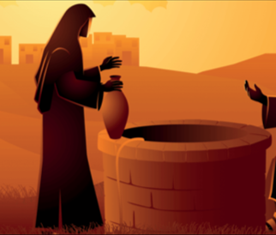

Slide 3
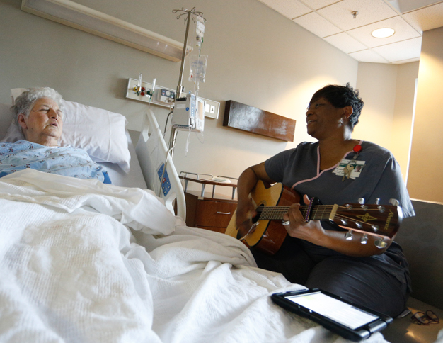


Don’t be selfish; don’t try to impress others. Be humble, thinking of others as better than yourselves. Don’t look out only for your own interests, but take an interest in others, too.

Slide 4


