Slide 1
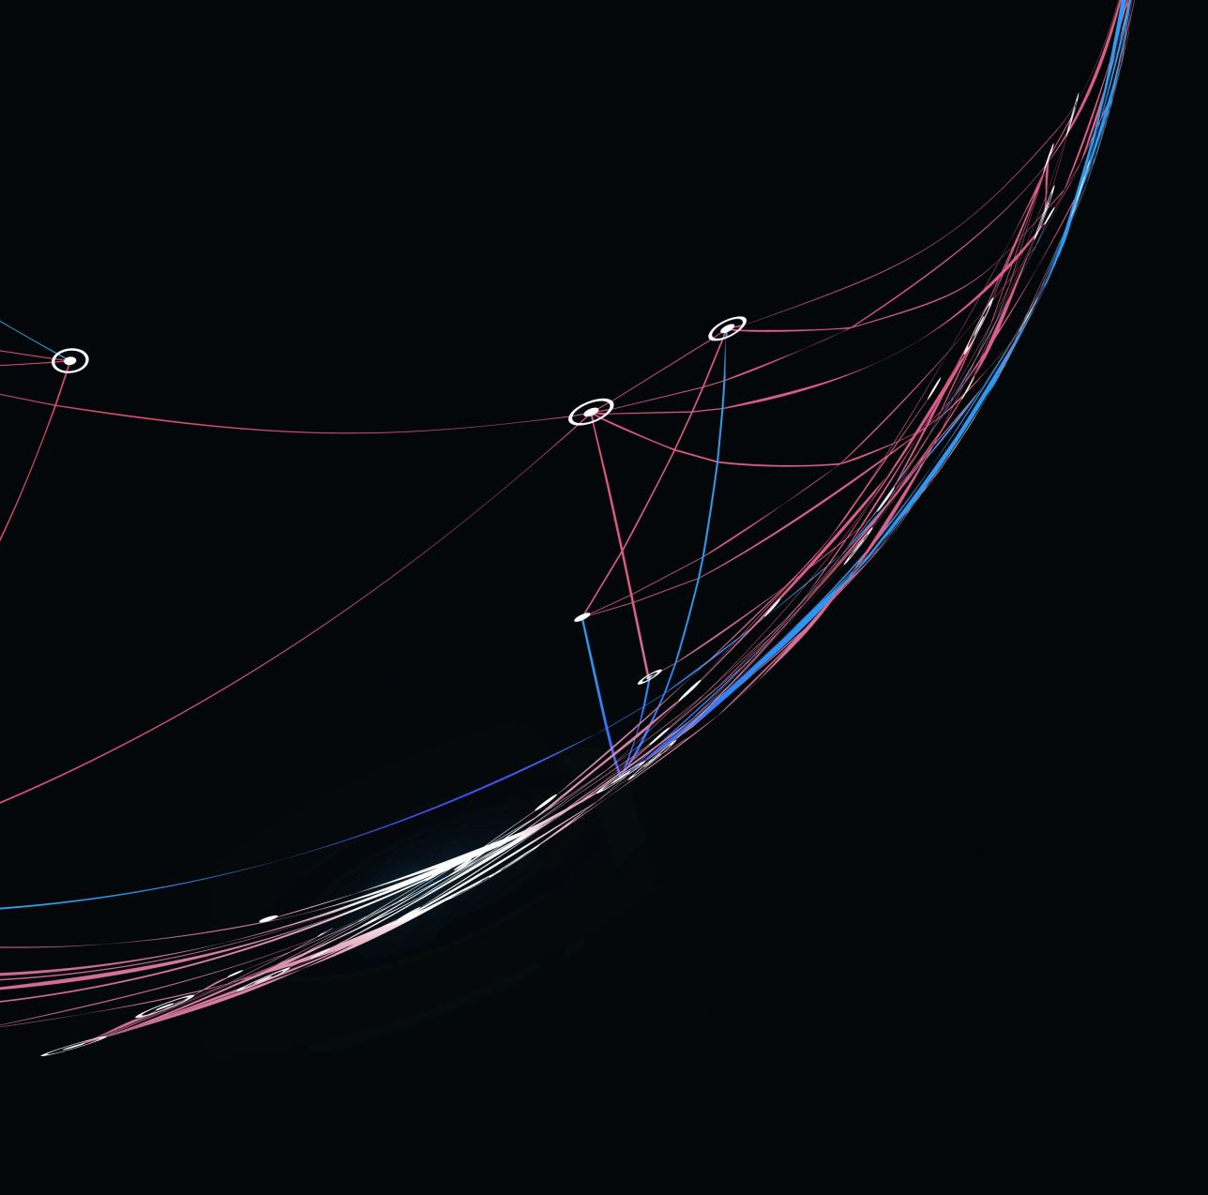
Nehemiah 8 - Redirect

Slide 2

Where are we at?
It took 52 days to rebuild the wall
The defences have been laid out
The people have been counted
So what comes next?

Slide 3
“Man shall not live on bread alone, but on every word that comes from the mouth of God.”
Matthew 4:4

Slide 4

Open & Read

Slide 5
Ezra the teacher of the Law stood on a high wooden platform built for the occasion. Beside him on his right stood Mattithiah, Shema, Anaiah, Uriah, Hilkiah and Maaseiah; and on his left were Pedaiah, Mishael, Malkijah, Hashum, Hashbaddanah, Zechariah and Meshullam. Ezra opened the book. All the people could see him because he was standing above them; and as he opened it, the people all stood up. Ezra praised the Lord, the great God; and all the people lifted their hands and responded, “Amen! Amen!” Then they bowed down and worshiped the Lord with their faces to the ground.
v. 4-6

Slide 6
Ezra the teacher of the Law stood on a high wooden platform built for the occasion. Beside him on his right stood Mattithiah, Shema, Anaiah, Uriah, Hilkiah and Maaseiah; and on his left were Pedaiah, Mishael, Malkijah, Hashum, Hashbaddanah, Zechariah and Meshullam. Ezra opened the book. All the people could see him because he was standing above them; and as he opened it, the people all stood up. Ezra praised the Lord, the great God; and all the people lifted their hands and responded, “Amen! Amen!” Then they bowed down and worshiped the Lord with their faces to the ground.
v. 4-6

Slide 7
Ezra the teacher of the Law stood on a high wooden platform built for the occasion. Beside him on his right stood Mattithiah, Shema, Anaiah, Uriah, Hilkiah and Maaseiah; and on his left were Pedaiah, Mishael, Malkijah, Hashum, Hashbaddanah, Zechariah and Meshullam. Ezra opened the book. All the people could see him because he was standing above them; and as he opened it, the people all stood up. Ezra praised the Lord, the great God; and all the people lifted their hands and responded, “Amen! Amen!” Then they bowed down and worshiped the Lord with their faces to the ground.
v. 4-6

Slide 8
Ezra the teacher of the Law stood on a high wooden platform built for the occasion. Beside him on his right stood Mattithiah, Shema, Anaiah, Uriah, Hilkiah and Maaseiah; and on his left were Pedaiah, Mishael, Malkijah, Hashum, Hashbaddanah, Zechariah and Meshullam. Ezra opened the book. All the people could see him because he was standing above them; and as he opened it, the people all stood up. Ezra praised the Lord, the great God; and all the people lifted their hands and responded, “Amen! Amen!” Then they bowed down and worshiped the Lord with their faces to the ground.
v. 4-6

Slide 9
Open & Read

Slide 10
All the people came together as one in the square before the Water Gate. They told Ezra the teacher of the Law to bring out the Book of the Law of Moses, which the Lord had commanded for Israel.
v. 1

Slide 11
Open & Read

Slide 12
Very early in the morning, while it was still dark, Jesus got up, left the house and went off to a solitary place, where he prayed.
Mark 1:35

Slide 13
Open & Read

Slide 14
So on the first day of the seventh month Ezra the priest brought the Law before the assembly, which was made up of men and women and all who were able to understand.
v. 2

Slide 15
Open & Read

Slide 16
Explain & Understand

Slide 17
The Levites—Jeshua, Bani, Sherebiah, Jamin, Akkub, Shabbethai, Hodiah, Maaseiah, Kelita, Azariah, Jozabad, Hanan and Pelaiah—instructed the people in the Law while the people were standing there. They read from the Book of the Law of God, making it clear and giving the meaning so that the people understood what was being read.
v. 7-8

Slide 18
The Levites—Jeshua, Bani, Sherebiah, Jamin, Akkub, Shabbethai, Hodiah, Maaseiah, Kelita, Azariah, Jozabad, Hanan and Pelaiah—instructed the people in the Law while the people were standing there. They read from the Book of the Law of God, making it clear and giving the meaning so that the people understood what was being read.
v. 7-8

Slide 19
Explain & Understand

Slide 20
I keep asking that the God of our Lord Jesus Christ, glorious Father, may give you the spirit of wisdom and revelation, that you may know him better.
Ephesians 1:17

Slide 21
Explain & Understand

Slide 22
Respond & Act

Slide 23
They found written in the Law, which the Lord had commanded through Moses, that the Israelites were to live in temporary shelters during the festival of the seventh month…
v. 14

Slide 24
They found written in the Law, which the Lord had commanded through Moses, that the Israelites were to live in temporary shelters during the festival of the seventh month…
v. 14
So the people went out and brought back branches and built themselves temporary shelters…
v. 16

Slide 25
Respond & Act

Slide 26
All scripture is God breathed and is useful for teaching, rebuking, correcting, and training in righteousness, so that the servant of God may be thoroughly equipped for every good work.
2 Timothy 3:16-27

Slide 27
Respond & Act

Slide 28
Then all the people went away to eat and drink, to send portions of food and to celebrate with great joy, because they now understood the words that had been made known to them
v. 12

Slide 29
Then all the people went away to eat and drink, to send portions of food and to celebrate with great joy, because they now understood the words that had been made known to them
v. 12
The whole company that had returned from exile built temporary shelters and lived in them. From the days of Joshua son of Nun until that day, the Israelites had not celebrated it like this. And their joy was great…
v. 17

Slide 30
Respond & Act

Slide 31
Do not merely listen to the word, and so deceive yourselves. Do what it says. Anyone who listens to the word but does not do what it says is like someone who looks at his face in a mirror and, after looking at himself, goes away and immediately forgets what he looks like. But whoever looks intently into the perfect law that gives freedom, and continues in it—not forgetting what they have heard, but doing it—they will be blessed in what they do.
James 1:22-25

Slide 32
Open & Read
Explain & Understand
Act & Respond

Slide 33
What is the cornerstone of your life?

