Slide 1
RUTH
Unexpected daughter

Slide 2
Tamar
Maybe a Canaanite
Pretended to be a prostitute
Had anonymous sex with her father-in-law
Gave birth to twins – of whom Perez appears in the genealogy of Jesus

Slide 3
Rahab
Actually was a prostitute
A Canaanite
Father of Boaz who appears in the genealogy of Jesus

Slide 4
Bathsheba
Possibly a Hittite
Raped
Forced marriage with David
Mother of Solomon who appears in the genealogy of Jesus

Slide 5
RUTH
Sits between Rahab – her other mother-in-law
And
Bathsheba who marries her great grandson David

Slide 6
RUTH
A Moabite
Israelites forbidden to marry them due to the Moabites’ sexual immorality and worship of false gods

Slide 7
Ruth
A Hallmark Story

Slide 8
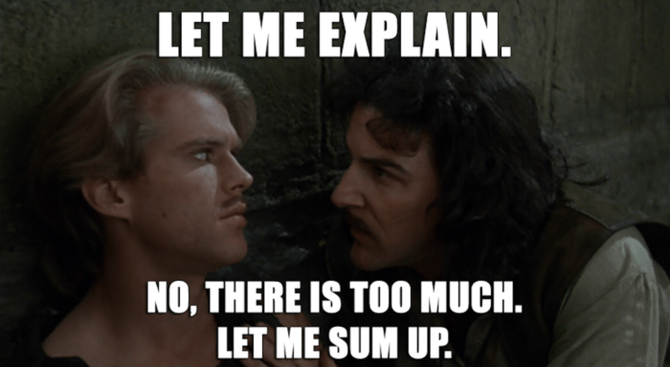

Slide 9
We see a picture of Christ the Redeemer

Slide 10
There is hope even in the most devastating times of our lives

Slide 11
We do not need to be prisoners of our circumstances and our current circumstances need not determine our future

Slide 12
Our character should be consistent in private and in public

Slide 13
Doing the right thing may require sacrifice

Slide 14
Living out our faith can lead others to faith

Slide 15
God uses ordinary people
God uses damaged people
God uses heartbroken people
God uses desperate people
God uses those on the margins

Slide 16
God asks us to be faithful
God asks us to be righteous
God asks us to be dutiful
God can work through the laws and customs of the land – a miracle isn’t always needed

