Slide 1
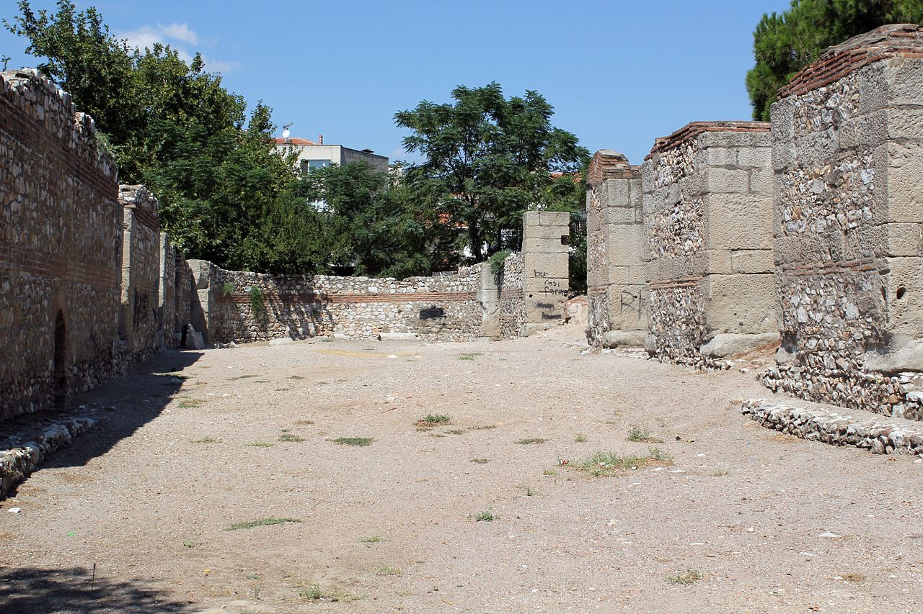
7 Dangers: Tolerance
Thyatira
Revelation 2:18-29

Slide 2
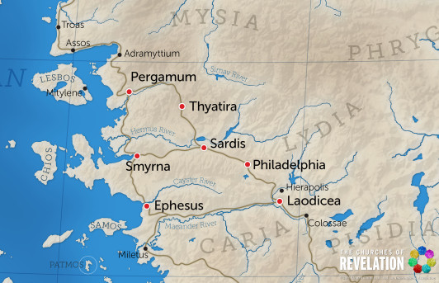
Context
Military city
Worship of Apollo
Trade guilds

Slide 3
Commendation
Love
Faith
Service
Perseverance
“I know your deeds…”
More than at first

Slide 4
Condemnation
False teaching
Dark secrets
Peer pressure
“I have this against you…”

Slide 5
Consequences
Judgement for Jezebel and her followers
Repentance brings forgiveness
Hope for those who hold to the truth
Faithfulness brings rewards

Slide 6
7 Dangers: Tolerance
Thyatira
Revelation 2:18-29

