Slide 1


Slide 2
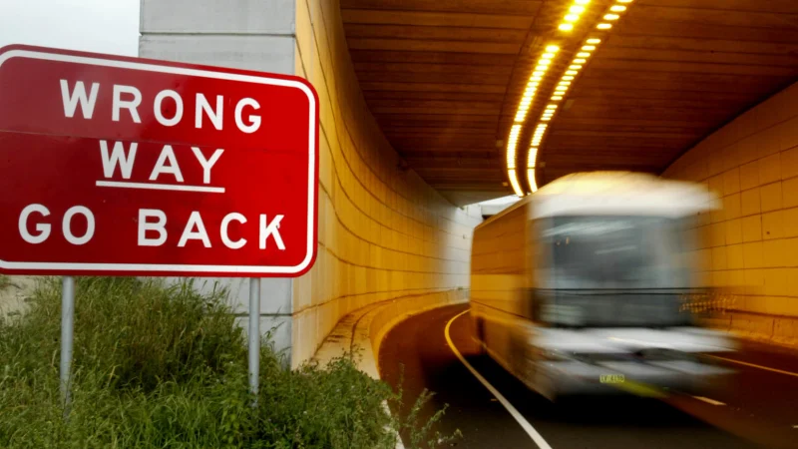

Slide 4
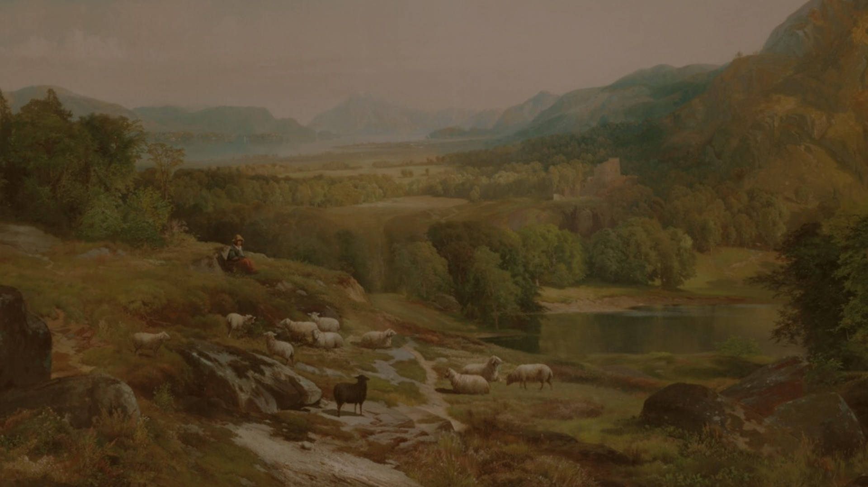
Exodus 33:18
¹⁸ Then Moses said, “Now show me your glory.”

Slide 5
Exodus 33:18
⁶ And he passed in front of Moses, proclaiming, “The LORD, the LORD, the compassionate and gracious God, slow to anger, abounding in love and faithfulness,

Slide 7

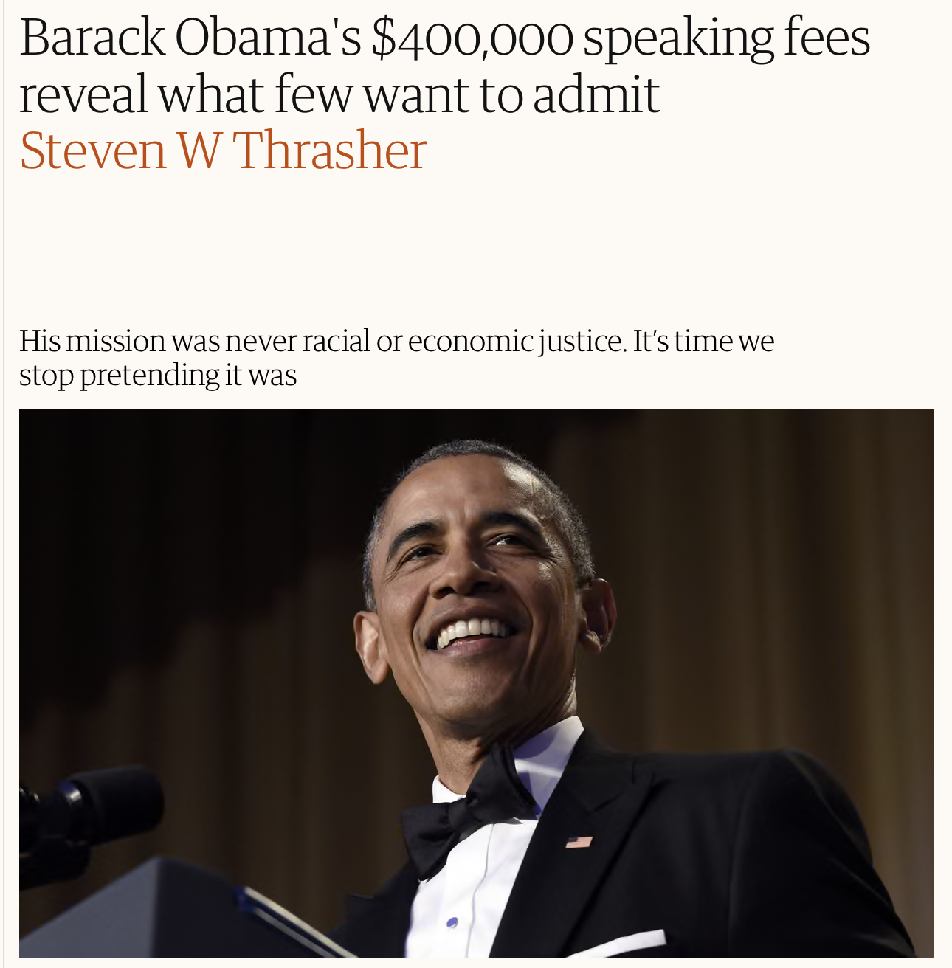


Slide 9
People tend to hold contrary opinions about Christ, but he reveals his disposition there to counter such misconceptions and attract them to him even more. We are prone to think that because he is so holy, he must have a severe and harsh disposition towards sinners and be unable to tolerate them. No, he says, "I am gentle." Gentleness is my nature and temperament…

Slide 10
… we may think that as the Son of God and the heir of heaven, especially now filled with glory and seated at God's right hand, he may look down upon our lowliness here below. Although not out of anger, he may consider us too insignificant for him …

Slide 11
… No, says Christ, "I am lowly" as well, willing to bestow my love and favour upon the poorest and humblest.
Thomas Goodwin

