Slide 1
Matthew 21
The Triumphal Entry
Prophecies fulfilled from Daniel 9 v 24 – 29, Zechariah 9 v 9, the feast of Passover in Exodus 12

Slide 2
Matthew 20 v 29 to 21 v 11
From here, Jesus begins to prepare for His entry into Jerusalem which begins at Bethphage.
These events took place in the last week of Jesus’ life alongside Passover preparations.
On the 10th of Nisan they would take a perfect male lamb into their home – it would usually be welcomed and treated very much as a pet and on the 14th of the same month it would be sacrificed.
Here, Jesus was entering the city on the 10th to lots of adulation but would be sacrificed on the 14th.
Bethphage has a very interesting history so that even this starting-point for Jesus’ ‘Triumphal Entry’, as it is often called (celebrated as ‘Palm Sunday’ in Anglican churches) has great significance.
Adjacent was the village of Bethany to which it is believed that Jesus sent His disciples to obtain the Donkey and her colt.
Bethany was also where Jesus had raised Lazarus a few days ago and was the home-village of Lazarus and Mary and Martha, Jesus’ friends. He had also feasted at the home of Simon the (ex)Leper here)
How did He know there were two animals there that He could use?
Well, when He wrote the prophecy in Zechariah 9 v 9, He already knew that these would be needed.
How did He know that the owner would be amenable to lending them?
When was this arrangement set up?
Well, in one sense, before the foundation of the world.
But what we have here is more evidence of the supernatural nature of God’s word, showing us that God knows the end from the beginning and is able to arrange and write about human history before the event.

Slide 3
Matthew 20 v 29 to 21 v 11
The name Bethphage means ‘house of unripe figs’. (Remember Jesus cursed a fig tree because it had no figs. Fig trees always symbolise Israel – this might well have been a metaphor saying that Israel was a house of unripe figs)
It was declared a part of Jerusalem, though it was outside the city wall – outside the camp, so to speak.
The Sanhedrin had this built as a village exclusively of priests; of legal authority and contained one of the two seats of the Sanhedrin (A religious governing authority over the Jews consisting of 71 members).
Here, final sentences were passed on those who were to be executed, decisions were made as to whom or what could enter the city, declaring them to be either holy or unholy.
It was named as the ‘House of Unripe Figs’ because Rabbis believed that the fruit that Adam and Eve ate in the garden was a fig.
They believe this because immediately after the fall, they made clothing of fig-leaves to cover their nakedness.
The truth is that there is no way we can ever know what this fruit was, but the name of this town came from this belief.
The implication was that they would not again put themselves in the way of temptation with ripe figs – they did not want to ‘fall’ again.
Jesus began His journey into Jerusalem from the very place that would finally sentence Him to death.
Also, it was outside the camp on the Mount of Olives where sin sacrifices had to be made, including the Red Heifer and where all executions took place.
They had no reason to stop His triumphal entry – He entered the city as someone who was considered Holy – He was a Rabbi, yet in the end they killed Him as an unholy blasphemer.
Many suggest that having arrived at Bethphage, the village from which the donkey and foal came was Bethany, which is adjacent. The name Bethany is of uncertain meaning.

Slide 4
Matthew 20 v 29 to 21 v 11
This was also the place from which the mode of transport came that would fulfil the prophecy in Zechariah 9 verse 9 and also fulfilled some other prophecies about the crucifixion.
So, let’s look at His entry into Jerusalem.
Was there purpose and significance over and above the fulfilling of ancient prophecy?
I believe there was.
He came as King and normally this would have been on a horse – usually a white horse – with some kind of entourage.
A royal entry would have been accompanied by lots of regal ceremony, trumpets etc. and the King would have had a Kingly appearance.
This was the kind of King the Jews wanted – a king that would overcome the Romans and lift their oppression: a military leader.
Jesus, however, came in humility, not even on a donkey, but on a donkey’s colt – the donkey was almost certainly the mother of the colt. (to ride an unbroken colt would normally have been a disaster – divine intervention?
His reputation for the miraculous had evidently preceded Him, hence believers worshipped Him because of His reputation and because they knew He was fulfilling what was prophesied in Zechariah 9 v 9.
We can also infer that He came looking for peace and not war – the Horse would have meant war. He came as the Prince of Peace.
From Luke’s account (Chapter 19 v 37) we know that it was believers who were praising him in the streets – those who had seen Him doing great signs, wonders and miracles.

Slide 5
Matthew 20 v 29 to 21 v 11
Let’s remind ourselves of what had preceded this event.
Jesus had fed thousands of people from almost nothing and had done it twice.
He had healed many sick and dying people
He had raised the dead more than once, and the most significant of these occasions, the raising of Lazarus, happened at Bethany from where the donkey had come (this fulfilled the prophecy in John 5 v 25 – Lazarus, when dead, heard the voice of God).
He had demonstrated that He could control the weather.
The Jews must have thought, “with Him as King, we are invincible – if we die in battle, He can bring us back to life: they can’t starve us out because He can simply produce food miraculously and He could even send storms upon them if He wished.
Their cries of Hoshana were not relief at their potential to be forgiven, but were requests for salvation from Roman oppression.
The Prophecy in Zechariah 9 v 9 is followed by a lot of victorious military references, so their confusion is understandable.
Some of what is prophesied refers to his first coming and some to his second.
Revelation 19 v 11 – 16 describes Him at His second coming.
But at this first coming, He comes in humility (meekness or lowliness).
He actually did nothing at all, but had a look around and went back to Bethany (Mark 11 v 11)

Slide 6
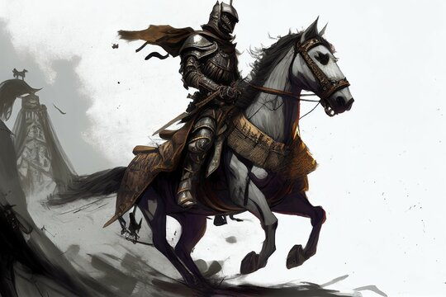

Slide 7
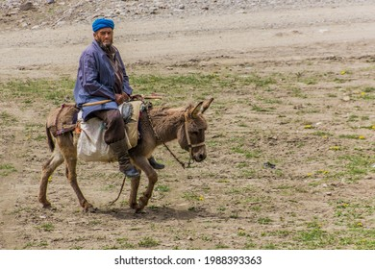

Slide 8
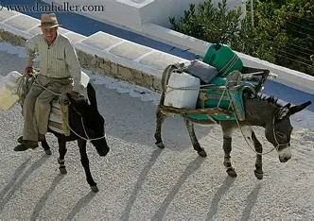

Slide 9
Matthew 20 v 29 to 21 v 11
While we are dealing with the fulfilment of prophecy, we cannot go past this passage without looking at a further fulfilment of prophecy which further demonstrates that the Bible was written from outside time.
God says, “I am God, and I tell you the end from the beginning” (Isaiah 46 v 9 & 10).
According to Daniel chapter 9 verse 24 and following, there is to be a period of 70 X 7 (weeks of) years 490 years) from the going forth of the decree to rebuild Jerusalem to the completion of Messiah’s ministry (The final reconciliation of the Jewish remnant to Himself when ‘all Israel’ shall be saved).
However, the same prophecy records that after 69 X 7 years (483 years) Messiah would be ‘cut off’ (the crucifixion), leaving a period of 7 years yet to come (the period of the Great Tribulation, which is yet future), not for Himself but for the benefit of others.
The prophecy tells us that this period of 483 years begins at the going forth of the decree to rebuild Jerusalem.
Scholars broadly agree that this decree was given in 445 BC (Artaxerxes started his reign in 465 B.C. The decree to rebuild Jerusalem was given on the first day of Nisan, in the 20th year of Artaxerxes. In our calendar system (the Julian calendar) that date is March 14, 445 B.C. (Neh. 2:1).
Sir Robert Anderson – knighted for his research that revealed this in his book, ‘The Coming Prince’ - concluded that a prophetic year was 360 days long (taken from history and from Revelation 11 3 & 3 , 12 v 6 and 13 v 5 in which 1260 days equates to three and a half years)
483 years, therefore, equates to 360 X 483 = 173,880 days.

Slide 10
Matthew 20 v 29 to 21 v 11
Jesus started His ministry in the 15th year of Tiberius (see Luke 3:1).
Tiberius started his reign in 14 A.D., so Jesus’ ministry started in 29 A.D.
Anderson believes that Jesus celebrated four Passovers during His ministry, one each in 29, 30, 31 and His final Passover in 32.
With the help of lunar charts, we can calculate the exact date of ancient Passovers, so it is possible to calculate the exact day of Jesus’ triumphal entry into Jerusalem as April 6, 32 A.D. (the 10th of Nisan in the Jewish calendar)
From 445 B.C. to 32 A.D. there are 476 years on the Julian calendar
(not 477 years, because there is no year zero)
476 years x 365 days = 173,740 days
Adjusting for the difference between March 14 and April 6 adds 24 days
Adjusting for leap years over a period of 476 years adds 116 days
The total number of days from March 14, 445 B.C. to April 6, 32 A.D.
173,740 + 24 + 116 = 173,880 days.
In Luke 19 v 42 Jesus said to the Jews that they should have known this date and goes on to prophesy the end of Jerusalem, as it occurred in 70A.D.

Slide 11
Daniel’s 70 weeks prophecy - summary
1 week =7-days as we know.
However, in Hebrew the word is ‘shabua’ meaning ‘a seven’.
Daniel’s prophecy has two tracks to it – a fulfilment after 70 weeks of days (490 days) and one after 70 weeks of years (490 years).
The date of the starting point of the 490 years is given as the date of the signing of the decree to rebuild Jerusalem, agreed by most scholars as March 14th 445 BC.
However, this refers to Jesus’ fulfilment of all things after His second coming.
The prophecy in Daniel refers to the death of Messiah (being ‘cut off’) after 483 years (7 + 62 = 69 x 7 – 483)
483 Jewish years of 360 days (173880 days) from March 14th 445 BC takes us to April the 6th 32 AD (the 10th Nisan).
This was the day of the triumphal entry when Jesus presented Himself to the Jews as their Messiah and King.

Slide 12
Matthew 20 v 29 to 21 v 11
So, we have a crowd of believers in front, around and behind, entering the city and causing a stir.
Those in the city were asking, I would imagine in a clamour, “who is this?”
They have been calling out, “Lord Save”, “Son of David” – in other words ‘Messiah’.
Then they ask, “Who is this” so they then use another description that confirms He is Messiah – Jesus, the prophet from Nazareth.
From Luke we learn that the Pharisees demanded that the disciples be quiet and Jesus tells them that the rocks would cry out if the crowds fell silent.
He was there to be proclaimed as Messiah for them to accept or reject.
He had proven time and again that He was the promised King.
Luke tells us that Jesus wept over the city, as He knew what was available to them but also knew that they would reject Him.
He was approaching with a crowd of believers towards a crowd of His enemies.
Next time He comes He will be accompanied by a believing army of people and angels and will make war against a large number of enemies.

