Slide 1
Matthew 27 v 33 - 66
The Crucifixion and burial of Jesus

Slide 2
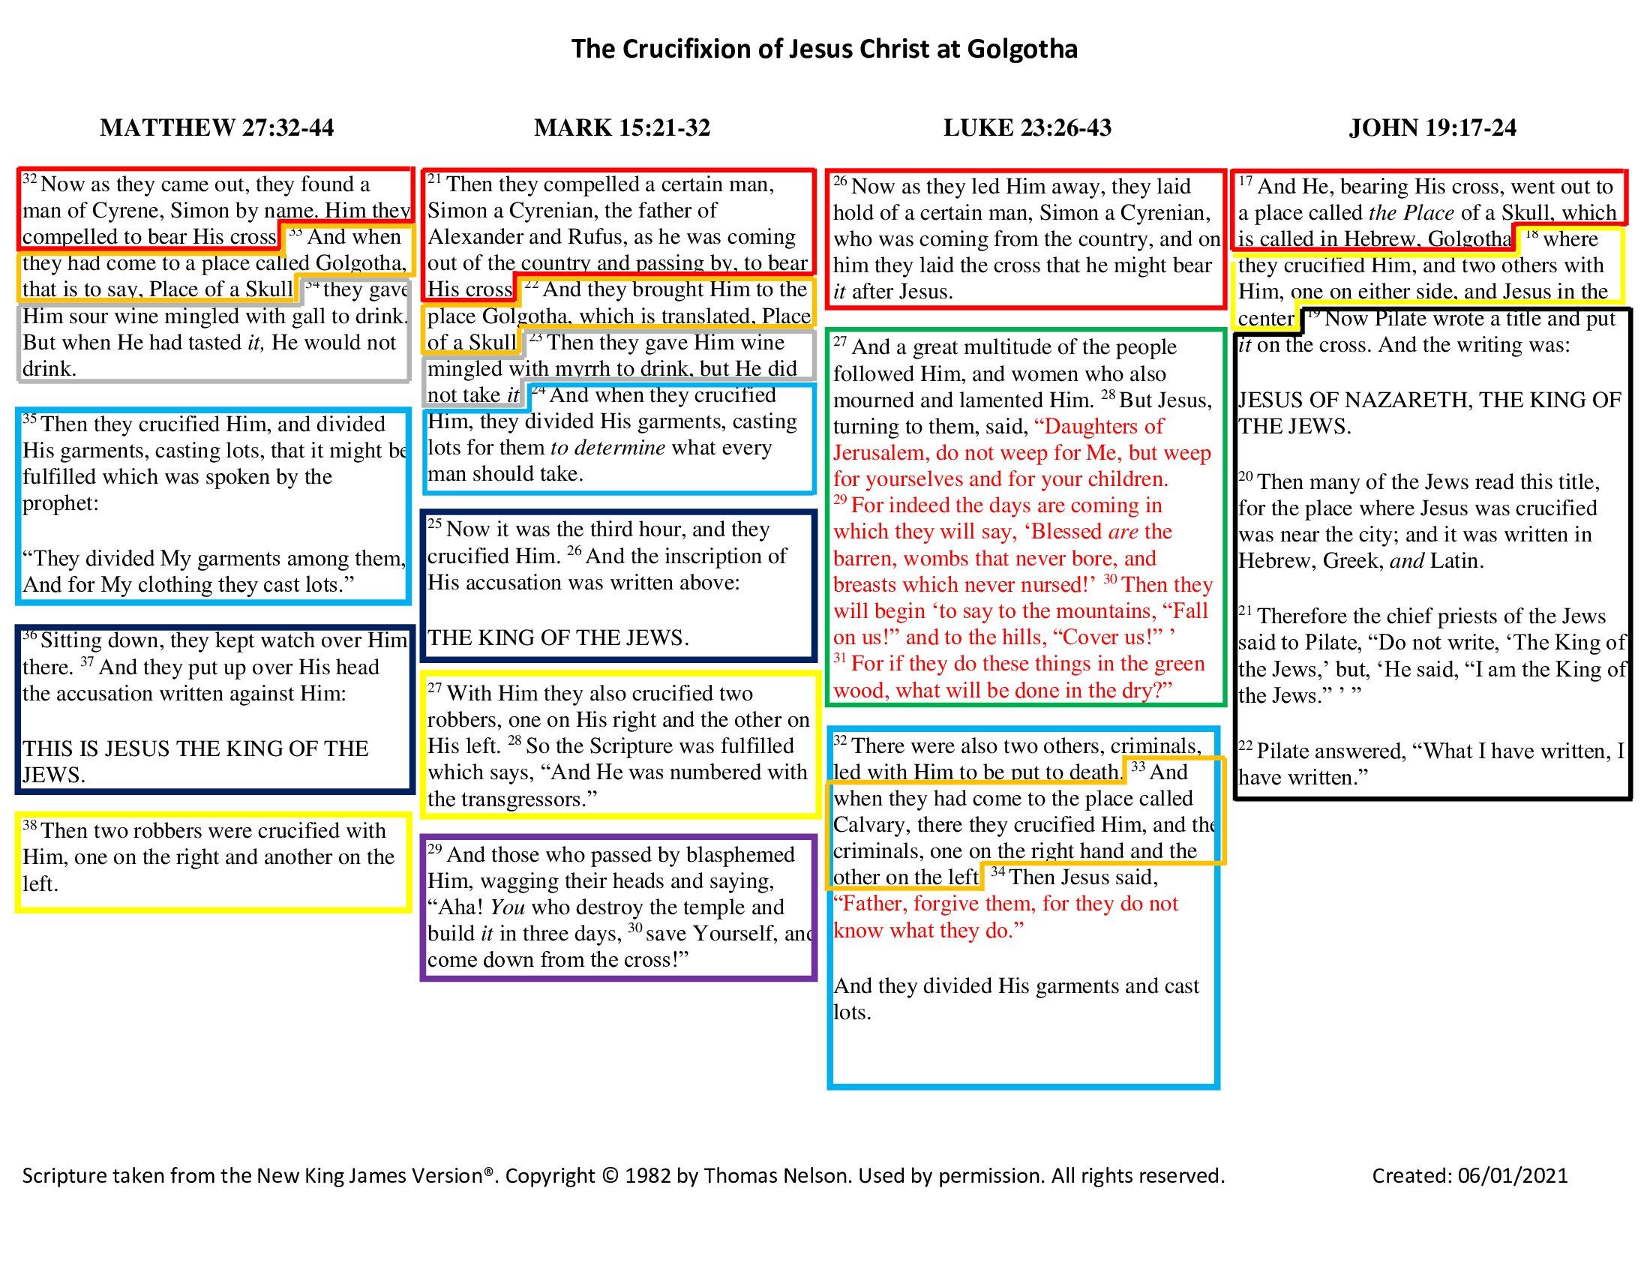

Slide 3
Matthew 27 v 33 – 66 – Jesus’ crucifixion and burial
In our last session, we arrived at the point where Jesus was taken away for crucifixion.
He had been mocked and beaten, scourged and a crown of thorns rammed upon His head.
This fulfilled parts of Isaiah 53, Genesis 3 v 18 (the curse of thorns)
“…cursed is the ground because of you; in pain you shall eat of it all the days of your life; thorns and thistles it shall bring forth for you”.
The Roman soldiers unknowingly took an object or emblem of the curse and fashioned it into a crown for the one who would deliver us from that curse.
In Galatians 3 v 13 we read “Christ redeemed us from the curse of the law by becoming a curse for us—for it is written, ‘Cursed is everyone who is hanged on a tree’”.
So, having fulfilled several prophetic scriptures and already shed His blood for us in the Garden, through the beatings, during His scourging and through the crown of thorns, He was led away to be crucified.
The prophetic background to the crucifixion is breathtaking, in that it reveals the intentional nature of it on the Lord’s part.
He was led to Golgotha, outside the city (blood sacrifices had to be made outside the camp Hebrews 13 v 12 & Leviticus 4 v 12)

Slide 4
Matthew 27 v 33 – 66 – Jesus’ crucifixion and burial
Golgotha was in the same place as Mount Moriah, where Abraham was going to sacrifice Isaac as a prophetic type of Christ (Genesis 22).
There is speculation that Goliath’s skull is buried at Golgotha.
David brought Goliath’s head to Jerusalem as a trophy of war (1 Samuel 17 v 54).
This was a trophy of battle where good or righteousness overcame evil.
Jesus’ crucifixion was also a victory of righteousness over evil.
It is very likely that Goliath’s head would have been buried outside the city, as to bring it inside would have rendered the city unclean.
Archaeologists are wanting to excavate to try to find the skull, but the location of Golgotha is not certain, so they’re not sure where to dig.
In verse 34, they gave him wine to drink mixed with gall, prophesied in Psalm 69 v 21.
Gall was reputed to have some pain killing effects, but Jesus refused to have the suffering of the cross reduced in any way.
There is no detail of the actual nailing to the cross in any of the Gospel accounts.
They all simply say, “They crucified Him”.
Crucifixion was a form of execution so barbaric that the Romans would not use it against a Roman criminal.

Slide 5
Matthew 27 v 33 – 66 – Jesus’ crucifixion and burial
Those crucified usually took days to die (the recorded maximum was 13-days), in agony, fighting for every breath.
Having nailed Him to the cross, on the ground, they would then have lifted it up and dropped it into a socket in the ground.
They stripped his clothing off Him and drew lots for the cloth, keeping the outer garment in one piece (fulfilling Psalm 22 v 18).
They shared the cloth but drew lots for the outer garment (perhaps a symbol of the completion of His ministry).
In verse 37, the charge against Him contained no alleged crime.
Two robbers were crucified with Him, one on either side (fulfilling Isaiah 53 v 12).
All were hurling insults at Him including the robbers (Psalm 22 v 7 fulfilled) and mocking Him (Psalm 22 v 8 fulfilled)
V 45, Darkness fell upon the land from the 6th hour (noon) to the 9th hour (3 pm).
This was the brightest part of the day and could not have been an eclipse because Passover was always celebrated at a full-moon (anyone can look this up).
His cry of “Eli Eli lama sabachthani” was recorded 1000 years before it was made in Psalm 22 v 1.
This was truly traumatic for Jeus, as he had never been abandoned by the Father before.
They had enjoyed the best and closest of fellowship, but now God could not look upon Him, as He bore our sins.

Slide 6
Matthew 27 v 33 – 66 – Jesus’ crucifixion and burial
His cry of ‘Eli’ was similar to the beginning of Elijah’s name, hence they though He was calling for Elijah.
They knew from their own knowledge of the scriptures that Elijah was expected just before judgement day (Malachi 4 v 5 & 6).
In verse 50 we are told that Jesus ‘cried out in a loud voice’.
In John 19 v 38 &39 we are told what that cry was.
It wasn’t just a cry of pain, it was a very specific word, rendered as “It is finished” in most translations.
If this were true, we could have been forgiven for thinking it referred only to the end of the crucifixion process.
But the word He used was ‘Tetalestai’, which means, ‘Paid in full’ (a debt redeemed).
It was a declaration that his mission spoken of in Matthew 1 v 21, to deliver His people from their sins, was now complete.
The price had been paid in full for human sin for all time for every person.
He had redeemed us from the slave-market of sin.
He had satisfied the wrath of God against sin – this is what ‘propitiation’ means in 1 John 2 v 2 and Romans 3 v 25.
At this precise time, Matthew tells us, that the veil in the Temple was torn in two.

Slide 7
Matthew 27 v 33 – 66 – Jesus’ crucifixion and burial
When the tabernacle was set up and subsequently in the Temple, there was always a ‘Holy of Holies’ or ‘Most Holy Place’. (See next slides)
This was a part of the Temple or Tabernacle that was for God only.
No one was permitted to enter, on pain of death, because it was the abode of the perfect and righteous God.
Sinners could not enter God’s presence and live.
We had the famous occasion of Nadab and Abihu (sons of Aaron) in Leviticus 10 v 1 & 2, when these two entered in a manner God had not prescribed and died instantly.
So, the curtain in the temple was very much an object of fear, separating sinful man from their righteous God. It was as thick as the span of a man’s hand.
The very idea of access to God was alien to the Jews – God was inaccessible.
Once a year, after being ceremonially purified, the High Priest was allowed in beyond the veil to make atonement for the sins of the people.
Jesus was our great High Priest (Hebrews 4 v 14) and made a final payment for all sins, for all time, for all men.
And when this was ‘Paid in full’, this curtain or veil was torn in two from top to bottom, opening up the way to God for all men from then on.

Slide 8
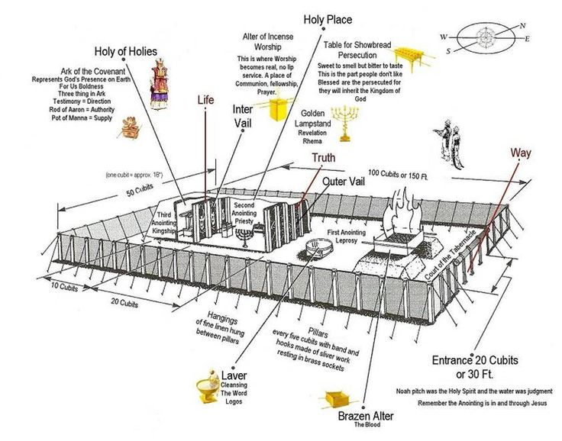

Slide 9
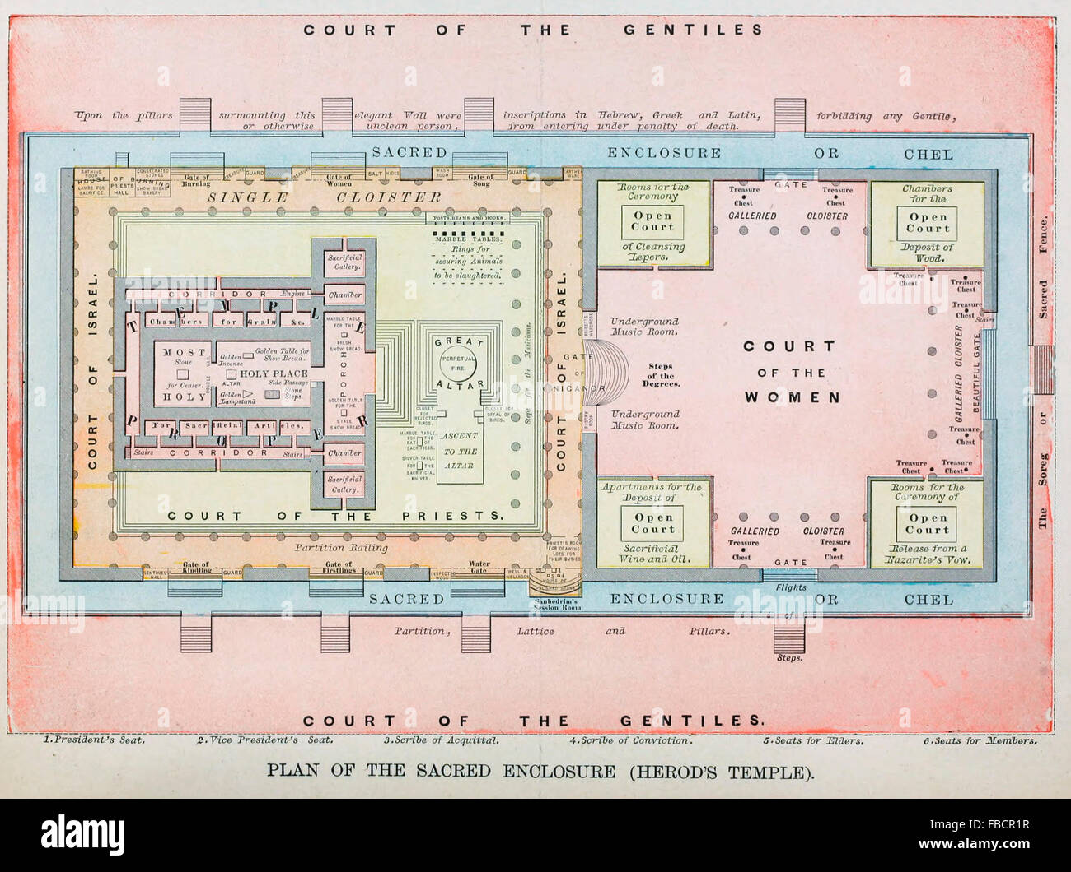

Slide 10
Matthew 27 v 33 – 66 – Jesus’ crucifixion and burial
At the same time as this there was an earthquake and rocks split.
God was ensuring that this death would always be remembered.
In John’s account we read of blood and water flowing out together from Jesus’ side (John 19 v 34), proving beyond doubt that He was dead. (See next slides)
The Roman Centurion that stuck a spear in Jesus’ side was a trained killer.
He would have stuck the spear up at an angle between Jesus’ ribs and into the pericardial cavity, which would have been engorged with water as a result of the trauma Jesus had suffered.
Then on into the heart, bursting it, so the water would have flowed first, followed by the blood.
This injury would not have been survivable, though He was already dead when it occurred.
It was the fact that He died so promptly and unusually that convinced the Centurion that He was the Son of God.
After the darkness, the shout and the tearing of the curtain, He gave up His spirit.
John 10 v 18 – no one takes my life; I lay it down etc.
Once the wrath of God was satisfied, He passed from this life.

Slide 11
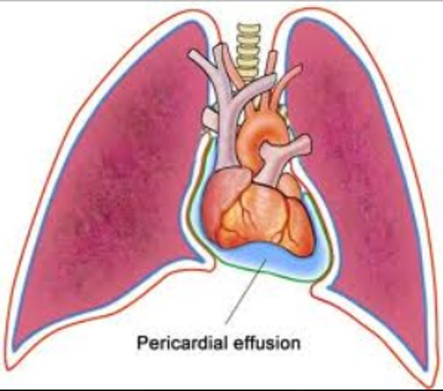
First, did Jesus really die?

Slide 12
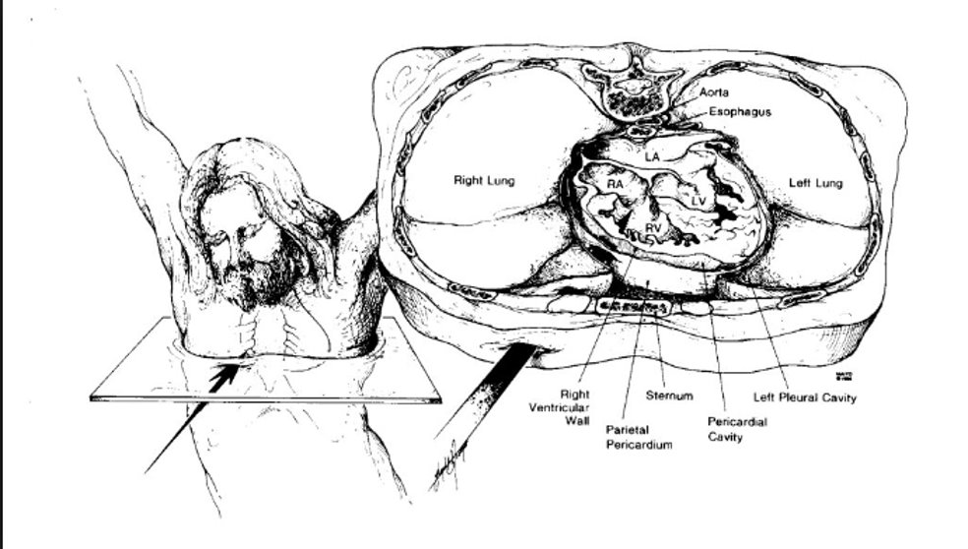
First, did Jesus really die?

Slide 13
Matthew 27 v 33 – 66 – Jesus’ crucifixion and burial
Spectators to all of this from a distance were the women including Mary Magdalene, Mary the Mother of James and Joseph and also the Mother of the sons of Zebedee (we will see them again at the resurrection).
Now we meet Joseph of Arimathea.
A wealthy member of the Sanhedrin who had become a secret disciple of Jesus (John 19 v 38).
He asks for the body of Jesus – a courageous thing to do.
Up to this time He would have been flung into a mass grave with all the other criminals and strangers.
Joseph, however, had purchased a private tomb – he was a wealthy man – so He was originally assigned with the wicked but was with a rich man in His death (Isaiah 53 v 9 fulfilled).
Once in the grave (wrapped in a clean linen cloth – he must also have washed the body I suppose), Joseph rolled a large stone over the mouth of the tomb (Mark 16 v 4).
This was at the very least several hundred kilos and more likely a couple of tonnes.
It was rolled downhill over the hole and wedged in – not possible for a man to roll it away or for a recovering brutally injured Messiah to move it.

Slide 14
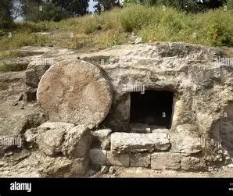

Slide 15
Matthew 27 v 33 – 66 – Jesus’ crucifixion and burial
So, Jesus is incarcerated.
Then the Jews and Romans are discussing that ‘that deceiver’ said He was going to rise again on the third day.
So they discussed precautions.
They arranged to seal the tomb and to guard it.
The Guard was required to stay awake – falling asleep was punishable by death.
There would have been an official seal over the stone – breaking the Roman seal without official sanction was also punishable by death.
So, massive precautions were taken to prevent anyone getting to the body and stealing it.
The same precautions would mean that there was no escape from the tomb without being seen.
Probably the best application for us with this event and the four accounts of it, is to understand the depth of love that must have driven it.

Slide 16
