Slide 1
1 Samuel 8-9
17 Mar 2024

Slide 2
1100 BC | Birth of Samuel | 1 Samuel 1
1100 BC | Hannah's Song | 1 Samuel 2
1070 BC | Battle of Shiloh | 1 Samuel 3
1070 BC | Philistines Take the Ark | 1 Samuel 4, 5
1070 BC | Philistines Return the Ark to Israel | 1 Samuel 6
1070 BC | Ark brought to Abinadab's House | 1 Samuel 7
1050 BC | Israelites Repent at Mizpeh | 1 Samuel 7:3
1043 BC | Saul Becomes King | 1 Samuel 8 - 10
1042 BC | Saul Defeats the Ammonites | 1 Samuel 11, 12
1041 BC | Saul's War with the Philistines | 1 Samuel 13
1041 BC | Jonathan's Miraculous Victory | 1 Samuel 14
1028 BC | Saul's Disobedience and Samuel's Rebuke | 1 Samuel 15
1024 BC | Samuel Anoints David at Bethlehem | 1 Samuel 16
1024 BC | David Kills Goliath | 1 Samuel 17
1015 BC | Jonathan's Friendship with David | 1 Samuel 18
1014 BC | David Protected from Saul | 1 Samuel 19
1013 BC | David and Jonathan's Covenant | 1 Samuel 20
1012 BC | David at Nob and Gath | 1 Samuel 21
1011 BC | Saul Slays the Priests of Nob | 1 Samuel 22
1011 BC | David Flees Saul | 1 Samuel 23
1011 BC | David Spares Saul's Life | 1 Samuel 24
1011 BC | Samuel Dies | 1 Samuel 25
1011 BC | David Spares Saul a Second Time | 1 Samuel 26
1010 BC | David Flees to the Philistines | 1 Samuel 27
1010 BC | Saul and the Witch of Endor | 1 Samuel 28
1010 BC | Achish Sends David Away | 1 Samuel 29
1010 BC | David Destroys the Amalekites | 1 Samuel 30
1010 BC | Saul and His Sons Killed | 1 Samuel 31

Slide 3
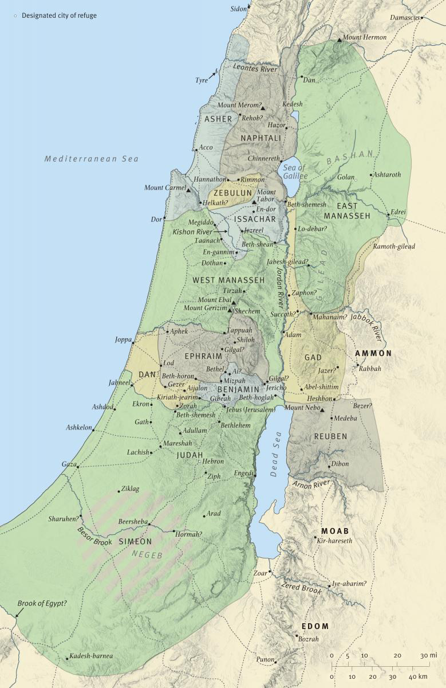

Slide 4
