Slide 1
1 Samuel 17
8 Sep 2024

Slide 2
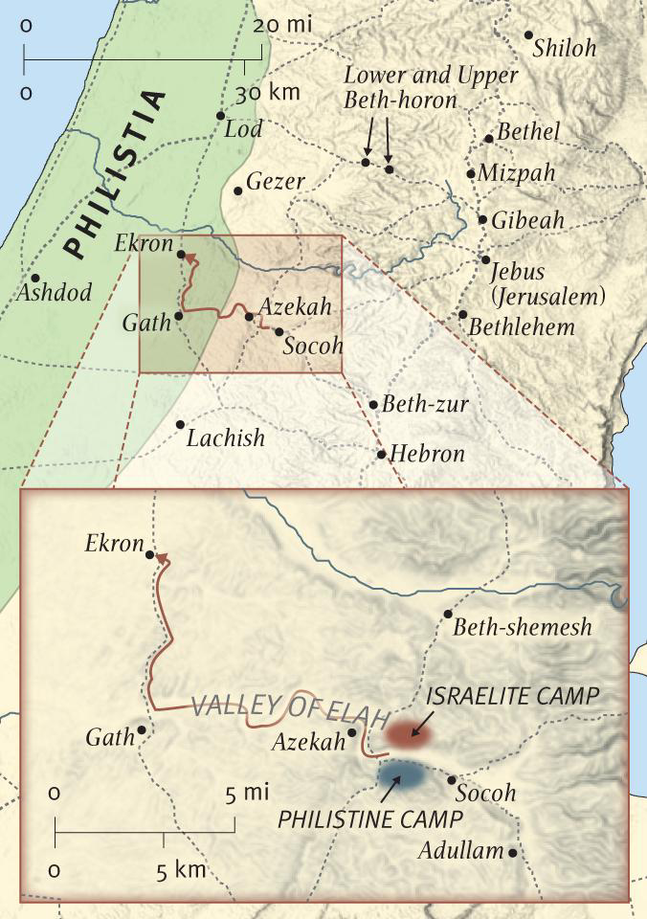

Slide 3
Valley of Elah

Slide 4
1 Samuel 17
8 Sep 2024

