Slide 1
Matthew 21 v 12 - 17
The Cleansing of the Temple

Slide 2
Matthew 21 v 12 – 17 – cleansing the Temple
Last time we dealt with the Triumphal entry in Jerusalem.
We saw Jesus fulfilling the prophecies given hundreds of years previously in Daniel 9 v 24 and Zechariah 9 v 9.
In Mark’s account of these events, we read that He had looked into the Temple and ‘looked around at everything’.
Mark tells us that Jesus returned to Bethany in the evening (probably staying with Mary, Martha and Lazarus).
The events we are now considering happened, according to the timeline in Mark’s Gospel, on the following day.
Matthew and Mark have their records of the fig tree that Jesus cursed in reverse order, but it is Mark’s account that gives a chronology of the events.
Matthew simply records that they occurred.
As we are studying Matthew, we will deal with this event next time.
So, having seen the goings on in the Temple on the previous day, He comes to correct matters on the day following the triumphal entry.
All of these things take place during the final week of His life.
We are reminded in Psalm 69 v 69 that “Zeal for His father’s house will consume Him”.

Slide 3
Matthew 21 v 12 – 17 – cleansing the Temple
So, let’s set the scene.
The account of this event is recorded in three of the Gospels, Matthew, Mark and Luke (The Synoptic Gospels).
This is the second time that Jesus has driven people out of the Temple, the other occasion being recorded in John chapter 2 v 13 and following.
The former occasion took place on the run-up to Jesus’ first Passover and this time it occurred on the run-up to His last Passover.
In this sense, the cleansing of the temple has provided bookends for Jesus’ period of ministry.
Because both occasions were during the Passover season, the city would have been teeming with people.
All accommodation would be full, people would have filled their homes with guests, many would have brought tents or slept in the open air.
Josephus estimates that the population would have increased from about 60 – 80 thousand to 2.5 – 3 million.
The Temple area was never supposed to be a place of trade – every part of the Temple was designated as Holy Ground and a place where anyone – Gentile or Jew – could meet with God.
However, over time the attitude towards the Gentiles was degraded and the Jewish traders were allowed to set up their stalls in the court of the Gentiles and to bring in their sacrificial animals for sale – initially they were only allowed to do this outside the perimeter walls.

Slide 4
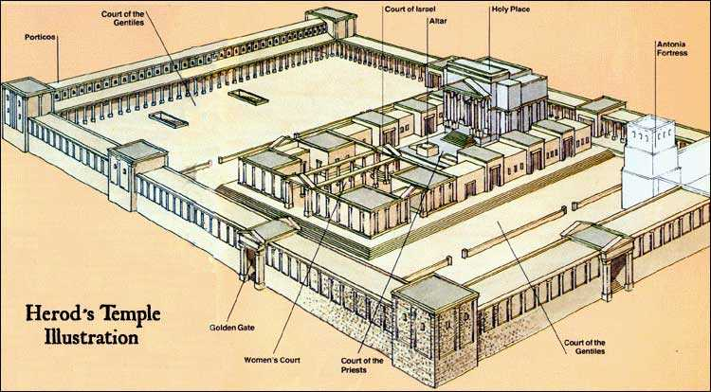

Slide 5
Matthew 21 v 12 – 17 – cleansing the Temple
The next question we should ask is, why the extremes of anger.
Apart from the misuse of the Temple space, to which we will refer more fully in a moment, our clue as to the Lord’s attachment to the Temple can be gleaned from the combined accounts of 1 Chronicles 22 v 8 and 2 Chronicles 6 v 46 to 7 v 16.
The Jews had lost sight of the fact that the Temple was ‘owned’ by the Lord and was precious to Him.
It was the place where prayers offered would be answered and where there would be discourse between the Lord and His people.
Being also a place of sacrifice, it was the place where things would be set right between the Lord and His people.
So, over a number of years (decades or even centuries), the Priests and their business cronies had made use of the opportunity of the major feasts to become wealthy.
All families that could do so were expected to make their way to the Temple for Passover, hence the massive influx of people at that time.
They were supposed to bring their animals of sacrifice, which had to be perfect in the eyes of the Priests whose job it was to inspect them.
They would also be expected to bring money with them to pay the half-drachma tax
They would often bring these in their own coinage and would have to exchange money in order to pay it.

Slide 6
Matthew 21 v 12 – 17 – cleansing the Temple
It is even said that the Temple minted their own coins for this and would only accept these coins, which could not be obtained from anywhere else.
The Priests, when examining the sacrificial animals would find imperfections, forcing the people to but animals at exorbitant prices from the Temple.
Similarly, because of the constraints deliberately placed on currency, the exchange rates were very high, effectively fleecing the people.
The animals that were formerly sold outside the temple had now been brought into the court of the Gentiles.
This would have involved, potentially, thousands of animals.
Imagine the mess and the smell in what was supposed to be a holy place.
Also, there were many Bazaar stalls, known as the Bazaars of the Sons of Annas (High Priest) – the Priests had made it a family business.
So, the House of God had become a house of noise, dung, extortion and robbery – a very far cry from its original purpose.
Those who were seeking to do the right thing and stay right before God were being robbed and lied to in order to line the pockets of the Priests, who were supposed to be servants of the people they were robbing.
The Lord had challenged these practices in the same way three years earlier, and clearly, His protestation had made no lasting impact.

Slide 7
Matthew 21 v 12 – 17 – cleansing the Temple
Let’s for a moment consider what a miracle this was – it’s not normally listed as a miracle, but in my estimation, it shows the exercise of supernatural power.
Remember, this involved commanding thousands (possibly tens of thousands) of people, as well as hundreds of animals and many traders who would not have been pleased to have their income removed.
He was vastly outnumbered and had no help – if I had tried this, I would have been beaten up and ousted myself.
I believe this demonstrates His ability to exercise absolute authority.
In John chapter 2 He used a whip, though it is most likely that the whip was for controlling the animals rather than the people.
This time, there is no mention of a whip – it is as though He simply commanded it, and it happened.
Under all normal circumstances, the people could have simply said “NO”.
For some reason, which we do not know, the people were compelled to comply.
The Lord quotes Old Testament Prophecy at them when He says in verse 13, “MY HOUSE SHALL BE CALLED A HOUSE OF PRAYER”.
The quotation is from Isaiah 56 verse 7 and if we turn to that scripture and read the preceding verses, we get a sense of the love and the purpose He had for the Temple.

Slide 8
Matthew 21 v 12 – 17 – cleansing the Temple
In verse 3 we see reference to the inclusion of the foreigner (the Gentiles) in God’s house.
In verse 5 those who might expect to be completely overlooked (eunuchs) will receive a name better than that of sons and daughters.
In verse 6 the same promise is extended to include other foreigners (Gentiles) who keep the Law – they will be made joyful in the House of the Lord.
And in verse 7, God’s house will be called a house of prayer for ‘all the peoples’.
The second part of the quotation comes from Jeremiah 7 verse 11.
This passage indicates the sort of consequence that happened when similar offences against God were committed in Jeremiah’s day.
The promise here is that He would do to their house the same as was done to Shiloh.
Shiloh was the place where the Lord placed His name and the place where people could meet with Him.
God always wanted a place where His name was known – a place of fellowship with Him – it was precious to Him.
In Shiloh, Hophni and Phinehas had reduced the dwelling place of God to an immoral den of robbers, so God brought a judgement through the Philistines (1 Samuel 3 & 4) during which the Ark was captured (the Ark represented God’s presence among His people)
You can review Joe’s/Tony’s teachings on 1 Samuel if you want to get more information on this.

Slide 9
Matthew 21 v 12 – 17 – cleansing the Temple
We then read that Jesus healed the lame and the blind in the Temple.
This fulfilled Isaiah 35 v 6 – a Messianic prophecy.
Isaiah 35 speaks of the time when God would come to save, so this was a clear statement to the religious Jews that this time had come.
Yet we read that when they saw all the wonderful things Jesus had done, they became indignant.
I think they were probably more focussed on the loss of their illegitimate profits.
Jesus refers them once again to the scriptures they are supposed to know and live by.
He introduces a note of apparent sarcasm, “Yes; have you never read, ‘OUT OF THE MOUTH OF INFANTS AND NURSING BABIES YOU HAVE PREPARED PRAISE FOR YOURSELF’?”
This quotation is from Psalm 8 – a Psalm that magnifies the Lord and recognises His greatness and the wonders of His power, contrasted with the weakness and smallness of man.
He says that if these children did not cry out these things, then the very rocks would do so.
I believe this was a way of saying that this was so obvious – the power to cleanse the Temple, the fulfilment of messianic prophecy etc. that even inanimate objects would cry out the truth.
God was in their midst, and they refused to recognise Him.
The last sentence reflects a somewhat tragic loss.
“And He left them and went out of the city to Bethany and spent the night there.” – had they welcomed Him He would possibly have stayed with them – He went to where His friends were.

Slide 10
Matthew 21 v 12 – 17 – cleansing the Temple
Some points of application.
There is a direct analogy in scripture between the Temple and believers.
In 1 Corinthians 6 v 19 & 20, Paul tells us that we are the temple of the Hold Spirit.
We need to be strict about what we allow into our temple and be prepared to submit to His desire to overturn the stuff that shouldn’t be there.
When He does these things, indignation is not the right response, regardless of the discomfort it might bring us – thanksgiving is the right response.
We need to recognise when God is showing Himself to us and desire that He should remain.
We should learn from this passage that God’s word is true. We have here two groups – one of believers and children who realised who Jesus was and grasped him and exalted Him and another group who were wilfully ignorant because they had other priorities.
He needs to be our top priority: as it says in Deuteronomy 6 v 5 and reiterated by Jesus in Matthew 22 v 37 – 40 “You shall love the LORD your God with all your heart and with all your soul and with all your might”.

