Slide 1
Matthew 23
Dealing with hypocrites

Slide 2
Matthew 23: Dealing with hypocrites
The Jews have been asking Jesus questions for a long time. It is now just a couple of days to Jesus’ death.
As we discussed last week, these questions were not for the purpose of fact-finding or establishing the truth.
In fact, they were deliberately structured as traps to get Jesus to be embroiled in conflict with the Jews and the Herodians.
At the end of the last chapter, He had asked them a question about whose son Messiah was.
They said, ”the Son of David”, and He then showed them that their answer was only partially correct.
That whilst He was humanly the Son of David, He was spiritually the Son of God, taken from Jesus’ interpretation of Psalm 110 v 1.
We read at the end of Chapter 22 that this question had drawn to a close the investigation of Jesus as a potential Messiah.
They were unable to ask Him loaded and disingenuous questions without, themselves, falling into the very traps they were setting for Him.
His knowledge and intellect was far superior to theirs and everything about Him confirmed that He was their Messiah, yet they would not admit they were wrong - would not humble themselves, and were determined to destroy Him.

Slide 3
Matthew 23: Dealing with hypocrites
So, Jesus is recorded as speaking to a gathered multitude of both disciples and others and publicly denigrates the Pharisees.
He is not rude but is brutally factual.
He publicly shamed the Pharisees with lots of allegations of their Hypocrisy.
He pointed out that much of the content of what they taught and spoke about, as well as their public face was correct, and they should seek to live by it.
Bent ministers and pastors often have a public persona that is difficult to impeach but below the surface there can be all sorts of misconduct.
But He says “do not do what they do”.
He points out that their actions, their lifestyles etc. do not align with their teaching.
The passage says that they had seated themselves in the seat of Moses.
Synagogues had a large seat at the front from which Rabbis used to teach the Law.
They referred to it as Moses’ seat for this reason – it was the seat from which good teaching would proceed – teaching that should be carefully followed.
However, these teachers were not role models.
A number of reasons for this is stated.

Slide 4
Matthew 23: Dealing with hypocrites
They put burdens on people that they are not, themselves, prepared to carry.
They do what they do to impress men – to put on a show (all leaves and no fruit, to return to the example of the fig-tree).
The word ‘hypocrite’ is heavily used in this chapter and in this Gospel.
It is used 17 times in the Gospel of Matthew and 7 of those occasions are in this chapter (it is only used a further 19 times in the whole Bible).
So, Jewish hypocrisy is very much a focus of this Gospel and, in particular, this chapter.
The Greek word used is ‘hupokritēs’, which means an actor – someone taking on the character of another – what you see is not what you get.
In Greek plays of the time, actors would wear a mask that was in keeping with the role they were playing – a laughing mask when the lines were funny or a frowning mask when displeasure was warranted.
The hypocrite was one where it was not possible to see the real person but only the one the person wanted you to see.
In verse 5 Jesus points out very publicly some evidences for their hypocrisy.
They broaden their phylacteries – a box strapped to the forehead containing written portions of the Torah – instead of praying quietly and privately, they made a lot of noise and show and wore bigger and bigger phylacteries to show how holy they were, whilst at heart they were evil.

Slide 5


Slide 6
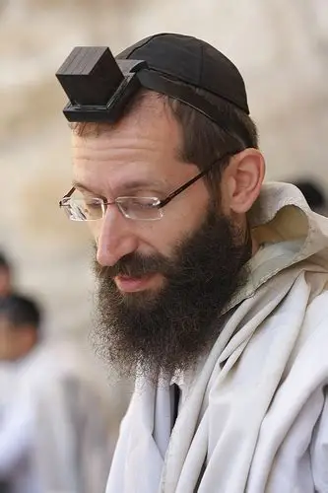

Slide 7
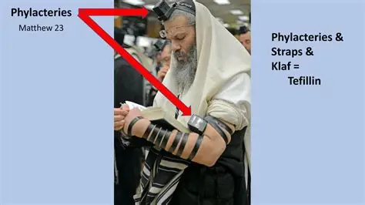

Slide 8
Matthew 23: Dealing with hypocrites
In Matthew 6 v 1 - 7 we are told not to heap up empty words (like the hypocrites) or use meaningless repetition when we pray and we are given a very thoughtful, succinct and directed alternative.
We are instructed to pray privately and sincerely in our ‘inner room’ where others cannot see.
We are told to serve God ‘in secret’ – in other word, never for show.
In Luke 18 v 10 – 14 we have right and wrong attitudes in prayer contrasted.
In verse 22 and 23 of Matthew 23 we are instructed not to seek out the place of honour at banquets or to be called Rabbi (teacher or master).
I would observe that there are men whom we put in that place in our own minds, hopefully because they are good role models and are gifted in some way, but not because they demand it.
I have seen situations where the leader demands to be served first.
The true Godly leader will be serving the people before himself.
Only Jesus is our leader and only He is our father.
In verses 11 & 12 Jesus once again makes the point that the greatest among them is the one who serves all.

Slide 9
Matthew 23: Dealing with hypocrites
We then come to Jesus’ declaration of 8 woes, all of which are aimed at the Scribes and Pharisees (Hypocrites) who have rejected Jesus.
Today we will deal with the first 3 because of time limitations: the other 5 we will deal with next time.
He says, “Woe to you hypocrites because…” (woe in Hebrew is an onomatopoeic word expressing grief)
‘Woe’ is an exclamation of grief – it’s what we feel at the funeral of a friend – it’s the consequence of an irrevocable or irreversible set of circumstances – it is doom laden (remember Jesus takes no pleasure in the death of the wicked Ezekiel 33 v 11).
In imagining the tone of voice here, I imagine it as being like a lament, as well as the anger that is evidently included in it.
Redolent of Ezekiel 18 v 19 – 30 – a heart that wants men to turn and live rather than die in their sin.
“Woe to you hypocrites because you have this double-barrelled sin in that you don’t enter heaven yourselves and you prevent others who are about to enter from doing so.
Jesus seems to be painting them as the ‘doorkeepers’ to salvation, yet they are turning people back from the threshold.
When you want to know about religious matters you would go to them, and they would steer you away from the truth.
Teachers are warned in James 3 v 1 that they will be judged more strictly.

Slide 10
Matthew 23: Dealing with hypocrites
The second woe refers to the Leaders’ habit of preying upon widows.
Widows were often left with the wealth of their dead husbands and so were a source of generous giving to these leaders who would be over-attentive, praying long prayers with them and taking money from them.
You may note that the verse is in brackets in many bibles with a footnote saying that it does not appear in the earliest manuscripts.
I have not bothered to dig deep on this, because the verse is included with certainty in both Mark’s (Chapter 12 v 40) and Luke’s (chapter 20 v 47) Gospels.
This verse does not, therefore, lead us away from the message of God’s word.
This practise was well known among the Jesuits, befriending wealthy widows and either making unjust claims from the estate or exacting gifts from the widows under the false banner of righteous concern for them.
Sometimes this would involve laying claim to houses that the widows had been left – assets that the widow could either sell or take a rental income from.
The attention given to the widows would seem compassionate, but the motives were mercenary.
These actions and this hypocrisy, Jesus said, would lead to greater condemnation.

Slide 11
Matthew 23: Dealing with hypocrites
Then there is the third Woe.
These men would travel widely to bring back with them, proselytes whom they favoured because of their wealth, status, reputation etc.
Rather than working with and upon their local community to advance the Kingdom of God sincerely and with pure motives, they were going to places to bring in men of influence that would enhance their own reputation by association.
What is often referred to these days as ‘optics’
Being seen to be with people of repute and undoubtedly people of wealth.
The church is not immune to this kind of snobbery – the name-dropping and obsequious pandering to certain men for the elevation of one’s own reputation, often to the exclusion of the poor the sick, the widowed and the otherwise needy.
God’s church should never be a place where this happens.
Wealth and status can be a block to true ministry.
We should note that Jesus refers to those that do this as ‘Sons of Hell’ and that this kind of proselytising will lead others to be sons of hell too, only worse examples.
Our role is to lead men away from such sin, if possible, not to encourage it and lead them deeper into it.
Let us hate with a passion, that which God hates with a passion – He is being passionate here.

