Slide 1
The Feasts of Yhvh (Yahweh)
The Feast of First Fruits

Slide 2
The Feasts of Israel - The Feast of First Fruits
Introduction
Today we are beginning a series in which we will study the Jewish feasts.
We are going to begin with the Feast of First Fruits, because we are beginning on Easter Sunday, which is traditionally the day upon which we celebrate the Resurrection of our Lord Jesus Christ, and the Feast of First Fruits is intimately linked to the Resurrection.
The feasts are divisible into two parts – the spring feasts and the autumn feasts (4 in spring and 3 in the autumn).
Each feast was inaugurated in celebration of an event in Jewish history, so looks back to a time when God did something noteworthy.
But each feast also looks forward, prophetically, to a time when God would visit His people again in some dramatic way.
At our time in history, we can also divide the feasts into two parts in another way, though the division by this means produces the same groupings.
They can be grouped as, those that have been fulfilled prophetically and those that have not (yet) – the spring feasts have been fulfilled, the autumn feasts have not yet been fulfilled.
Another way to think about them is that the spring feasts were fulfilled by His first coming and the autumn feasts will be fulfilled by His second coming.

Slide 3
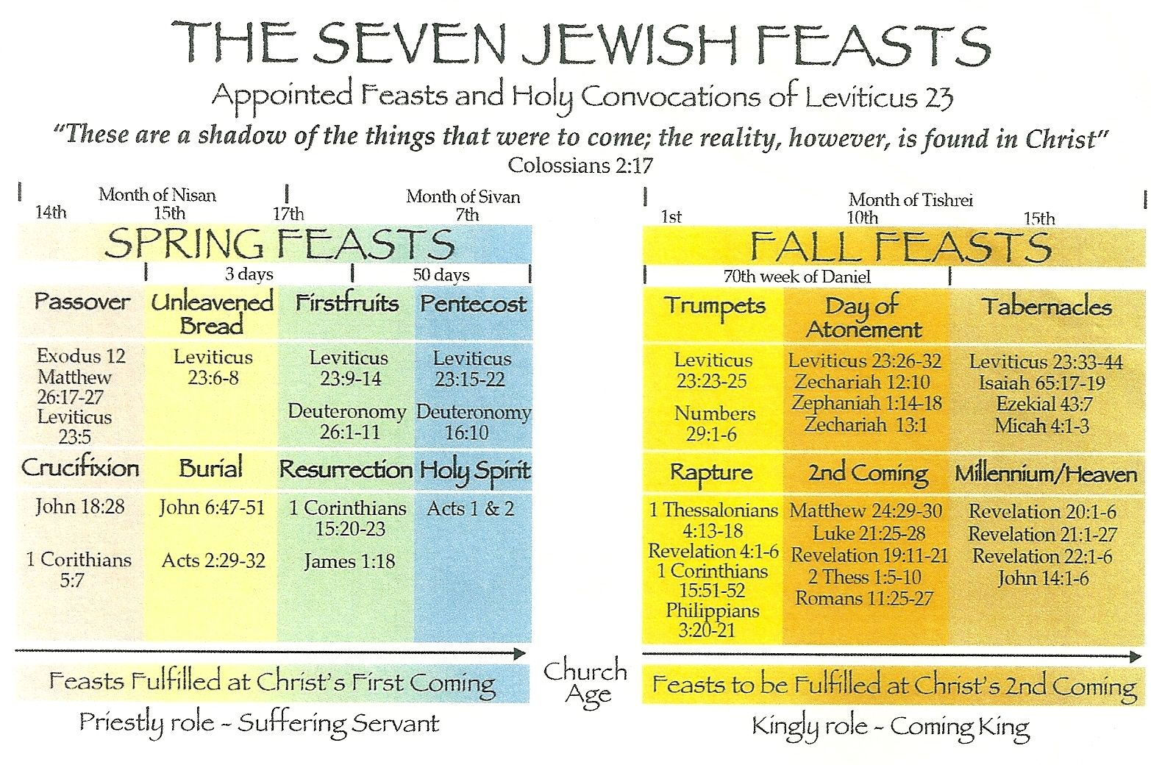

Slide 4
The Feasts of Israel - The Feast of First Fruits
The Feast of First Fruits was among the spring feasts.
To understand when and why it was set up, we need to look at its inauguration.
We read about God’s instruction as to when and how to celebrate this feast in Leviticus 23 verse 9 and following.
So, what was the special occasion?
Well, the Israelites had come through the wilderness for the last 40 years and had undergone adventures.
They had left Egypt (and slavery), led by Moses, whose mission was given by God to this end (Exodus 3 v 10 & 7 v 8 - 10).
Moses was given miraculous powers to achieve this exodus (Exodus 4 v 1 - 10).
They witnesses the plagues of Egypt, and saw God treat them differently from their enemies (the lights stayed on in Goshen, their firstborn did not die).
They had followed a pillar of cloud by day and fire by night.
They were dependant upon the Lord to lead them.
They had crossed the Red Sea and seen the Egyptian army drowned.
Water came from a rock in the desert (as an aside, look at the next 3 slides).
And now they are about to enter the promised Land

Slide 5
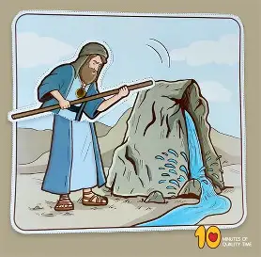

Slide 6
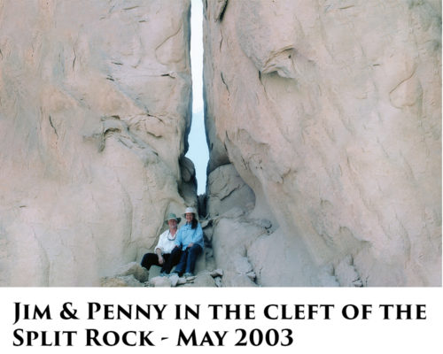

Slide 7
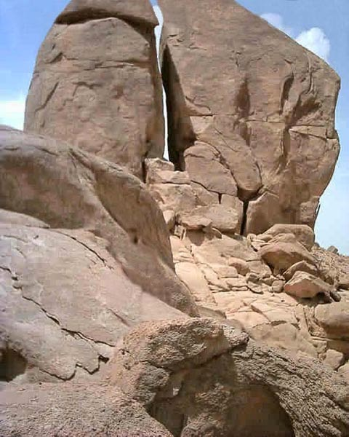

Slide 8
The Feasts of Israel - The Feast of First Fruits
The Instruction from the Lord in Leviticus 23 v 9 is,
“When you enter the land which I am going to give to you and reap its harvest, then you shall bring in the sheaf of the first fruits of your harvest to the priest”.
So, the significant event was their entry into the promised land, but not just that.
It was their first harvest in that land.
They had followed God for years and not truly known whether the land to which He was leading them would sustain them.
The final proof of God’s provision was to be the plentiful first harvest.
So, in verse 10 we read that the Priest (always a type of Christ) had to take the first sheaf of the first harvest (the barley harvest), and wave it before the Lord as a wave offering (this had to be done before anyone ate any of the barley).
Note, in verse 11 God said, “He shall wave the sheaf before the LORD for you to be accepted”.
There seems to be a dual meaning in this.
God was accepting the thanksgiving for the harvest, so, approved of the harvest.
But also, God was showing His acceptance of the thankful people by giving them the plentiful harvest.
To complete the feast, a male lamb, perfect and without blemish had to be offered.

Slide 9
The Feasts of Israel - The Feast of First Fruits
So, like the Passover lamb, this had to be a perfect male lamb, one-year old, to be offered as a burnt offering.
So, the first thing to note is that the wave offering of the sheaf was accepted when the burnt offering was made.
The first recorded burnt offering was offered up by Noah (Genesis 8 v 20) after the flood, after receipt of which, God said He would never again flood the earth.
It was in Genesis 22 that the substitutionary nature of the burnt offering becomes obvious.
Isaac was to be offered as a burnt offering, but God provided a substitute in the form of a ram (male sheep).
A major symbolism in the burnt offering was that the perfect one was destroyed by fire, instead of the one(s) making the offering.
The Hebrew word used for the burnt offering, literally meant to ascend or to ‘go up’ in smoke, thus, the total destruction of the perfect one by fire caused the smoke to rise as a pleasing aroma to God, bringing forgiveness and atonement for sins to those making the offering.
So, coming back to the Feast of First Fruits, when the first sheaf is waved at the time of the burnt offering in which the substitute is destroyed and its smoke goes up to heaven, the people are accepted.

Slide 10
The Feasts of Israel - The Feast of First Fruits
So, now we move to the prophetic aspects of this feast
The harvest is often a type of humanity.
Jesus used this analogy when He spoke of evangelism and the destiny of the Apostles – ‘The fields are white unto harvest, but the labourers are few (John 4 v 32, Matthew 9 v 37 and Luke 10 v 2)’.
We have the sons of Jacob depicted as sheaves in Joseph’s dream.
The parable of the sewer, the analogy of planting and watering in 1 Corinthians 3 v 6 and so on.
So, the sheaves of the harvest are a type of individual children of God.
Then, at the time of the harvest, the first sheaf of the first cut is waved to ensure it is acceptable to God at the same time that a burnt offering is offered (a substitute consumed)
So, the sheaf is a picture of Jesus – the first sheaf of the first cut.
He is described as the firstborn among many brethren (Romans 8 v 29) – He is our firstfruit (1 Corinthians 15 v 23).
This means He is the sheaf that is waved and is acceptable to the Father.
He is also, ultimately, the same as all the other sheaves – all the sheaves covered by the offering of the Lamb.

Slide 11
The Feasts of Israel - The Feast of First Fruits
So, we see Jesus in the Lamb.
We also see Jesus in the sheaf that was waved – if He was accepted as the first sheaf, we all are as the subsequent sheaves of the harvest.
But I think we also see Him in the smoke of the offering, in that the smoke rises as a sweet-smelling savour in the nostrils of God who accepts the offering(Acts 1 v 9).
At His ascension, Jesus also rose to be seated in heavenly places with the Father, so gone from earth (nothing left of Him on earth) and ascended – like the smoke – to the Father.
Here He sits at the right hand of the Father and ever lives and intercedes for us (Hebrews 7 v 25), and as Jude tells us, presents us unstained (make us to stand) faultless (blameless or spotless) before the throne of God.
He was the first human being to achieve this and is our first-fruit, so has made it possible and arguably certain for us too.
But let’s also think of some other Bible language surrounding the risen Jesus – remember, what is true of Him is and will be true of us too.
In Colossians 1 v 18, Jesus is referred to as the firstborn from the dead.
In John 12 v 24, Jesus says, “The hour has come for the Son of Man to be glorified. Truly, truly, I say to you, unless a grain of wheat falls into the earth and dies, it remains alone; but if it dies, it bears much fruit.

Slide 12
The Feasts of Israel - The Feast of First Fruits
So, arguably, the first sheaf was produced from seed that had gone into the ground and died.
In that sense, it was the first-born sheaf from the dead.
This parallels Jesus who was sown as a seed of God into the ground where He died.
He was then resurrected as the firstborn from the dead (Colossians 1 v 18) and the firstborn among many brethren (Romans 8 v 29), to be presented before the Father, perfect and without spot or blemish.
When God accepted the offering of the First-fruit, He accepted the whole harvest.
When God accepted Jesus as our first-fruit, He accepted the rest of the harvest of souls too.
From then on (from the resurrection on) He has accepted all those who are sheaves in the same harvest, whether planted before of after the resurrection – He was the first sheaf to be cut.
1 Corinthians 15 v 20 tells us that He is the first-fruits of those who are asleep (already dead) – the first to be raised incorruptible.
So, whatever was true of the first-fruit (or sheaf) is true of all the other sheaves.
They are accepted by the Father (we who put our trust in Jesus are accepted).
After our being raised (born again from the dead (sin) we can bear much fruit (just like Jesus).
After our being raised physically, we receive a new body, just like Jesus.
We are destined to be seated at the right hand of the Father, just like Jesus in Psalm 110 v 1 & Hebrews 1 v 3 & 13 & 10 v 12, Matthew 22 v 44 – these verses refer to Jesus, but whatever is true of Him will be true of us.
Ephesians 2 v 4 – 6 is unequivocal – He has seated us at God’s right hand.

Slide 13
The Feasts of Israel - The Feast of First Fruits
But there is yet more.
We note from verse 13 that there was also a grain offering and a drink offering offered at the same time as the burnt offering.
The grain offering was a thanksgiving offering, which was very closely tied to salvation, in that it reflected the fact that they would not starve because God had given them a plentiful harvest.
But we see Jesus in the grain, as the only reason they were thankful was because God accepted what had been offered up.
The grain would be roasted by fire and mixed with some oil and frankincense.
This would change the offering from a malodourous sacrifice to a fragrant one and would have other connotations to do with the Holy Spirit and death and burial.
The drink offering would then be poured all over the fire in which the lamb was burning, which was a metaphor for the blood of Jesus being poured out for us.
This happened at the point of the destruction and total consumption of the lamb, just as Jesus’ blood was poured out at the time the spear was thrust into His side and blood and water poured out together.
In Luke 22 v 20 we see a reference to this analogy when Jesus speaks of the cup of wine representing His blood, poured out for us.
So, we see Jesus also in the drink offering.
So, in summary, this feast speaks of a past significant event and prophesies the resurrection of Messiah.
One more thing – many scholars see this as Jesus being part of a sheaf and the persons seen resurrected after Jesus as the rest of that sheaf. I am not sure – sounds plausible but we cannot know.

Slide 14
The Feasts of Israel - The Feast of First Fruits
This is principally taken from Deuteronomy 26 v 1 – 11.
Here, the Jews were told, as a part of the feast of First Fruits, to bring baskets of the fruit of the ground and the fruit of their labours.
This was evidently in addition to the sheaf of the first fruits that was waved on behalf of all the people.
This was all set before the Lord at the same time as the sheaf was waived and the other sacrifices and offerings were carried out.
They were a precursor of the rest of the harvest.
The produce of the ground was prominent at the Feast of First Fruits.
And, arguably, the ground gave forth the fruit of Holy men who had died, to be presented before the Lord immediately after the resurrection of Jesus.
This would confirm for believers that the resurrection was no for Jesus alone, but was for all men and certainly for believers.
So, it is very possible that the feast predicted the event in which the men who were raised from the dead in addition to Jesus appeared to many, further fulfilling the prophetic aspects of the Feast.

