Slide 1
Zechariah 1 v 18 - 21
Vision 2 – Horns and craftsmen

Slide 2
Zechariah 1 v 18 – 21: Horns and Craftsmen
Up to now we have had God speaking to His people asking them to return to Him.
After the Babylonian captivity they had been released into a kind of no-man’s land.
God had asked them to return to Him so that He could return to them.
He had exhorted them not to do things the way their forefathers had, where they had ignored His word and disobeyed Him.
Then, about 3 months later we had the first of 8 visions that Zechariah had during a single night.
In verses 7 to 17 we dealt with Zechariah’s first vision of the man (The Angel of YHVH – Jesus) seated on a red horse among the Myrtle trees in the hollow or ravine.
We deduced that the Myrtle trees were symbolic of Israel – beautiful and hardy – at a time where both the people and the land needed restoration (a change of fortune as in Isaiah 53 v 13).
So Israel is seen as being in a low place after some extreme persecution, yet beautiful and hardy and the subject of YHVH’s restoration.
The promise they are left under after this prophetic vision is that YHVH is jealous (zealous) over Israel and intends to prosper her (overflowing with prosperity).
We also discovered that YHVH was angry at the nations that had been too harsh with Israel – the focus of His love.

Slide 3
Zechariah 1 v 18 – 21: Horns and Craftsmen
This anger against those who misuse and abuse His people is the focus of the next part of Chapter 1 – as we said previously, each vision feeds into the next and expands its predecessor.
This passage not only speaks of God’s anger against those who have mistreated His people but speaks also of God’s anger against those who will mistreat them in the future.
These 4 verses are full of symbolism, and as we have previously said, we need to let the Bible be its own best interpreter to understand the meaning of the passage.
So, this is obviously the 2nd vision of 8 that Zechariah had in a single (presumably restless) night.
We know it is a new vision because of the first line of verse 18.
“Then I lifted up my eyes and looked, and behold, there were four horns”.
So, what are ‘Horns’ in the Bible – what do they represent or symbolise?
In this passage we read that these ‘Horns’ have scattered Judah, Israel and Jerusalem.
This seems to indicate that whatever or whoever they are, they are powerful and able to impose their will over God’s people and the city of Jerusalem.
So, these are not musical horns or horns that might sound alarms or give warnings.

Slide 4
Zechariah 1 v 18 – 21: Horns and Craftsmen
Wherever we see ‘horns’ referred to in the Bible it refers to powerful Kingdoms or Kings – those who are empowered in some way.
Horns are always a symbol of strength, whether used for righteousness’ sake or evil.
In Psalm 18 v 2 we read:
“The LORD (YHVH) is my rock and my fortress and my deliverer, My God, my rock, in whom I take refuge; My shield and the horn of my salvation, my stronghold”.
The word ‘Horn’ here indicating the power of God to save.
Psalm 92 v 10 and Luke 1 v 69 uses this word in a similar way – the ‘Horn’ being a way of expressing supreme power.
In 1 Samuel 2 v 10 we see a similar use of the word in relation to God selecting and using a King for his own purposes by ‘exalting their Horn’ (in other words, by empowering them).
“Those who contend with the LORD (YHVH) will be shattered; against them He will thunder in the heavens, the LORD (YHVH) will judge the ends of the earth; and He will give strength to His King, and will exalt the horn of His anointed.”
So, the ‘Horns’ referred to, we should expect, will refer to powerful Kingdoms that have subjugated Israel in some way.
We see this use of the noun/adjective ‘Horns’ in several places in the Bible, always referring to the exercise of power that has been given or removed, and we will see this as the study unfolds.

Slide 5
Zechariah 1 v 18 – 21: Horns and Craftsmen
We see the imagery of horns used in Jeremiah 48 v 25 – The Horn (power) of Moab has been cut off.
We see the imagery of horns used extensively in Daniel chapter 8 v 1 – 10.
The ‘horns’ in this passage accurately reflect what happened in the ensuing history.
The Ram with 2 horns, one bigger than the other represents the Medo-Persian Empire (the Medes joined with the Persians as a world dominant joint Kingdom).
The Medes and Persians joined forces in 553 BC when Cyrus the Great married the Median queen, Amitis, marking a significant political alliance. This union allowed the Persians to integrate the Medes into their administration, leading to the formation of the Medo-Persian Empire. The Persians gained the ascendency and so today we rarely hear of the Medo-Persian Empire – it is simply referred to as the Persian Empire.
We will see other references to horns in Daniel to which we will refer later.

Slide 6
Zechariah 1 v 18 – 21: Horns and Craftsmen
We find the imagery describing the kingdoms that will oppress Israel spoken of by Zechariah in the book of Daniel, written some 70 years earlier.
Daniel was an exilic prophet ( ministering during the exile) in Babylon.
In Chapter 2 v 31 – 43 we have the King’s dream (the King was Nebuchadnezzar).
If you’re familiar with the account, you will recall that Nebuchadnezzar didn’t trust his magicians to give a faithful interpretation of the dream, so he demanded that someone tell him what the content of the dream was and also the interpretation.
The penalty for failure was to be death.
Daniel gave glory to God for the fact that he was able to provide both the substance and the interpretation of the dream, thereby saving the lives of all the magicians.
This prophetic dream was given approximately 70 years prior to Zechariah’s ministry and confirmed the idea that there would be 4 empires that would come into history and would oppress the Jews.
Nebuchadnezzar had seen his own empire as the head of gold – the first of the 4 empires - 2 further empires of silver and bronze that would follow (Medo-Persia and Greece) and then Rome represented by Iron.
Zechariah ministered at a time when the Jews had already had 70 years under Babylon, and they were currently under Persian rule with the Greek and Roman empires yet to come.

Slide 7
Zechariah 1 v 18 – 21: Horns and Craftsmen
Zechariah’s vision of the 4 empires that God would use to discipline His people should have been no surprise to the Jews for at least 2 reasons.
First, Daniel had already prophesied it, as we have seen; and,
Second, this is what God had promised He would do when He spoke to them before He allowed them to enter the Promised Land (Deuteronomy 28 v 15, 36 & 48-49).
We have seen the four Kingdoms that God would use described in Daniel 2 as quite attractive from the world’s viewpoint, though we should note that each is described as being made of a less precious metal than its predecessor (sin seems to abound more as we progress from one to the next).
But many scholars see the description recorded in Daniel 7 as being of the same Kingdoms, as seen from a Jewish perspective (or perhaps through God’s eyes).
Here the four beasts are, according to the interpretation beginning in verse 17, 4 Kings that will arise in history ‘from the great sea’ (references to ‘the sea usually represent things that come from the sea of humanity, so these are testimony to human ambition, though some commentators say it’s a reference to the Mediterranean sea, as it is focussed around Israel – both could be true).
The first beast is described as a winged lion – archaeologically it has been discovered that the Lion was worshipped in Babylon as the one who gave strength to their God, Ishtar.

Slide 8
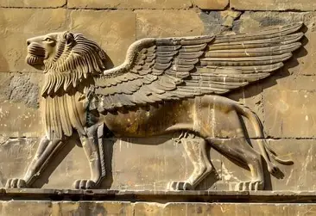
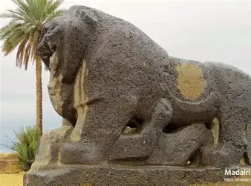
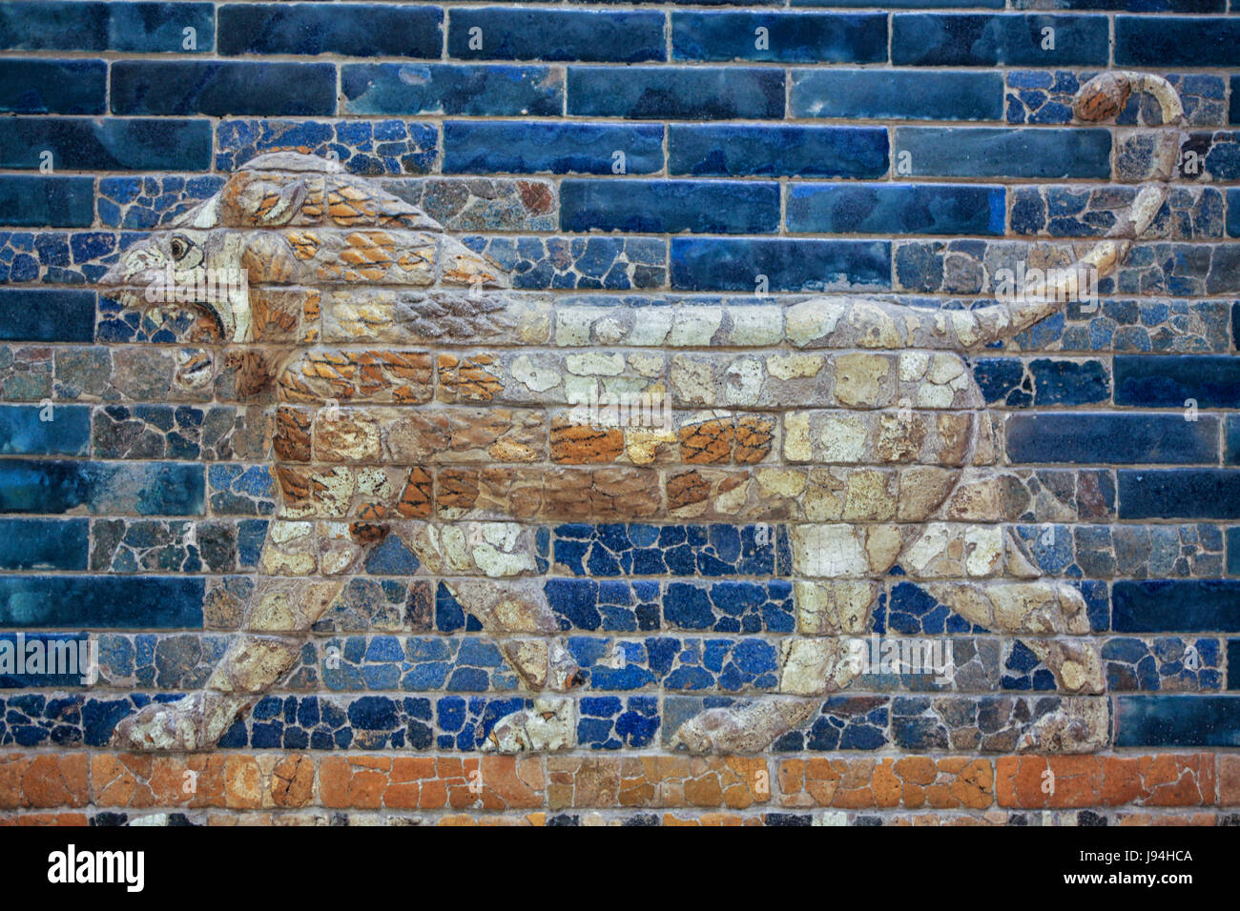
Lion symbolisms found in Ancient Babylon.
In Babylonian culture, the lion symbolized strength, kingship, divine protection, and the power of the goddess Ishtar, appearing in art, architecture, and biblical imagery

Slide 9
Zechariah 1 v 18 – 21: Horns and Craftsmen
The second beast was a bear – this was a lopsided bear (raised up on one side).
Reading about Medo-Persian culture shows us that the Bear was their symbol of strength though artwork on the matter is harder to find than for Babylon.
The bear is seen as having three bones sticking out of its mouth.
The Medo-Persian Empire conquered Egypt, Lydia and Babylonia.
So, the second beast from Daniel 7 almost certainly relates to the breast and arms of silver of the vision in Daniel 2 and relates to the empirical power under which the Jews are subjugated at the time of Zechariah.
Daniel goes on to dream of a leopard-like beast that would come after the Bear, having four wings and 4 heads (the leopard is more known for its speed).
The empire that followed Medo-Persia was Greece and most scholars agree that this represented the rise of Greece under Alexander the Great.
Alexander made a remarkable conquest of the earth during his young life, achieving world domination over the Medo-Persian empire (the imagery in Daniel 8 v 1 - 8 seems to reflect his time and the subsequent division of the Greek empire into four parts after his death).
He died at the age of 30 in an alcoholic stupor, according to history, and having no children or family heirs, his kingdom passed to his 4 generals.
One of these was Antiochus Epiphanes who slaughtered a pig on the altar in the temple in 167 BC – so no friend of the Jews.

Slide 10
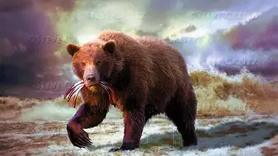
Artist’s impression of the Medo-Persian Bear.

Slide 11
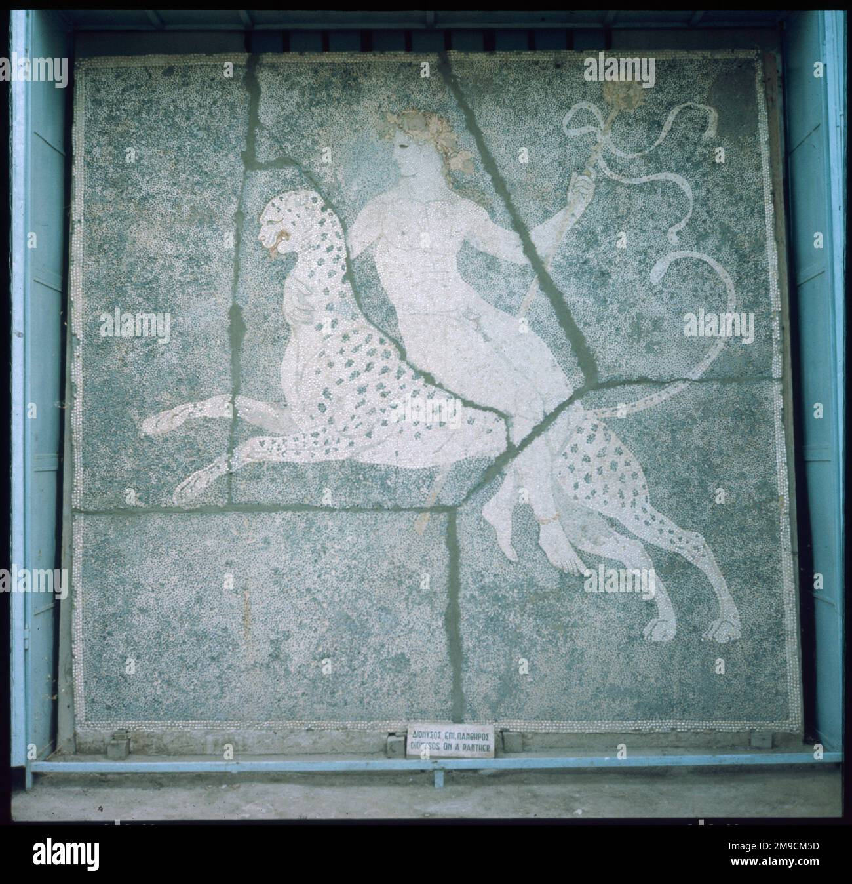
Zechariah 1 v 18 – 21: Horns and Craftsmen
In Greek mythology, the leopard was not a general national symbol of Greece but held specific symbolic importance. The god of wine, Dionysus, is often depicted riding a leopard, which symbolizes his wild, ecstatic, and untamed nature. The leopard’s attributes of speed, cunning, and hunting prowess were seen as reflections of Dionysus’ power and the transformative energy he brought to his followers and rituals.

Slide 12
Zechariah 1 v 18 – 21: Horns and Craftsmen
The last of these empires was Rome, which is introduced to us with lots of ‘Horn’ imagery (Daniel 7 v 19 – 21).
Thus he said: ‘The fourth beast will be a fourth kingdom on the earth, which will be different from all the other kingdoms and will devour the whole earth and tread it down and crush it. As for the ten horns, out of this kingdom ten kings will arise; and another will arise after them, and he will be different from the previous ones and will subdue three kings. He will speak out against the Most High and wear down the saints of the Highest One, and he will intend to make alterations in times and in law; and they will be given into his hand for a time, times, and half a time.
So, all of these scattered and oppressed the Jews, up to Rome, which was the last empire to do this.
So, the testimony of History confirms that Zechariah’s prophecy gave a true account of his present and future history.
So, this leads us on to Zechariah’s ‘craftsmen’.
We know from the last verse (v 19) that these craftsmen are sent to terrify those who have terrified the Jews.
The word ‘craftsmen’ in Hebrew is ‘charash’ meaning a fabricator – someone one would employ to achieve a carefully crafted outcome (KJV says ‘carpenter’).
So, it describes those who will ‘craft’ the response to those who have terrified Israel.

Slide 13
Zechariah 1 v 18 – 21: Horns and Craftsmen
So, we can see that each successive empire has been the ‘Craftsman’ for its predecessor.
At the time of Zechariah’s vision, they had seen the Babylonian Empire defeated by their ‘craftsman’, the Medo-Persian empire.
This Empire would be defeated by its craftsman the Greek empire and the Greeks would eventually be defeated by their craftsman, the Roman empire.
However, this is only 3 craftsmen.
Who is it that will terrify the Roman empire?
The demise of the Roman empire that we read about in our history books was not a single event like the others but occurred over centuries and was mainly caused by political fragmentation, economic failures, partial invasions of parts of the empire, epidemics all put the empire under existential pressure, Odoacer deposed Emperor Romulus Augustulus in 476AD as a result of the general collapse of the empire.
In Daniel 7 v 19 – 24 we see this beast of this empire described and there is a final ‘Horn’ (King) that will arise that is invariably associated with the Antichrist figure of the end times.
In Revelation 17 v 8 – 11 we see the idea that the Roman empire is to be revived. It has never suffered the terror of overwhelming force but has simply imploded and slipped from sight.

Slide 14
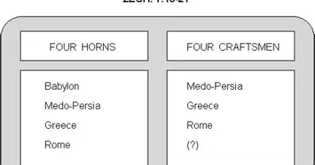

Slide 15
Zechariah 1 v 18 – 21: Horns and Craftsmen
If this is true – and I believe it is – then Rome’s ‘craftsman’ will be Jesus at His second coming when He comes to wage war against the Kingdom of Antichrist.
Rome had associations with many different animals, but none is offered here by scripture.
This beast had a human face and spoke blasphemous words and suffers its terror at a time yet to come at the hand of Jesus when he is cast into the Lake of fire, prepared beforehand for him and his demons.
So, in my estimation, the craftsmen are Medo-Persia, Greece, Rome and, mightiest of all, Jesus.
It is fair to say that some writers disagree with this interpretation of our passage, but this seems to me to be the best and most likely interpretation, given the known history to this point.
God will use evil people and nations to further His own purposes – He did it during the time of Joseph, he promises to do it here and he did it with Judas.
He is doing the same thing in the world today to bring in the antichrist figure and regime – governments promulgating false emergencies such as the so-called climate crisis, resulting eventually in the subjugation of the people so that some will turn back to God.
In the end, though, Jesus will be the final craftsman and will rule over all.

