Slide 1
Matthew 14 v 1 - 12
The death of John the Baptist

Slide 2
Introduction
So, to round-off from last week, we were looking at Jesus’ return to His home-town of Nazareth.
He was utterly rejected once again, despite showing His Messianic credentials to them.
They tried to kill Him by throwing Him off a cliff.
We read that He could do no miracles there because of their unbelief and we deduced that this did not mean that He was incapable but that there were other reasons why He chose not to do many miracles there.
We also clarified that where the Bible referred to Jesus’ marvelling at their unbelief did not mean that it took Him by surprise – that He didn’t see it coming – but that it described a visceral (gut) reaction, despite knowing the outcome ahead of time.
We looked at God’s reaction to His beloved people perishing in Ezekiel 33 v 11 – His heart cry that they should repent and live.
We ran out of time, but we could also have looked at John 11 v 35 where Jesus, at the tomb of Lazarus, wept, despite knowing what the outcome would be.
What we did not get to last week were the points of application from the study, which we will look at now before moving on the Chapter 14.

Slide 3
The return to Nazareth
Applications
There are no contradictions in God’s word, so we need to be diligent to understand it.
Study for yourself and do not believe what your favourite preacher says unconditionally. They are all wrong in part, so be a Berean and read it for yourself.
The emotions we feel are also emotions Jesus feels with even greater intensity.
Jesus’ responses are driven by love – we need to understand his depth of love for us that is not diminished because of His foreknowledge or because He has to judge us, discipline us or correct us.
Jesus went back to His home-town knowing how He would be received, but He persisted anyway – we need to love people more than our fear of their reactions or rejection.
The Gospel is not a message of unconditional salvation for all, but for those who believe: for those who refuse to believe it is an eternal death sentence.
We need to share the Gospel with all and be prepared for gut wrenching sadness (though not guilt) when many or perhaps all reject it.
Now, on to chapter 14.

Slide 4
Chapter 14 v 1 - 12
This passage provides us with the account of the death of John the Baptist.
We may ask what that has to do with the flow of the Gospel we have studied thus far – why does Matthew record it here.
Well, Matthew has spent the Gospel so far giving reassurances about the pedigree of Jesus as Messiah.
He has told the story of the Religious Leaders’ rejection of Jesus, and with it their rejection of the message to ‘repent for the Kingdom of God is at hand’.
The situation in Israel was one of two legal systems – Jewish and Roman.
Herod was not a Jew and was in charge of this part of Israel as a puppet ruler for Rome.
He was also claiming, as his father did, to be pro-Israel and therefore claiming to respect the Jewish Law.
In fact, his father, Herod the Great, claimed to be the King of the Jews, which was why he was so perturbed when the Magi showed up looking of a new King of the Jews – this led to Herod murdering all the children under 2 to try to eradicate the Messiah.
John’s challenge to Herod, as it was with everyone, was that he needed to repent, as what he was doing was not lawful under the Law of God.
This was a natural progression from chapter 12 v 41 & 42 where Jesus had spoken of Gentile Nineveh who did repent eventually.
Both John and Jesus carried a message demanding repentance and were killed because of it.

Slide 5
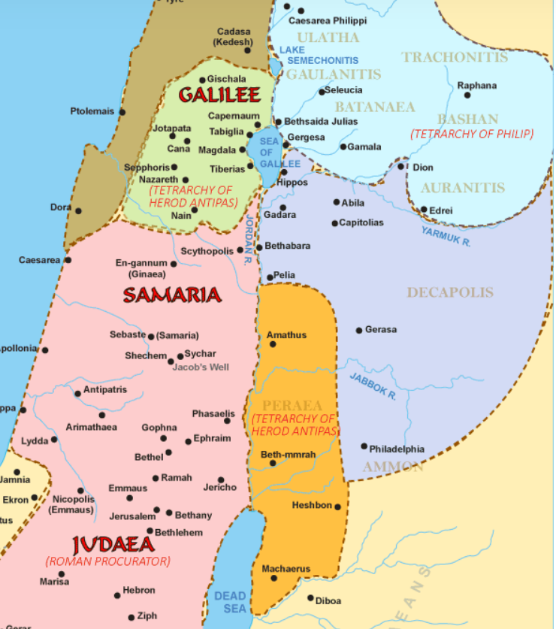

Slide 6
Chapter 14 v 1 - 12
A potted history of Herod Antipas.
He was one of four sons of Herod the Great.
Herod the Great was an evil and vicious ruler who often killed people on a whim.
He executed two of his wives and two of his own sons, as well as various religious and political leaders and, at one time, the entire Sanhedrin.
It was said that it was safer to be Herod’s pig than his wife or son.
His answer to anyone who disagreed with him was not debate, it was execution.
He was also paranoid, hence his concerns about the new King of the Jews (Jesus) who was being born – any threat to his political position was dealt with by execution.
At his death, his kingdom was divided between his four sons, hence the title, Herod the Tetrarch. He was a ruler of a fourth of what was his father’s kingdom.
These were Herod Philip, Lysanius, Archeleaus and Herod Antipas (The Tetrarch) – Plus two that he killed.
He was known to be vicious and paranoid like his father, as well as a paedophile and sexual pervert.
His perversions led to a military conflict in which many lives were lost and much blood shed.
He was originally married to Phasaelis – the daughter of a Nabatean Arab Leader called Aretas IV.
He later divorced her to marry Herodias and the Aretas took military action against him.
He was defeated in this conflict, but was rescued because Rome stepped in and took back his territory.

Slide 7
Chapter 14 v 1 - 12
Herodias was married to Herod’s brother who was known as Herod Philip I.
By this husband, she gave birth to Salome III (of 7 veils fame).
She then divorced Philip and married Herod Antipas.
Salome was therefore his stepdaughter, as well as his niece.
It is thought that she was between 12 and 16 years old – probably about 14.
What kind of an uncle would want to encourage his young teenage stepdaughter and niece to dance erotically in front of him, in front of his drunken lecherous mates and what kind of mother would put her daughter up for this kind of debauchery, dressing her like a whore and putting her on display.
He was a known paedophile, and she was obsessed with getting rid of John the Baptist.
Why the obsession?
Because John had continually brought their own sins before their eyes and said that what they were doing was unlawful.
Interestingly, all of this was probably not against Roman law, but Herod claimed to support the Jews and their Law, so John was pointing out their hypocrisy, as well as their moral bankruptcy.
This enraged Herodias, and John was imprisoned to appease her (Imprisoned in Herod’s palace).
Herod was afraid to kill John, though wanted to, because of the people with whom John was popular – he didn’t want the political boat rocked. He also liked to listen to John.

Slide 8
Chapter 14 v 1 - 12
So, Herod, in this debauched situation created by the Scheming Herodias, makes a promise.
“You can have anything you ask for up to half my kingdom” (He didn’t actually own a Kingdom).
Herodias manipulates this and asks, through Salome, for the head of John the Baptist.
John now has conflicting fears
If he kills John, it might cause political upset with the people; and,
If he doesn’t, he will lose face in front of all his highly placed friends.
As with many of us, what his friends thought of him won the day, so John’s utterly pointless death took place as a face-saving exercise.
There are several learning points for us in this passage, but before we look at them, let’s look at the reason Matthew records this sorry series of events just here in his Gospel.
John came as the forerunner of Jesus, fulfilling the prophecies in Isaiah 40 v 3, Malachi 3 v 1 and 4 v 5.
He was imprisoned and subsequently put to death unjustly and without due process.
He died at the hands of the Roman regime as a means of appeasing others.
This was a rehearsal of Jesus’ death yet to come and modelled the kind of justice that would be meted out to Jesus at the crucifixion – they called for Barabbas to be set free rather than Jesus.
He was killed to appease the crowd, not because he had done anything wrong.
So, when Herod heard about Jesus and all that He had done, he though John had been raised.

Slide 9
Chapter 14 v 1 - 12
This is an odd thought process but tells us something about John’s ministry.
Signs and wonders must have been part of John’s ministry for Herod to make this assumption.
Herod also sought to see Jesus, presumably to check whether this was John (Luke 23 v 8).
However, knowing this, Jesus decided and structured the time when He would meet Herod to coincide with the completion of His work (Luke 13 v 32 and following).
Jesus wasn’t afraid of Herod but simply managed His meeting with him to coincide with His plan.
Applications for us
Both John and Jesus carried an uncompromising message against sin and demanded repentance for salvation – so should we.
They maintained their stance even in the face of death – so should we.
This takes more courage than most of us possess, so we need to pray for God to embolden us and empower us in situations that demand it.
Serving the Lord is costly, and we are deceived if we expect it to be cost-free (2 Sam 24 v 24).
David works on the principle that it will cost him to save Israel from the plague – are we prepared to pay a price to provide an opportunity for salvation to others? John and Jesus both laid down their lives for others.

