Slide 1
Matthew 16 v 1 - 20
Who do you say that I am?

Slide 2
Matthew 16 v 1 - 20
So, over the last 2-weeks, we have seen Jesus take His disciples into Gentile territory, Gentile houses and minister to Gentiles, all of which would have made His disciples very uncomfortable.
Contrary to the will of God, The Jews had, for centuries, not provided love and God’s word to the Gentiles.
Jesus had showed them the error of their ways as He ministered to the Canaanite woman in the same region as Elijah had ministered to a Gentile woman centuries earlier.
He then took His disciples into the area of the Decapolis (ten Gentile cities around Galilee) and ministered to and talked to thousand of Gentiles.
He then performed a similar miracle to the feeding of the 5-thousand when He fed them from 7-loaves and a few fish with 7 large baskets full left over.
He then returned to Magadan/Dalmanutha where He was met immediately off the boat by a group of Pharisees and Sadducees.
This, in itself, is worthy of comment.
These two groups of Jews did not cooperate on any venture. They were diametrically opposed to one another in many practices and doctrines and usually hated each other.
However, they both came together in opposition to Jesus.
Pharisees revered the Law; Sadducees had no time for legalism – they were the liberal theologians of their day. Pharisees believed in a bodily resurrection; Sadducees didn’t etc.

Slide 3
Matthew 16 v 1 - 20
The one thing upon which they were all united was that they wanted rid of Jesus.
Given the Pharisees’ and the Sadducees’ differing view of Scripture, it’s no surprise that they argued over certain doctrines. The Sadducees rejected a belief in the resurrection of the dead (Matthew 22:23; Mark 12:18–27; Acts 23:8), but the Pharisees did believe in the resurrection.
The Sadducees denied the afterlife, holding that the soul perished at death, but the Pharisees believed in an afterlife and in an appropriate reward and punishment for individuals.
The Sadducees rejected the idea of an unseen, spiritual world, but the Pharisees taught the existence of angels and demons in a spiritual realm.
In Acts 23 v 6 we see Paul using these differences to escape the clutches of the religious dignitaries.
Yet they were united in their hatred of Jesus and their desire to destroy Him.
They then asked Him to show them a sign from heaven – literally, a sign called down out of heaven.
They had already had an answer to this request in Matthew 12 v 38 – 45 and Jesus remained consistent in His response.
On the previous occasion He had said they were an evil and adulterous generation and had pointed out that they were going to go from bad to worse – an increase in demonic activity.

Slide 4
Matthew 16 v 1 - 20
Here, He was shorter in His dealing with them but maintained the same diagnosis and the same promise when it came to their expectation of signs.
The only sign they were going to see was that of resurrection (Jonah).
Even in this case, they would not believe (Luke 16 v 21).
He belittles them – you can read the sky, but you cannot read the signs of the times (even when I’m smacking you in the face with them).
He came on time, of the right lineage, born of a virgin, went into Egypt, settled in Nazareth, performed all the messianic miracles, was visited by Gentile Kings who understood who He was, raised the dead and cast out demons and exercised control over the weather, multiplied the food to feed the multitude and still they wanted a sign!!
The only sign left for them was the raising of the dead (publicly), and even faced with that they would not repent and believe.
We note that, seemingly abruptly, He left them, and His disciples went with Him.
We then come to what appears to be a confused moment.
After they crossed over the lake, the disciples realised that they had forgotten to bring bread – nothing to eat, AGAIN!

Slide 5
Matthew 16 v 1 - 20
At the same time, Jesus says, “Beware the leaven of the pharisees and Sadducees” (Mark adds Herod into the mix who had also adversely altered the Law).
The disciples seem to think He was having a dig at them for forgetting the bread.
Jesus was quick to correct them in a way that sort of told them off.
“You of little faith, don’t you remember the 5000 and the 4000”.
The source of as much bread as they could possibly eat was there with them, yet they still didn’t get it!
But curiously He said He was warning them about the leaven of the Pharisees and Sadducees which is hypocrisy (Luke 12 v 1).
This Gospel speaks of the leaven as the ‘doctrine’.
So, let’s dissect this a bit.
The Jews commonly used unleavened bread for their offerings.
The idea that they would allow leaven into their offerings was anathema to them.
However, to be hypocritical was to present in public that which was not true in reality.
So, to insist on fulfilling the Law (of righteousness) whilst seeding the Law with the teachings of men was hypocritical.

Slide 6
Matthew 16 v 1 - 20
In Matthew 15 v 9 (Quoting from Isaiah 29 v 13) Jesus spoke harshly to the Pharisees for teaching as doctrines (of God) the precepts of men.
In this passage Jesus also refers to them as hypocrites – teaching what they themselves do not live out.
The bread of the offering was unleavened – nothing was supposed to be added.
Leaven (yeast) adds nothing of any nutrition. But puffs up and looks good.
The Pharisees and the Sadducees added to the Law, puffing it up with non-nutritional extras and demanded that the people live up to this ‘improved’ Law, whilst being unable to achieve this themselves.
Their challenges to Jesus were mostly centred around their additions to the Law – the keeping of an amended Sabbath.
Healing on the Sabbath, plucking grain on the Sabbath and eating with unwashed hands, for example.
The people honour God with their lips, but their hearts are far from Him.
The teaching of the Pharisees and the Sadducees represents the leaven Jesus was referring to – nothing to do with bread, which was merely a metaphor to help them understand.
After they left that place and went to Caesarea Philippi, Jesus asked the disciples, “who do people say that I am?”
This goes to the root of the whole issue and it still does today.

Slide 7
Matthew 16 v 1 - 20
Their response was a bit better informed than we would produce today. At least they chose Bible characters.
Today we have, some say He is the half-brother of Satan, others the archangel Michael, still others that He was a good man but not God.
The next question is the key.
Who do YOU say that I am?
This has obvious application for all of us and for those we share the Gospel with.
The whole of our eternal security depends upon who we think Jesus is.
Do we believe He is divine (Romans 10 v 9 – 11).
We have already seen that some Gentiles understood who He was and addressed Him as Lord and Son of David (the Canaanite woman, the Roman Centurion and the Magi to give 3 examples).
It would seem that it is only at this point that the disciples understand fully the implications of who Jesus really is.
When Peter, as spokesman for the rest, said, “ you are the Christ, the son of the living God” it had finally dawned on them with whom they were dealing.
Jesus says, “Blessed are you, Simon Barjona, because flesh and blood did not reveal this to you, but My Father who is in heaven”.

Slide 8
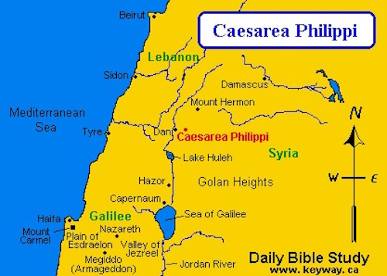

Slide 9
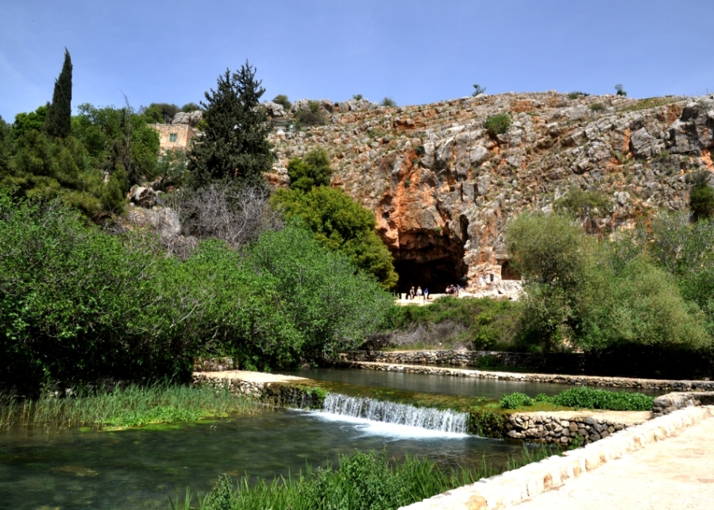

Slide 10
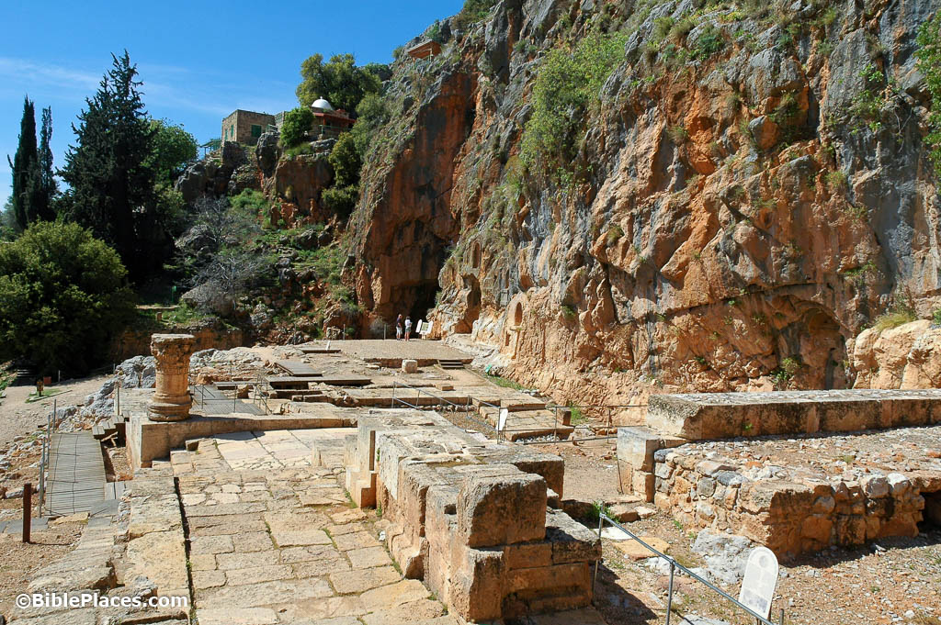

Slide 11
Matthew 16 v 1 - 20
At the end of this section of scripture (verses 18 – 20) we have a source of much unnecessary confusion.
This is still used to this day to support the doctrine of the Roman Catholic Church known as ‘Apostolic Succession’.
Jesus says to Simon, you are Peter – renaming him at this point – and on this rock I will build my church.
They were at Caesarea Phillippi, which is where the headwaters of the river Jordan rise from the ground, before flowing down the Jordan valley to Lake Galilee and on to the Dead Sea.
The large cave at this place was a temple to the Pagan god ‘Pan’. It was also a centre of Baal worship.
We are aware of the story of Peter Pan, Pan Pipes etc. These had their origins with the Pagan god Pan.
Herod the Great had built a temple here for the worship of Pan and Herod Philip, one of his sons, had named the place after himself and the incumbent Caesar (Caesars were viewed as Gods and had to be worshipped), Hence Mark’s reference to the Leaven of Herod.
It was widely believed and feared that entering the cave was a gateway to the underworld (the world of departed souls or ‘Hades’ and that venturing in might result in a person never being able to return.
So, this place was viewed by Pagans as the gates of Hades.

Slide 12
Matthew 16 v 1 - 20
So, it was in this environment that Jesus said “Simon, you are Peter” (Petros – masculine noun meaning a small stone).
“On this rock” (Petra – feminine noun meaning large rock) “I will build my church”.
So, an exploration of the language reveals that Jesus did not mean He was going to build His Church on Peter the little stone but on a large rock – we can see in the background a large rock for comparison.
This was a metaphor for Jesus Himself – perhaps He might have said, “On this rock” indicating Himself.
In 1 Peter 2 v 8 and Romans 9 v 33 Jesus is referred to as the stumbling stone (Lithos - a large fashioned stone(Not a small stone)) and a rock (Petra) of offense.
Paul, writing Romans, was here quoting Isaiah 28 v 16, showing that Jesus (not Peter) was known, prophetically, as ‘The Rock’ in the Old Testament for centuries.
There are prophetic references to Messiah as a great stone in Daniel 2, In Isaiah 8 v 14 and numerous references to this in the New Testament.
So, suddenly there is much more sense in the saying that ‘on this rock Jesus would build His church and the gates of Hades (all the Opagan worship etc) would no prevail against it.
Finally, Jesus says He would give them the keys to the Kingdom of Heaven and whatever they bound and loosed would be bound and loosed in heaven – except that’s not quite what it says, despite the protestations of the word of faith movement.
Peter was being told that things that Heaven had already declared bound or loosed, they, as servants of God, would be able to bind and loose in the earth.
In other words, they were commissioned to bring about the will of God, expressed from Heaven, on the earth.

