Slide 1
The Resurrection
The most significant event in human history

Slide 2
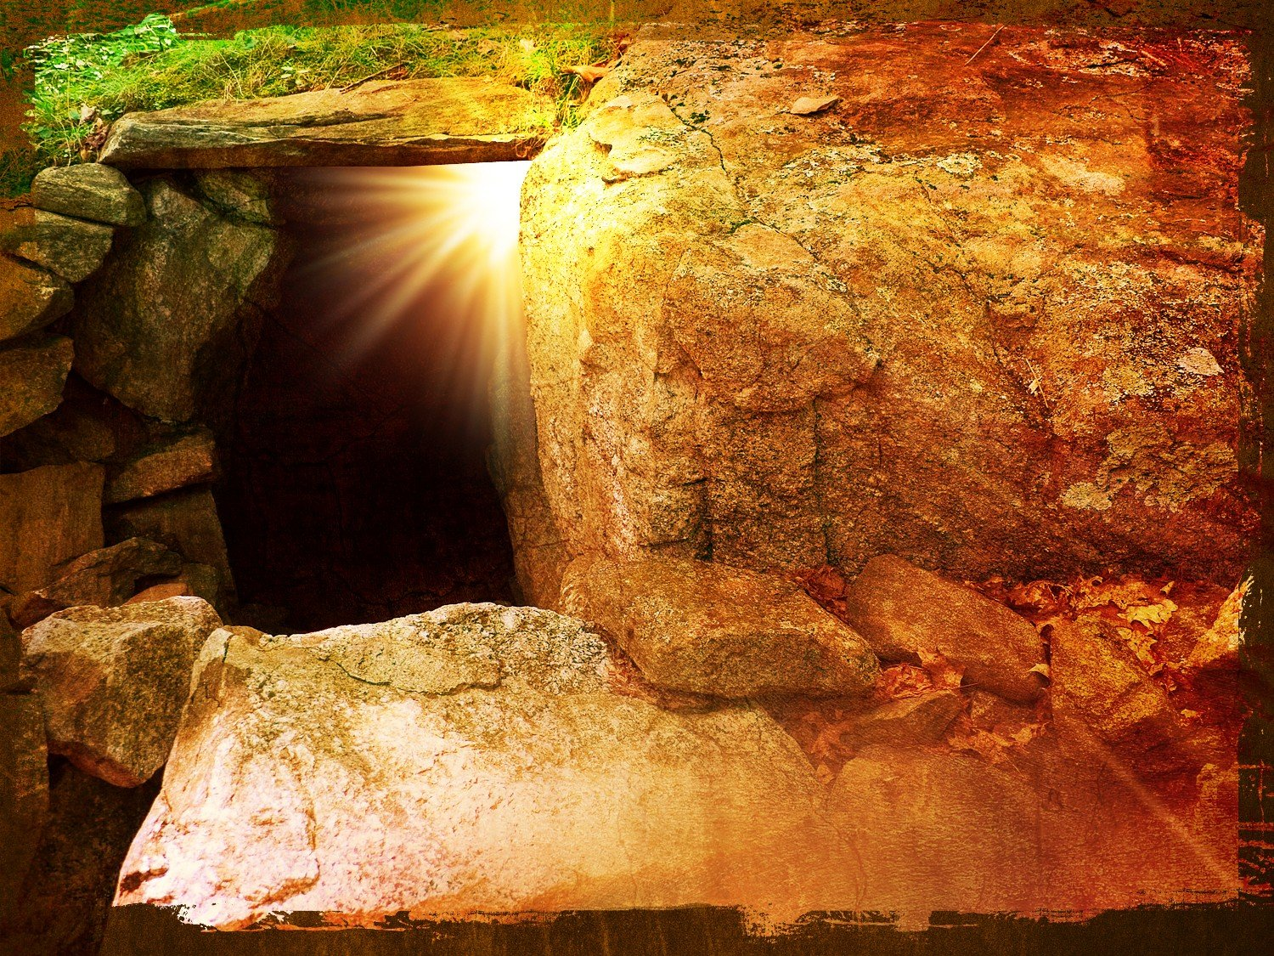

Slide 3
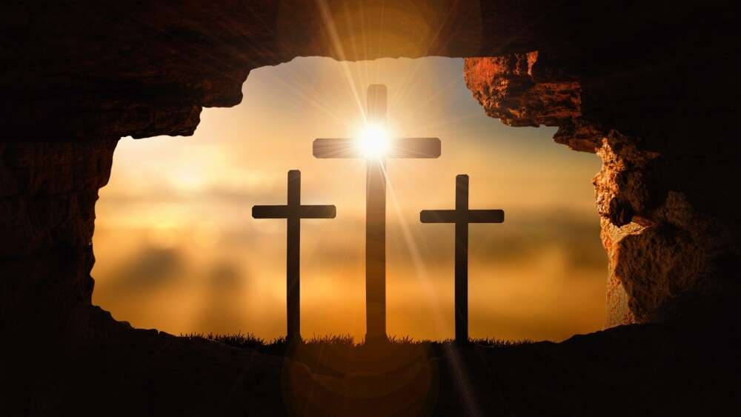

Slide 4
The Resurrection
So, let’s imagine: we’re in the shoes of the disciples on the first Good Friday.
All our hopes and drams have been lost.
Jesus has told us numerous times that He must be put to death by the authorities, ‘according to the Scriptures’.
He also said that He would rise again the third day, ‘according to the Scriptures’.
In the book of Acts, chapter 2 beginning at verse 22, Peter , when preaching the Gospel after Pentecost, alludes to the resurrection.
He speaks of the fact that Jesus being handed over for execution was ‘planned’ – It was God’s plan all along, which is why Jesus was able to prophetically warn of its approach.
In his message, Peter takes us to a prophetic, Messianic Psalm, psalm 16, and quotes from verse 8 – 11.
Peter uses this as one of the places that the scripture predicts Jesus will rise again.
Many believe that this is a Psalm in which David is speaking of himself, so not Messianic.
However, this cannot be the case, as the passage in Acts points out.
David has died and has suffered decay – his tomb can be visited to this day, and it remains sealed (there is some disagreement over where the site is, but none over whether David is dead).
So, David was speaking in the first person as though of himself, but God was speaking of Himself, through David

Slide 5
The Resurrection
Verses 30 – 32 then seals the resurrection promise from the Old Testament and cites Jesus as the fulfilment of this prophecy.
Peter says a Resurrection was promised and Jesus fulfilled that promise.
In 2023 we looked in detail at why we can confidently believe that the resurrection actually took place. You can get the notes for that talk from this link. https://1drv.ms/p/c/fe8bf2b6eea63579/EXk1pu628osggP5JFgAAAAABwfXyCfQDXZ4assjQRIAPCQ?e=lX5in5
The recording of the talk is at https://1drv.ms/u/c/fe8bf2b6eea63579/EXk1pu628osggP5CDQAAAAABPjwDdCeQvdMu03i3ZMR9VA?e=4k4pdq
This morning, we are going to look at why this is important and what provision God brought to us in His resurrection.
One of the reasons it is important is that the resurrection, if it happened (and it did), proves the Bible to be true and elevates its status as God’s word.
It prophetically promised Messiah’s resurrection – if it happened it’s true and if it didn’t it’s false.
For the moment we’ll leave aside other issues like the timing, the place etc. all of which the Old Testament speaks of, and stick with, “if it didn’t happen, we can all burn our bibles, our faith is void and we are still in our sin and not saved (1 Corinthians 15 v 12 – 19).
Given the massive historical attestation to the Resurrection, I’m going to presume that we all agree that the event happened (those not in agreement can use the links above).

Slide 6
The Resurrection
So, we know that Jesus died at Passover, fulfilling the feast to the letter.
Passover prophesied that the blood of the lamb (identified by John the Baptist as Jesus in John 1 v 29) would protect God’s people when the firstborn died (Jesus was God’s firstborn son who died, and His blood protected us from God’s wrath and judgement).
But this feast is followed closely by the feast of first fruits – Jesus is referred to as our first fruits (1 Corinthians 15 v 20 – 23).
The feast looked back to when God provided Israel with a good harvest and celebrated this fact – it was a convocation (Gathering) of thanksgiving.
You can read the brief from God about this feast in Leviticus 23 where once the harvest was in and sheaved, one would take the first sheaf of the harvest to the priest and wave it before the Lord and the Lord would bless the sheaf, and by extension, the whole harvest.
The first sheaf was acceptable to the Lord and therefore all the subsequent sheafs were also acceptable to the Lord.
If, as the first sheaf, Jesus was acceptable to God, then all subsequent sheaves presented will be acceptable too.
The resurrection guarantees that all of us of the harvest of souls are acceptable to the father.
As our first fruit of the harvest of souls, when He was presented before the Lord, the Lord accepted the whole harvest – amazing.
Whatever is true of the first sheaf becomes true of all the sheaves.

Slide 7
The Resurrection
So, What was true of the first sheaf – Jesus?
Well, He was given a ‘resurrection body’, and so shall we be (1 Corinthians 15 v 39 – 49).
This will be different from our earthly bodies – will have attributes we do not have.
Jesus is His resurrection body passed through walls, yet could be felt, touched and could eat fish and bread (John 20 v 19, Luke 24 v 36 – 43).
There are some teachers that say that the linen cloths lying there implies that Jesus did not cast them off, but arose through them, so they would have been left, as it were, deflated.
There is every reason to believe that the stone was not rolled away do Jesus could get out, but so that the disciples and others could get in to witness the lack of a corpse.
After all, He later appeared to the disciples by entering a locked room – the stone was no barrier to Him.
I have no idea whether this is correct, but a resurrection body would permit this.
If it can pass through walls, then cloth should present no problem.
So, we will have glorified bodies like Jesus did after His resurrection.
These will be recognisable, tactile, able to eat and drink, but also able to pass through walls and, for all we know, able to move between dimensions.
So, what else?
Well, in 1 Corinthians 15 v 15 & 52 we read that flesh and blood, perishable and mortal cannot enter the Kingdom of Heaven.

Slide 8
The Resurrection
Jesus, the first sheaf, is able to enter the Kingdom, as He is not on flesh and blood drive but Holy Spirit drive.
So, we too will have the same capability to enter the Kingdom of heaven.
One of the matters the death of Jesus dealt with was to bring about perfect justice, in that all sin has been justly paid for – tetalesti (Paid in full).
Of course, justice is decided and judgement meted out by a judge and for that judgement to be righteous, the judge has to be righteous.
For an innocent man to be put to death for the sins of the unrighteous can hardly be called justice if there was no resurrection.
However, if the righteous judge paid the penalty for the sins and rose from the dead to confirm that all accounts had been settled, we have a new starting point in heaven.
We have returned to the place where Adam was before the fall, with no barrier of sin between man and God.
Only because of the resurrection are we guaranteed fully righteous justice in eternity.
In 1 John 2 v 1 & 2 we are told that we have an advocate (defence lawyer) in Heaven who is Jesus Christ the righteous who is also the propitiation for our sins.
Propitiation is a noun that describes the gaining or regaining of the favour of someone, usually a deity.

Slide 9
The Resurrection
In Pagan religions they would make sacrifices to the God of the sea or the crops or the weather in the hope that the particular God would be propitious towards them.
The resurrection of Jesus shows us that God accepted His sacrifice and as a result is now propitious towards us – we have regained His favour.
No resurrection, no propitiation.
But we have a resurrection, God did accept the sacrifice, the demands of a righteous God have been satisfied, He is propitious towards us, and we can enter into His presence.
We infer from Daniel 12 v 1 & 2 that all human beings are eternal beings and will be resurrected as Jesus was.
Resurrection involves a body, it’s not some spiritual equivalent where our spirit is raised. Our first fruit had a bodily resurrection and so shall all of us (2 Corinthians 4 v 14, Romans 6 v 4 & 8 v 11, 1 Corinthians 6 v 14 & 15 v 20).
For believers, our first-fruit ensures we will be raised to everlasting life, not to everlasting disgrace and contempt.
My last comment for this morning is that the Resurrection of Jesus guarantees to us the presence of and indwelling of the Holy Spirit.
Jesus said, “But I tell you the truth, it is to your advantage that I go away; for if I do not go away, the Helper will not come to you; but if I go, I will send Him to you” (John 16 v 7)
So, no resurrection, no Holy spirit – Jesus said that if He didn’t return to the father The Spirit would not come

Slide 10
The Resurrection
The Apostle Paul teaches us that He has given us of His Spirit as a pledge (a promise or a downpayment or a guarantee) in 2 Corinthians 1 v 21 and 5 v 5.
John teaches the same principle in 1 John 4 v 13 – we know or can have confidence because He has given us of His Spirit.
So, no Resurrection, no Holy Spirit, no downpayment or promise or pledge, no helper, no one to lead us into all truth.
If there was no resurrection, then according to 1 Corinthians 15 v 19 we are among all men, most to be pitied.
So, Thank God, there was a resurrection, fulfilling many ancient prophesies, witnessed by many, confirmed by Jesus’ enemies, that produced a world-changing church from frightened men who became exemplars of courage, changed the worship practises of believing Jews overnight.
Because of the resurrection, we can have confidence in our salvation.

