Slide 1
The Feast of Trumpets
Yom Teruah – the time of blowing
The Jewish Rabbis taught that this was the day God created the Universe or that this occurred on 25 Elul so that the 1st of Tishri was the day Adam and Eve were created.
They also taught that this was the day Abraham offered Isaac.
Bing Videos
Rabbis placed significance on the fact that ‘Bereshit’ (Genesis) reads 1st Tishri if the letters are reorganised,

Slide 2
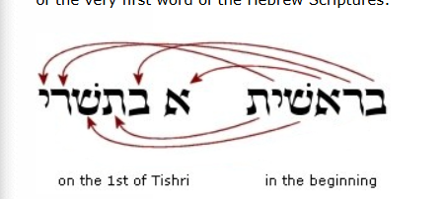

Slide 3
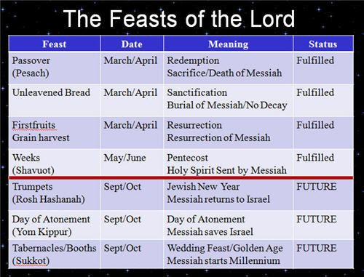

Slide 4
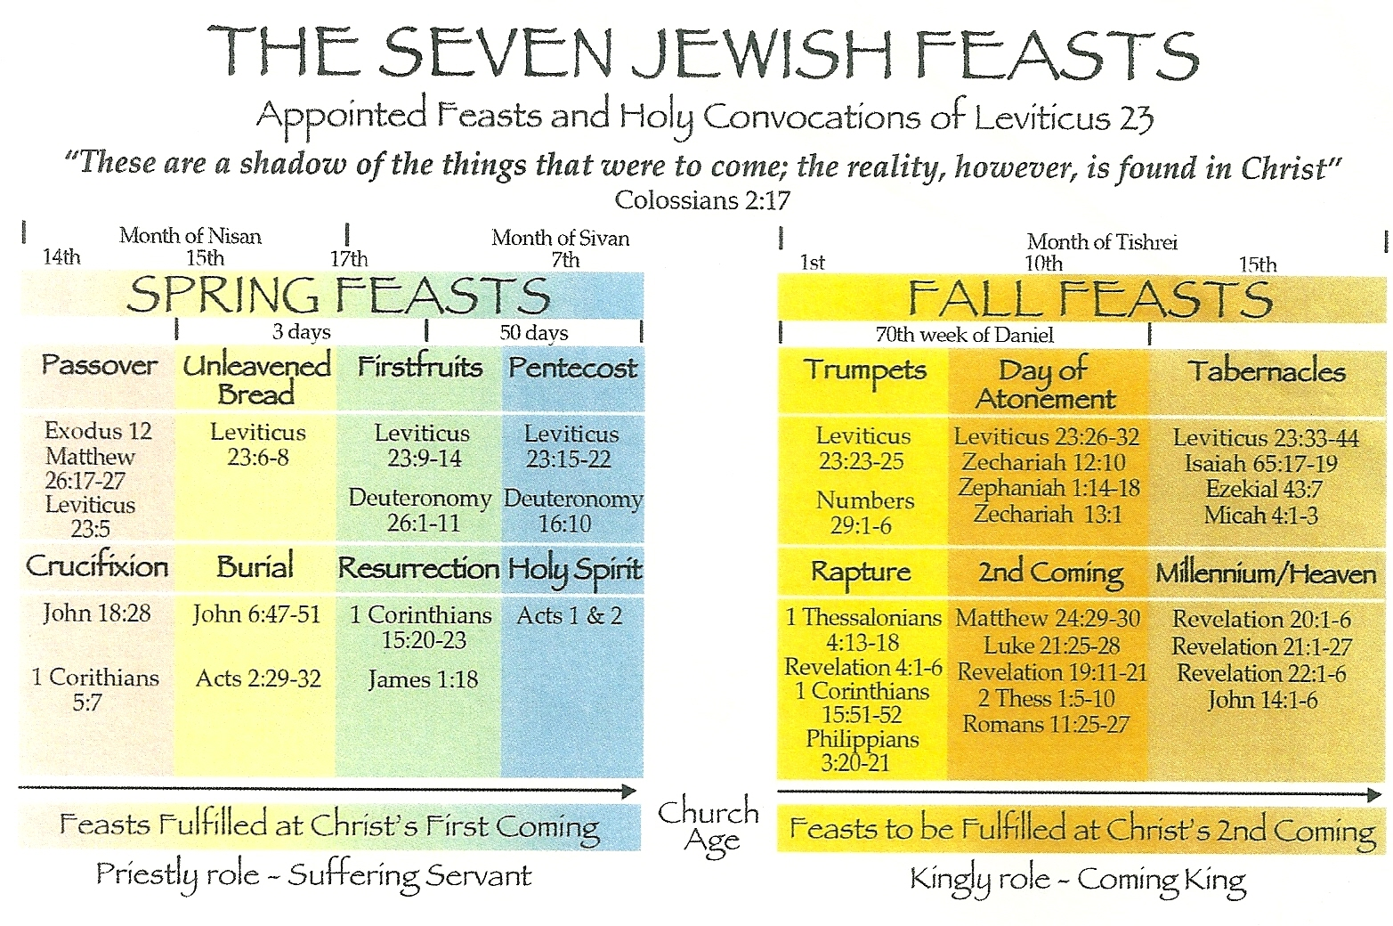

Slide 5
The Feats of Trumpets - Yom Teruah
In the feasts so far, we have seen that they prophesied future events.
They were based upon historical events but revealed events yet future at the time of writing.
The first four feasts were fulfilled by Jesus’ first coming and put together they spoke of a series of consecutive events as follows:
  The crucifixion (Passover)
  Jesus’ burial (Unleavened Bread)
  Jesus’ resurrection (First Fruits)
  The coming of the Holy Spirit (Pentecost and the birth of the church)
These feasts spoke of Jesus’ role as the suffering servant.
In a similar fashion, the remaining three feasts speak of a series of events associated with Jesus’ second coming. They are feasts of expectancy and do not seem to relate to past events.
The Feast or trumpets is the first of these autumn feasts and it had several commonly used names, so its significance was quite wide and varied.
The Feast began officially on the 1st of Tishri – the 7th month of the religious calendar but the 1st month of the civil calendar (Remember that God designated Nisan as the first of the months at the first Passover).
So, the Feast is at Israel’s civil New Year, hence one of its names is Rosh Hashanah (The Head of the Year).
It is another ‘Harvest’ feast, celebrating the wheat harvest – the last of the grain harvests.

Slide 6
The Feats of Trumpets - Yom Teruah
  Yom Teruah: Literally means “Day of Blowing” or “Day of the Sounding of the Shofar.” This is the biblical name found in Leviticus 23:24 and Numbers 29:1, emphasizing the trumpet blasts that mark the holy convocation and memorial of the day.
  Rosh Hashanah: Hebrew for “Head of the Year,” this is the common Jewish name for the feast today, marking the beginning of the Jewish civil new year. It is associated with creation and the start of the High Holy Days.
  The Day of the Awakening Blast: A prophetic and spiritual title highlighting the shofar’s role in awakening the soul and calling for repentance, as well as symbolically awakening the dead at the time of the Lord’s return.
  The Day of the Sounding of the Shofar: Emphasizes the central ritual of trumpet or shofar blasts, which serve as a memorial and a call to attention for spiritual reflection.
  The Wedding Day of the Messiah: A symbolic name used in prophetic interpretation, reflecting Jewish wedding imagery where the Messiah comes to claim His bride, representing the faithful.
  The Day Which No One Knows: Refers to the uncertainty of the exact day due to the lunar calendar and the two-day observance, symbolizing the unknown timing of the Lord’s return.
  Zicharon Teru’ah: Means “memorial of triumph” or “shout for joy,” highlighting the celebratory and commemorative aspects of the feast, enthroning God as King.
  Yom Truah: Another biblical designation meaning “day of blowing the trumpet,” reinforcing the ritual of trumpet blasts.
  Yom Ha Melech - The announcement of the coming of the King.

Slide 7
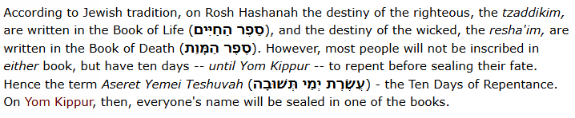
The Feats of Trumpets - Yom Teruah
  As the end of the month of Elul approached, the emphasis on repentance increased, particularly as they introduced a week of prayer known as ‘Selichot’.
  These prayers were special prayers for forgiveness, recited in the early hours of the morning in the Synagogue to help with the preparation for the coming feasts.
  On the day before Rosh Hashanah the men will go through a ritual washing (Mikveh) and the Parokhet (Ark cover) is changed for a white cloth, symbolising purity.
  The blast of the Shofar is supposed to break us out of sleep and cause us to remember who we are by remembering that The Lord is our King.
  There were two kinds of trumpet referred to in the Bible – the Shofar (ram’s horn) and the silver trumpet referred to in Numbers 10 v 1 – 4.
  The Silver Trumpets were blown only by the Priests and used to call the people to ordered corporate worship or meetings.
  The Shofar could be blown by anyone and had several uses, it was not a primitive trumpet.

Slide 8
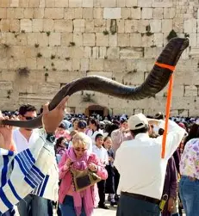
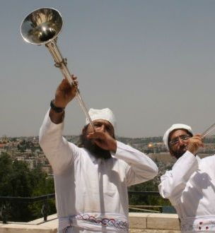

Slide 9
The Feats of Trumpets - Yom Teruah
  We read the instruction for the Feast of Trumpets in two places in the Bible.
    Leviticus 23 v 23 – 25 – a Sabbath rest and a reminder.
    Numbers 29 v 1 – 6 – a whole day for the blowing of the Shofar.
  Because of the importance of this feast, the Jews would devote the whole of the previous month (Elul) to mental and emotional preparation for this feast.
  Elul means something that stick out or protrudes, in the sense that it refers to something that should not be there.
  This tradition almost certainly has its origin in the necessary practice of taking out the tares from the wheat harvest – removing that which should not be there.
  This was a metaphor, also, for dealing with one’s own imperfections and sins – rooting out that which should not be there.
  So, the month of Elul was a time of reflection and self-examination leading up to the Feast of Trumpets (Yom Teruah).
  As we can see from the various names, the Feast was a symbolic preparation for the coming (second coming) of the King – The Messiah – and the purpose was to make sure one was found ready, being in repentant heart and having examined oneself honestly and thoroughly.
  One of the names for this day is very curious – ‘The Day Which No One Knows’.
  This name referred to the fact that the celebrations could not begin until the Priest had seen the New Moon.
  Sometimes the New moon could not be seen because of atmospheric conditions, so because of this uncertainty, no one knew when it was going to be until it was declared.

Slide 10
The Feats of Trumpets - Yom Teruah
  Of that day and hour no one can know: only the Father knows.
  2-days were set aside for this Feast because of the uncertainty of verifying the New Moon. (Incidentally, the Feast of Tabernacles, 2-weeks later, was always on a full moon).
  Every New Moon was a rest-day unto the Lord and was like a Sabbath except that food preparation was permitted, though no productive work. This new moon was special.
  So, the Feast recognised that The King and Messiah was going to come in Judgement and the trumpet blasts were a reminder to rehearse for this.
  And the Feast marked the beginning of what is known as ‘The Days of Awe’.
  This period was to allow preparations for the Feast of Atonement, where God’s people were to ‘humble their souls’ ready for judgement, either of the sinner or the scapegoat.
  By extension, the humbling of souls implied the elevation of a righteous God – understanding that no one deserved to be before Him, much less blessed by Him.
  The month of Elul followed by this feast and the days of awe led to the conclusion that it was only by God’s grace that they were allowed to live and enjoy God’s provision.
  This is a 10-day period of reflecting upon and expressing sincere sorrow for one’s sins that had come to one’s attention over the preceding month.
  A time of mixed emotions because there was gratitude for the plentiful harvest but also deep sorrow for falling short of God’s standards.
  On the Feast Day itself, offerings were made for sin as well as thanksgiving offerings.
  It was a celebration of the fact that they were blessed, not because of what they were, but in spite of what they were. Bitter-sweet one might say.

Slide 11
The Feats of Trumpets - Yom Teruah
  Both this feast and the Feast of Atonement were symbolically in preparation for the coming of Messiah, anticipating final judgement.
  The process of humbling the soul, leading to the conclusion that one has nothing to offer the King, but was reliant upon His mercy and grace.
  In Leviticus 23 v 28 to 30 we read that those who would not observe these feasts and/or cease from working would be cut off/destroyed by God.
  There was a logical flow from one feast to the next, raising awareness of the sinful condition throughout the month of Elul, the symbolic arrival of the King at Yom Teruah, the days of deep sorrow combined with gratitude for the grace extended by the King, leading to the passing of judgement at the Feast Of Atonement.
  It is very interesting that the Jews gave over a period of almost a month and a half every year to the serious consideration of their sins and the need to get right before their God (it is more done by rote these days, like our reciting the Lord’s prayer).
  These days, the majority of churches make very light of the matter of sin by comparison.
  Because of what took place on the Day of Atonement, the extreme gravity of sin and the insuperable barrier it presented to fellowship with their King or Messiah was in the forefront of their thinking.
  This then leads us to the questions about how we should respond to the teachings of this feast.

Slide 12
The Feats of Trumpets - Yom Teruah
  Does this feast refer to Jesus coming, second advent, when all Israel shall be saved (Zechariah 12 v 10 & Romans 11 v 26)?
  Does it refer to the Rapture of the Church , when Jesus comes for the Church?
  If one listens to a broad spectrum of teachers on this matter, both views are expressed and even the view that both are true – a kind of double fulfilment.
  Personally, I believe this is a Jewish festival aimed at encouraging Jews and possibly those who come to faith during the Great Tribulation (the last 7-years of history) and that it therefore relates to the 2nd coming of Jesus.
  Why do I say this? Well, the Rapture of the church is not followed by judgement of believers’ sins and has no process that leads up to it, it happens in a moment, in the twinkling of an eye (1 Corinthians 15 v 52).
  This Feast clearly speaks of a process that leads to forgiveness and reconciliation – a process that has already taken place for the church.
  We are not waiting for Him to return to us on earth, we are waiting for Him to call us up to Him (1 Thessalonians 4 v 17).
  When He returns, we will return with Him (1 Thessalonians 3 v 13, Jude 14 & 15 & Revelation 19 v 14).
  So, what are we supposed to gain from knowing about this Feast?
  Insight into the character and holiness of God.
  A realisation of our helplessness in dealing with our own sin.
  A conviction about our need for and dependency on the grace and mercy of God.
  The feats exhorts us to keep our lives under constant review before the Lord.

