Slide 1
Matthew 26 Part 2
Gethsemane
Verses 36 -46

Slide 2
Matthew 26 Part 2 – verses 36 - 46
You will recall that last time we learned from the early parts of this chapter that there was a plot to try to kill Jesus, other than at Passover.
We saw that Jesus arranged to eat the Passover with His disciples and at this time He instituted the Lord’s Supper – what is often called the breaking of bread.
We also read of Mary, sister of Martha and Lazarus, anointing Jesus with Spikenard – a very expensive perfume – for burial.
We saw Judas Iscariot complaining that this could have been sold for over 300 denarii – about a year’s wages. Judas was a thief and was stealing from the Lord’s funds.
Jesus revealed that He knew of the plot to kill Him and that one of the disciples (Judas) would betray Him.
Judas was given 30 pieces of silver to betray Him, fulfilling Zechariah 11 v 12.
We saw 2 major sins committed – betrayal by Judas (Paradidomi given over) and denial (disowning) by Peter.
The former lacked true repentance and was not forgiven, and the latter was forgiven because of heartfelt repentance and remorse.
So, we read that all of the disciples had said the same as Peter, that they would rather die that deny Him, but all of them fell away, as Jesus predicted.

Slide 3
Matthew 26 Part 2 – verses 36 - 46
Now we move to the next stage of the day of crucifixion.
After they had eaten the Passover meal and in the absence of Judas who had left the gathering to go to the religious leaders to betray Jesus.
This is important because when Jesus had said He would once again drink the fruit of the vine with them in the Kingdom, Judas was absent (John 13 v 21).
Satan had entered immediately into Judas at the time when Jesus had addressed him on the matter of betrayal (Luke 22 v 3).
We also learn from Luke’s account (Luke 22 v 39) account that it was customary for Jesus to go the Garden of Gethsemane – one of the reasons Judas would know to where he should lead the arrest squad.
The Garden of Gethsemane was, so history tells us, a privately owned, walled garden.
Evidently Jesus knew the owner and used it regularly.
Gethsemane means ‘oil press’, and, like many biblical words, has a dual meaning of Eight presses or the eighth (8 is the number of resurrection).
So this was a place of crushing where all of the olive oil would be pressed from the fruit of the olive trees (olives).
The oil was always a symbol of the Holy Sprit, so, at this place of crushing, Jesus’ spirit was poured out for humanity.
He was crushed in His spirit ‘to the point of death’ (Matthew 26 v 38)

Slide 4
Matthew 26 Part 2 – verses 36 - 46
And just as the oil would flow from the olives, Jesus blood would flow for the first time, as He sweat great drops of blood from His brow because of the anguish He suffered.
Hematidrosis is the name for this rare but not unknown medical condition.
A condition where the sufferer’s sweat is mixed with blood at times when they suffer from extreme stress and anxiety.
It is thought to be a result of the capillaries, usually in the brow, rupturing (perhaps one of the origins of the saying, “don’t burst a blood vessel” when referring to stress or sometimes anger).
What we see here is the humanity of Jesus – distress, fear, anxiety etc. mixed with omniscience (He knew in every detail what was about to happen to Him (Psalm 22).
The condition is known to be frequently fatal; hence an Angel was sent to strengthen Him.
Note that the Angel took nothing away from His suffering but strengthened Him to endure it.
All of the suffering was essential to pay the price for our salvation.
We do well to remember that the sacrifice for our deliverance included deliverance from sin and sickness, and included mental health – eternally there will be none – no sin, no sickness, no anguish, no pain – perfect resurrection bodies free from fear, stress and poor mental health.
He has not given us a spirit of fear but of love, power and a sound mind (2 Timothy 1 v 7).
He died to set us free from mental anguish eternally.

Slide 5
Matthew 26 Part 2 – verses 36 - 46
Verse 39 – Jesus said, “Father, if it be possible, let this cup pass from me, yet not as I will but as you will”.
In other words, if there is any other way this can be achieved, can we do that instead?
In order to pay for all sin for all time for all men, Jesus had to drink the cup of God’s wrath (Jeremiah 25 v 12 – 17 & Isaiah 51 v 12 – 23 & Psalm 75 v 6 - 10) to the dregs.
In Revelation 16 v 1 we see the outpouring of the bowls of God’s wrath; the culmination of what starts after Revelation 8 v 1 where what was unveiled was so breathtaking that there was silence in heaven for half an hour.
Yet even this seems insignificant compared to the final outpouring.
This, drastic though it is, is not the end of the draining of the cup of God’s wrath, but the beginning of it, and it has to be drained to the dregs.
The responses described in Revelation demonstrate how fear-inducing this exposure to a diluted form of God’s wrath is.
However, Jesus was fully aware of the reality of what was to come, as He drank the undiluted cup of God’s wrath for us in all of its ferocity.
“Father if there is another way!” But there was no other way for us to be saved.
Many so-called Christian pastors and teachers struggle with the idea that the Father could put His Son through such a barbaric death.
But this scripture shows that they did this by agreement. It was planned between them.

Slide 6
Matthew 26 Part 2 – verses 36 - 46
In Matthew 26 v 53 we read, “Or do you think that I cannot appeal to My Father, and He will at once put at My disposal more than twelve legions of angels?”
At any time, He could have pressed the stop-button on the whole scenario, but He chose not to.
The Father and the Son had agreed to purchase back humanity from the slave market of sin (the true meaning of redemption).
Jesus had said, “I’ll pay” and the price was so costly that He needed angelic support to carry it through.
It involved complete humiliation and the outpouring of His blood, which began at Gethsemane (though had been decided in the hearts of both Father and Son before the foundation of the world (1 Peter 1 v 18 – 20 & Revelation 13 v 8).
Let’s look at Psalm 22 v 6 – a Psalm that reveals that Jesus knew all that was going to occur at the crucifixion.
Here the Lord says, “ But I am a worm and not a man, A reproach of men and despised by the people”.
The description of Jesus as a mere worm spoke of His humiliation, yet the worm described here – lost in the English translation – is ‘Tola-at’.
The Tola-at was a small crimson worm that was crushed up to make very expensive red dye, so in a sense was both very humble and very valuable. Another name for the same worm is ‘Shaniy’

Slide 7
Matthew 26 Part 2 – verses 36 - 46
But the symbolism doesn’t stop here.
The Tola-at was/is a worm that climbs up to a high spot on a tree and affixes itself to the wood with its own secretions (a kind of cocoon).
It then gives birth to its young (eggs) under its own body and within the cocoon.
The young then feed off the body and blood of the worm and it dies to give life to them.
At the end of the process there is a red stain left on the wood.
Over time, the red stain is bleached white by the sun – “Your sins are red as crimson, but they will be like wool (Isaiah 1 v 18)”.
I will submit to you that our sustenance by the blood of Jesus began at Gethsemane where He suffered the sweating of His blood – it is here that the red stain began to form.
Psalm 22 also informs us that, from the Lord’s perspective, the ‘Bulls of Bashan’ were surrounding Him.
According to most reputable commentaries, this indicates a high level of demonic activity around Jesus at the time.
The plaguing of the mind with fear, doubts and anxieties is all part of the demonic activity humans suffer. The shed blood of Jesus paid for this too.

Slide 8
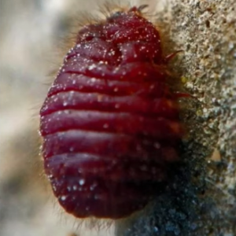

Slide 9
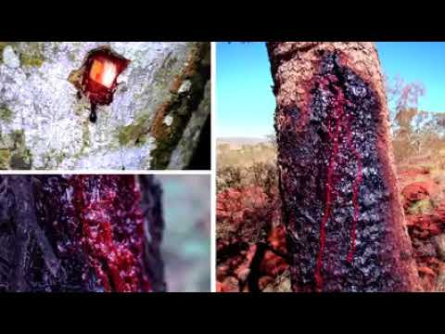

Slide 10
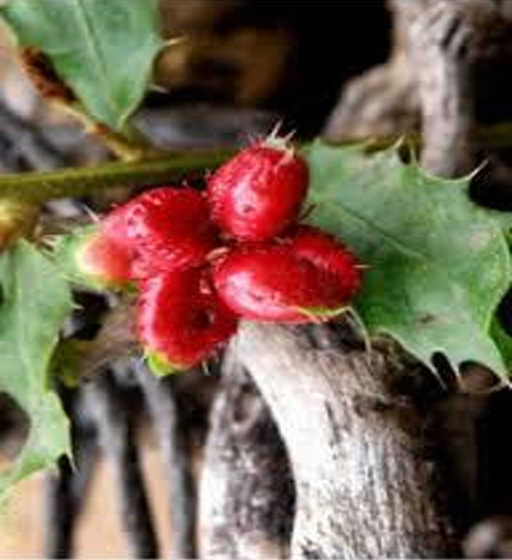
A Treasure Hunt for a Worm

Slide 11
Matthew 26 Part 2 – verses 36 - 46
We note that Jesus asked three times if the cup could be taken from Him.
There is no record of an answer.
This has similarities with Paul’s beseeching of the Lord three times to remove his thorn in the flesh – a messenger sent from Satan to buffet him (2 Corinthians 12 v 7 & 8).
Here we see messengers from Satan sent to buffet Jesus and His three-fold request for another route – but God graciously sent an angel, and this is the only recorded response.
God did not offer an alternative way out and neither did He compel Jesus to go through with it, hence Jesus was able to say, “no man takes my life from me: I lay it down” (John 10 v 18).
From a Midrashic perspective – the temptation in the garden was the beginning of the fall of man in Genesis chapter 3, and the temptation in the Garden was the beginning of redemption from sin.
Satan in the form of a serpent was in the first garden and was also in the last garden (the Bulls of Bashan and in Judas Iscariot).
We read also in John 19 v 41 that Jesus was buried in a garden – sin arose in a garden and was buried in a garden.
This is further evidence of a wonderful plan of redemption, not just a barbaric murder.
Application: Colossians 3 v 15 – 17 – a deeper understanding of God’s word causes thanksgiving to erupt in the heart of the believer.
Fall in love with His word (Matthew 4 v 4, Psalm 119 v 11 & 47 – 48 & 105, Hebrews 4 v 12, Isaiah 40 v 8, 2 Timothy 3 v 16, John 1 v 1 & 14, Job 23 v 12 & Ephesians 3 v 10 & 14 – 21).
30 Powerful bible verses that talk about the importance of god's word (Full Commentary) - Bible Study For You

Slide 12
Matthew 26 Part 2 – verses 36 - 46
Tola/Shaniy references
Exodus 16 v 20 the worm would eat the leftover Manna and it would stink.
Deuteronomy 28 v 39 – the Tola worm will destroy the grapes of sinful Israel.
Isaiah 14 v 11 – two worms the second one is a Tola, associated with the fall of Satan.
Isaiah 41 v 14 – Israel referred to as a Toleth and associated with the Lord’s redemption of it.
Isaiah 66 v 24 – the Tola will eat the flesh of those who transgress against God.
Jonah 4 v 7 – it smote the gourd over Jonah Took away his peace and covering.

