Slide 1
Matthew 10 v 16 - 25
Sheep in the midst of wolves:
The road of persecution.

Slide 2
INTRODUCTION
Last time we began to look at Jesus’ plan to use others to propagate His Gospel.
How He asked all disciples to pray for the Father to send workers into the harvest fields.
How He then commissioned the 12 to preach that the Kingdom of Heaven was at hand, accompanied by healings, the cleansing of Lepers, deliverance from demons and the raising of the dead.
Jesus established in His teaching that those He called (including some seemingly unsavoury and unsuitable men such as Judas Iscariot, Boanergese and Simon the Zealot (terrorist)) should not use their ministry to acquire wealth but should trust God for His provision and that this provision would always be sufficient for those He truly called.
One might infer from what is written that if you have been called, you will also have been empowered. We are all called to some extent to share the things of God – the Word, prayer, resources, exhortation to good works etc.
God certainly empowered the Apostles and others in the early church and may do so today too.
However, Jesus did not present us with a formula – a means of coercing God to do things.
What we now come to are Jesus’ warnings about a life following Him will bring.

Slide 3
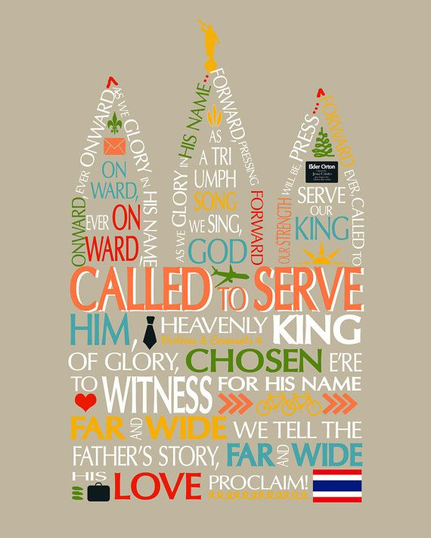

Slide 5
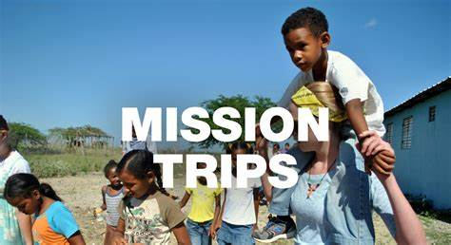

Slide 6
Ernest Shackleton’s advertisement for a South Pole expedition
Men wanted for hazardous journey. Low wages, bitter cold, long hours of complete darkness. Safe return doubtful. Honour and recognition in event of success.

Slide 7
Matthew 10 v 16 - 25
When calling people, particularly young people into the mission field there are many strategies used, most of which go something like this:
Join us for an exciting project in which you will see remote parts of the world, help people, meet new people, make new friends – it will be a wonderful adventure.
In short, what is portrayed is how going on a mission trip will do you the world of good – will be of benefit to you.
The mission societies will produce a program identifying what your food will be and when you will have days off and opportunities to explore the areas etc.
How your luggage will be looked after (both large suitcases).
Very few (and possibly none) will say, “oh you’ll need to trust God for your food and clothing. You should take no money or spare clothes. You will probably suffer extreme persecution, violence and even death and as for your families, say goodbye to them because you might never see them again.
The motivation to go into the mission field is all too often fearful and selfish – we will only go if there are some guarantees about our food, safety and general wellbeing.
We are about to read the Jesus standard for entering the mission field where those that go are willing to die for the privilege of doing so, whose only motivation is the salvation of those to whom they have been sent.

Slide 8
Matthew 10 v 16 - 25
So, Matthew 10, continuing from verse 16 (remembering the context established in verse 6 of this chapter.
Jesus said, “I send you out as sheep in the midst of wolves”.
The first thing to notice is that if you send a sheep out to evangelise wolves, the sheep cannot play Rambo when attacked.
When we attempt various endeavours – sports success or other team ventures – we often have mascots and will name them after savage and indomitable animals – ‘The Tigers’ or ‘The Bears’.
We probably would not favour ‘The Sheep’ as our intimidating similitude.
“Don’t mess with us, we’re the sheep”.
The connotation is that, if you come for us, we do not fight back.
We can do nothing in our own defence except run, and we don’t even do that very well.
Jesus was (and is) the Lamb of God and we read that He was silent like a sheep before its shearers during His trial and at His crucifixion.

Slide 9
Matthew 10 v 16 - 25
So, the ongoing exhortation is to be shrewd as serpents – we saw Jesus wisely avoiding trouble where possible (going late to the feast of tabernacles for example in John chapter 7) – there was no need to go looking for trouble – sheep generally don’t look for trouble.
Then there is what should be a surprising warning – that the ones to fear the most were the, so-called, people of God – ‘they will bring you before the courts and scourge you in their synagogues’ – and your families (religious fervour divides families now)
It is clear that Jesus intends this to provide opportunity for testimony against both unbelieving Jews and Gentiles.
They will speak out in courts, affirming Christ and rejecting the ways of their accusers, right up to and including royal thrones.
A daunting prospect – scourging, persecution, unjust court appearances and you can’t even fight back.
In verse 19 they are told, “when they hand you over” – so they’re going to scourge you and then hand you over: you, just continue to be like sheep and go along with all of it.
I can imagine them thinking, “Me!? Speaking to Kings and dignitaries? What on earth will I say?

Slide 10
Matthew 10 v 16 - 25
Pre-empting this, Jesus says, “Don’t worry what you will say, as it will be given to you when you need it”
So, you have to trust that God will provide you with abilities, phrases, oratory and courage far beyond what you normally have.
Speaking personally, I know what a coward I can be, especially when faced with pain, so I have to trust that if or when I face the equivalent of scourging for my faith and if I have to speak to important but hostile people, I will be able to stand my ground, say the right things and otherwise be a sheep and won’t fight back.
The promise to these disciples – and I believe to us too – is that it is not we who speak, but our father in us.
When we think about this, we should be reassured that God has done this – spoken through men who have no special capability – for millennia.
The whole of the Bible was produced in this way.
Some were scholarly, like Paul, but others were not, like Peter. They were supernaturally gifted in the moment to say and do what was necessary.
A picture is painted of a Christ hating society where family members will betray each other to death because of their faith – not uncommon today in some parts of the world.

Slide 11
Matthew 10 v 16 - 25
They (and we) are told that we will be hated by all because of the name of Jesus, but, just like sheep, we are to endure it and say nothing other than what God gives us to say.
The slightly disturbing line is ‘those who endure to the end will be saved’
This word needs to be understood in context – it means those who stand their ground will be delivered from the hardship they are going through.
This could mean temporally or eternally. Many disciples were martyred but eternally protected.
The next verse is an interesting one, which shows this to be primarily addressed to Jews and referring to Jewish history.
It speaks of a time when Jesus will come a second time – you will not finish going through the cities of Israel until He comes (see also Matthew 24 v 29 – 31).
Many preterist teachers interpret this as referring to AD70, however, Jesus did not come at that time.
I am going to suggest that this refers to His next coming (2nd advent) when Jewish history (now paused from a biblical point of view) comes off pause and is allowed to complete its last 7-years (listen to the Rapture recordings for clarity on this).
If this interpretation is correct, it means that these instructions were aimed at disciples beyond the generation that Jesus was teaching, as all these apostles were dead within 70 years of this teaching (most of them within 40 – 50 years).

Slide 12
Matthew 10 v 16 - 25
It is a separate study, included in more detail in the Rapture series, but Jewish history as the harbingers of the oracles of God continues until Matthew 12 when they commit the unforgiveable sin and once and for all reject Him as Messiah.
69 weeks of Daniels 70 weeks prophecy have passed, and Jewish history is put on hold – the Kingdom has been postponed (Matthew 23 v 37 - 39).
The 70th week begins when the Great Tribulation starts, sometime after the Rapture of the Church.
At the end of the Great Tribulation ‘The Son of Man comes’.
This is the only time He comes to earth and for His elect nation.
The progress of Israel was temporarily terminated in 70AD, after which they ceased to be a Nation, being scattered all over the earth (known as the diaspora).
To achieve God’s plan of Establishing His Kingdom with an Israel who were all saved, God needs to take them through the last 7-years of their history, which will bring them to the place where they will publicly declare Him as their Messiah and King, fulfilling the prophecy in Zechariah 12 v 10.

Slide 13
Matthew 10 v 16 - 25
In the last two verses of the morning’s study, Jesus says,
“A disciple is not above his teacher, nor a slave above his master. It is enough for the disciple that he become like his teacher, and the slave like his master”
Jesus was saying that whatever was the case for Him is what we who follow Him and serve Him can expect.
Our aspiration should be to be like Him and not better than Him (in the sense that we should not seek to forego the suffering, the insults or the defamation.
It is sufficient for us to be Like our master.
They have called the Master of the House (Jesus) Beelzebul, what do you suppose they’ll call you?
“You are in for the same kind of rough ride that they gave me”.
As we were saying last time, to be like Him, we have to speak out against unrighteousness and sin, forgiveness and the Gospel and be Kind and compassionate, as well as defenceless like sheep.

