Slide 1
Zechariah 2
The Man with the measuring line

Slide 2
Zechariah 2 – the Man with the measuring line
So, we are still in section 2 of the book of Zechariah.
You may recall that the book divides logically into 4 sections.
The first is the first 6 verses of chapter 1 in which God calls Israel to return to Him.
It is clear from the tenor of these verses that the Lord wants to fellowship with His people again, having exercised discipline over them because of their rebellion.
His exhortation is to return and be different from their forefathers.
The second section is from chapter 1 verse 7 to the end of chapter 6.
This section contains 8 visions, all of which took place during a single night (probably a very restless night).
We have so far looked at the first two visions, the first of which was actually an expansion of chapter 1 verse 15.
The first vision described a man on a red horse among the myrtle trees in the ravine or hollow – the low place.
We deduced that this was Jesus (a Christophany) pictured as battle ready and surrounded by a military force of the heavenly hosts all mounted on horses.
Verse 15 expressed His anger at the severity with which the nations had dealt with His people.

Slide 3
Zechariah 2 – the Man with the measuring line
Vision 2 expanded on this theme and spoke mysteriously through horns and craftsmen as to how YHVH would deal with those nations.
We should recall that this was with reference to past, present and future oppressors of the Jews.
We noted the principle that God would use Israel’s enemies to judge them when they were disobedient and would then judge those enemies once they had served His purpose.
So, now we come to the third vision, which is an expansion of verse 16 of chapter 1 in which God speaks of the certainty that His house will be built and in which He states that a measuring line will be stretched over the city.
The third vision is described in the whole of chapter 2 and begins with the Man with a measuring line in his hand. Let’s read it.
Scholars broadly agree that this man is the same one that was sat upon the red horse in the first vision, and so is a reference to Jesus.
The passage differentiates between the Man with the measuring line, the angel who speaks with the Prophet and the angel that comes out to meet him.
There appear, therefore, to be three beings present – 2 angels and the Man with the measuring line.
The Prophet asks what the Man with the measuring line is doing and the response is that He is Measuring Jerusalem – checking to see whether Jerusalem measures up.
This Man is overseeing the development of Jerusalem – something Jesus would do.

Slide 4
Zechariah 2 – the Man with the measuring line
This is an obvious reference to a future Jerusalem – one that is not yet developed but the Man with the measuring line knows what it needs to measure.
It puts me in mind of the New Jerusalem described in Revelation 21 v 10 – 27, which is very precisely measured and designed.
In verse 4, the second angel informs the first angel that he should tell Zechariah that there will come a time when Jerusalem will be inhabited ‘without walls’ because of the large number of cattle and people in it.
To the people hearing this, there would have been incredulity.
When they left Babylon, the majority of the Jews stayed behind, having carved out a life for themselves there and were safe under Cyrus.
50,000 (approx.) of them went back to Israel and only about 5000 of them lived in Israel – Ezra 2 v 64 & 65 and Nehemiah 11 v 1. Jerusalem was sparsely inhabited in Zechariah’s day.
To hear that Jerusalem was going to be so populous was the first source of their incredulity.
The second cause was that every city was seen to need walls for its own protection against enemies – it would be defenceless without.
Indeed, it would not be long before the walls would be rebuilt under Nehemiah.
So, this must have been referring to a Jerusalem yet future when God would protect them.
In verse 5 He says He will be a wall of fire around them and will also be the glory in the midst of her (Jerusalem). Ezekiel 43 v 1 – 9 is also instructive here.

Slide 5
Zechariah 2 – the Man with the measuring line
This imagery is redolent of the times when God went with them through the wilderness as a pillar of fire by night and of cloud by day.
He always protected His people when they were obedient.
We also read of Israel dwelling in unwalled villages at the time of the Gog and Magog battle in Ezekiel 38 & 39 (Particularly 38 v 10 – 13).
Arguably, we are now at a time when the land of Israel and Jerusalem do not depend upon walls for defence, though we are not yet at a time when they dwell securely from attack.
However, the Prophet speaks of a time yet future when this will be the case and their only protection will be the presence of their God.
Verse 6 is very interesting in that the Prophet instructs them, from YHVH, to flee from Babylon, described here as ‘the land of the north’.
Babylon was actually to the east of Jerusalem, so why the reference to the people of the north, confirmed as Babylon in verse 7?
As we see from the map, to get to Jerusalem from Babylon, one has to travel north because of the Arabian desert, and so if one approached Jerusalem from Babylon, one would come from the north.
This leads to a further question, which is, ‘were those who stayed behind disobedient to YHVH?’
I think possibly yes, though I wouldn’t be dogmatic about it.

Slide 6
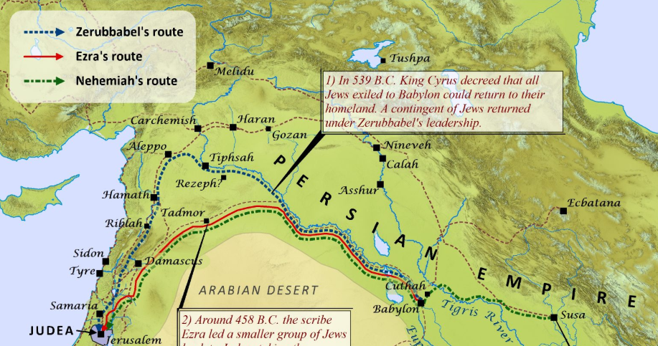

Slide 7
Zechariah 2 – the Man with the measuring line
The time in question is the one we read about in the book of Esther.
A strange book in many ways – one in which the name of God is not overtly mentioned (It is concealed in the text in several ways but not immediately obvious).
Also, the topic of prayer is not mentioned, though fasting is.
Had they obeyed this word, they would not have been in Babylon for the whole scene with the dreadful Haman.
The Jews in Babylon were threatened with extinction but, arguably, should not have even been there.
In the end they were delivered by Esther’s obedience to God and her courage in putting her own life on the line.
But it seems that whilst Esther’s obedience to God was celebrated, as was Mordecai’s wisdom and leadership, God did not obviously put His name to this period in Babylon (Persia).
It is a separate and fascinating study as to how the name of God and specifically Jesus is concealed in the text of Esther, but to give us confidence that Esther should be in the Bible, we will look very briefly at just one example of God /Jesus including His name in the book .
We have Malcolm to thank for drawing my attention to this. It is one of several examples we could use, and I am only going to give one example today, though we will return to its principle in later chapters.
In the New Testament Jesus says of Himself that He is the Alpha and the Omega (Rev 1 v 8)

Slide 8
Zechariah 2 – the Man with the measuring line
However, Jesus was not Greek, He was Jew, so He almost certainly said, “I am the Aleph and the Tav”, which was later translated to ‘Alpha and Omega’.
We also have Old Testament verses that speak of the ‘word of God’ coming through the prophets, saying, “I am the first and the last”. (Isaiah 41 v 4 & 44 v 6)
So the ancient texts of the Tenakh contain multiple (hundreds) of seemingly meaningless insertions of the Aleph/Tav (the first and last letters of the Hebrew aleph/bet).
This is a none-word, but we can think of it as an insignia for Jesus, as He, Himself, claimed it (a bit like an initial).
These are spread through the Hebrew texts – about 700 of them (some say as many as 900), yet English translators never include them because they are none-words: I believe we are the poorer for not having these translated because they teach us about God.
All of them show a particular connection with something of importance to Jesus – something that denoted His ownership, His presence or His creative power.
It appears in the creation account ‘In the beginning God created the heavens (Aleph/Tav) and the Earth (Aleph/Tav).
There are 13 occasions where this signature is used in the book of Esther, most of which are in chapter 4 and 9.
I have drawn out just one example for the next slide from chapter 4 v 7.

Slide 9
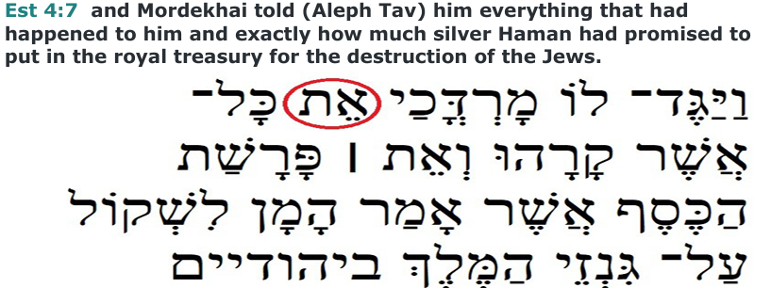
Here God is owning or declaring His presence in Mordekhai’s intervention, which saved the Jews from extinction.

Slide 10
Zechariah 2 – the Man with the measuring line
So, back to chapter 2 of Zechariah.
In verse 8 YHVH says that ‘after glory’ He has sent Me against the nations which plunder you, for he who touches you, touches the apple (pupil) of His eye’.
This phrase means ‘after he has shown His glory’ or ‘ after your glorious deliverance’
This is a reference to Deuteronomy 32 v 9 - 12 where God (YHVH) describes His deep and loving relationship with Jacob/Israel – His love is present whether he is dealing with Israel (the new name and in fellowship) or Jacob (the old name - supplanter/ heel catcher – out of fellowship).
So, what YHVH is saying in verse 8 is that whoever touches Israel is effectively poking Him in the eye. His glory is not abstract but is tied to the welfare of His people.
It is worth noting here that we have ‘YHVH has sent ‘Me’ (the Angel of the YHVH – Jesus) against the nations which have plundered Israel (God YHVH has sent God the Son – evidence of the concept of the trinity).
He will wave His hand over them and they will become plunder for their slaves – the slave owners will become slaves themselves of the ones they enslaved (also found in Isaiah 14 v 2).
In chapter Zechariah 8 v 22 & 23 we see a prophecy in which Israel has risen to new heights in the estimation of the other nations.
I believe we have never seen this to date, so I believe it refers to the millennial Kingdom – slave-masters do not have to be harsh but in charge.

Slide 11
Zechariah 2 – the Man with the measuring line
The last 4 verses of the chapter emphasise that YHVH is going to dwell in the midst of His people.
The hearers/readers of this word are exhorted to rejoice because the Lord (YHVH) is going to possess Judah and AGAIN choose Jerusalem.
This makes Jerusalem a holy city and the land of Judah a holy land.
I am not aware of time yet, when Israel was living peacefully, without antisemitism and was revered by its former enemies.
However, we are very much aware that God is protecting His holy land and holy city.
In 2 Chronicles 6 v 6 when Solomon dedicated the temple it is recorded that YHVH had chosen to have His house in Jerusalem.
In his prayer of dedication, Solomon had foreseen a time when the people would be estranged from their God (YHVH) and had prayed that whenever they prayed in or towards Jerusalem, He would remember them and forgive and restore them.
Solomon’s prayer is being answered in the days of Zechariah.
You may recall that Daniel had prayed towards Jerusalem (Daniel 6 v 10 & 11) under threat of death – this led to him being put into the lion’s den.
Daniel’s prayer was answered and the Jews were delivered from Captivity whilst He was protected from the hungry lions.

Slide 12
Zechariah 2 – the Man with the measuring line
Points of application
God’s covenant with Israel (both the land and the people) and with Jerusalem as His chosen city was and remains eternal.
Take care over the way in which you deal with, speak of and pray for Israel.
You may not always agree with the politics of the people of the land but should remain cognisant of the fact that God has chosen them – let’s not poke God in the eye!
Understand that just as God has owned His people and has plans to save and elevate them, so He has also owned you if you have given yourself to Him as a slave of righteousness (He will lift you up in the last day – John 6 v 37 – 40).
Treasure this in your heart.
Lastly, always remember that YHVH wants you to turn from sin and back to Him.
Hosea had prophesied a couple of hundred year prior to this that there would come a time when His people became ‘not my people’ because of their persistent sin.
However, the road to restoration was available to them for them to become ‘my people’ again (Hosea 6).
Let’s respond quickly and humbly to YHVH rather than spend decades estranged from Him.

