Slide 1
The Feasts of the Lord
Pentecost – The Feast of Weeks or Shavuot

Slide 2
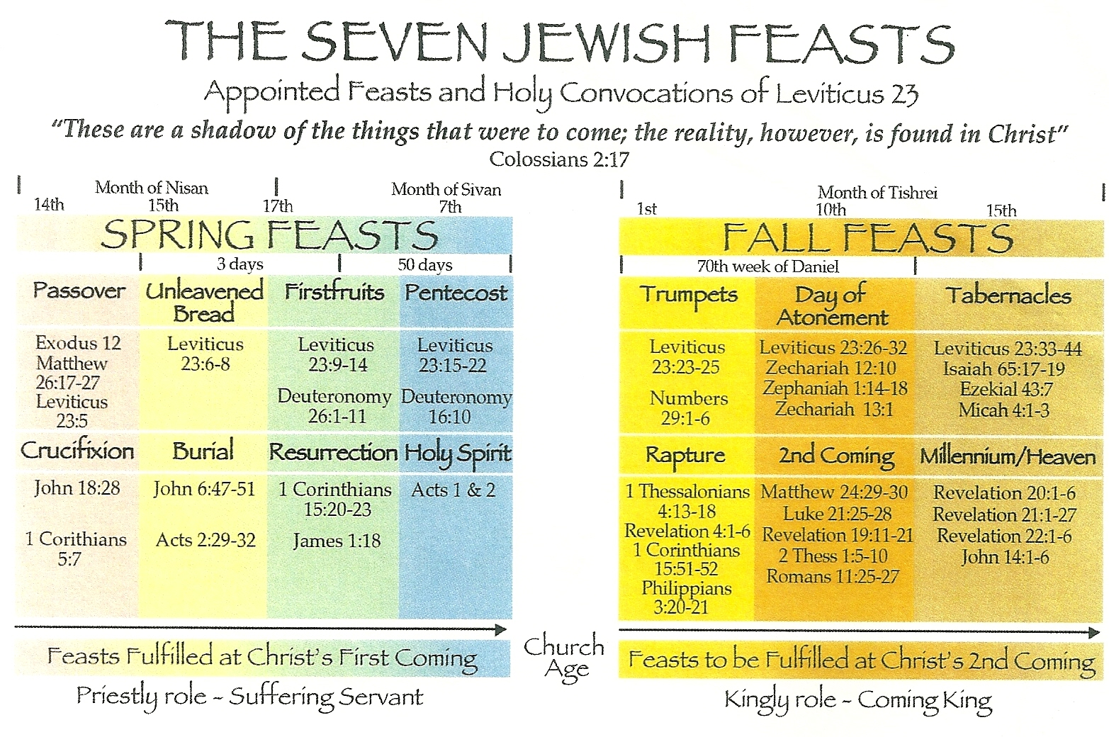

Slide 3
The Feasts of the Lord - Pentecost – The Feast of Weeks or Shavuot
So, we are going through a series explaining the Feasts of the Lord.
The Feasts (or appointed times) are prophetic and metaphoric ‘rehearsals’ of future events and so serve the dual purpose of celebrating something that God has done, whilst anticipating something that God will do in the future.
We began with the Feast of First Fruits, as we made this our Easter study – the Feast speaks of the resurrection and Easter is all about the resurrection, so it seemed appropriate to cover it on that day.
We have since looked at the Feast of Passover, which celebrates God’s dealing with Pharoah and releasing the Jews from slavery in Egypt.
The Passover Lamb was sacrificed in this feast as an emblem or a metaphor for Jesus – they were saved from the Angel of Death because of the blood of the lamb on their door-frames, just as men would be saved from the final judgement of their sins by the shed blood of Jesus.
Last time we studied the Feast of Unleavened Bread, which celebrated the Jews’ passage through the Red Sea and also spoke of the process of going forward from salvation, ultimately to a time when sin would be utterly consumed from the earth and would no longer affect us. This feast began as Jesus was buried on the 15th Nisan – His death brings life.
So now we come to the Feast of Weeks or Shavuot or Pentecost.
Once again, this Feast celebrates God’s past provisions and prophesies future events in which God would deliver His people.
In the case of this feast there are several noteworthy aspects to it.

Slide 4
The Feasts of the Lord - Pentecost – The Feast of Weeks or Shavuot
We see the instructions for the Feast in Leviticus 23 v 15 - 25 and Deuteronomy 16 v 10.
In Leviticus we see the corporate celebration and in Deuteronomy the individual offering.
So, if we count 49 days from the first day of Unleavened Bread and then look for an event on the next day – the 50th day – where do we end up?
We come to the 6th of Sivan with the 50th day being the 7th Sivan.
Whilst there is no fixed date in the Bible for either the Feast of First Fruits or for the Feast of Weeks (Shavuot) – they are dependent upon when the harvest comes in – it is a Jewish tradition that Shavuot takes place after this elapse of 49 days, on the 6th of Sivan in the belief that this was the case on the first occasion of its celebration.
These days, the Jews do usually have set dates for this, though the Bible simply relates these feasts to whenever the first fruits come in from, in this case, the wheat harvest.
At first examination, then, this is a celebration of the First Fruits of the later, wheat, harvest.
It is the origin of our ‘Harvest Festival’ and one of its purposes is to thank God for the harvest yet to be harvested (though we tend to hold it at the end of the harvest).
The other very memorable event that took place on the 6th Sivan was that God came onto Mount Sinai and gave the Law to Moses.
This was an event accompanied by fire and smoke (Exodus 19 v 18 & 24 v 17).
So, we have a visitation from God, we have fire and smoke, and we have the people being equipped with knowledge of how to please God.

Slide 5
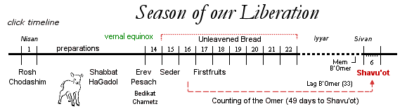

Slide 6
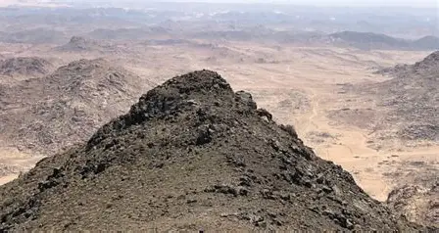
Blackened mountain peak in Sinai

Slide 7
The Feasts of the Lord - Pentecost – The Feast of Weeks or Shavuot
So, this was the occasion, and the Feast itself required the Priests to take two loaves of leavened bread as a wave offering before the Lord.
So why leavened bread this time, rather than unleavened.
And, why two loaves?
There are conjectures about the two loaves.
Some say they represent the two houses of Israel and others say they represent Jews and Gentiles.
I think when we look at what happened in the New Testament at the final Pentecost, this question answers itself, and we will come to that.
All seem to agree, however, that the two loaves represent people that belong to God despite bearing remnants of the sin nature.
If we take the view that leaven represents influence rather than just sin, we can infer that the leavened loaves can be waved before God because they have come under a new influence.
The waving of the loaves represents the people giving thanks for God’s provision of life sustaining food for them (it was an admission of dependency on Him).
Jesus is the bread of life (John 6 v 35) and in this sense He is seen in the loaves – He is the one we uphold before God as his provision for us and we give thanks.

Slide 8
The Feasts of the Lord - Pentecost – The Feast of Weeks or Shavuot
The Jews always believed that the Law was given at Shavuot.
But in terms of its celebration, it was treated almost entirely as an agricultural festival right up to 2 BC.
However, the Jews saw the feast also as a completion of the Passover season.
The previous three feasts were seen as feasts of liberation from something.
In practice, from slavery in Egypt, from the threat of the Egyptian army and from the potential for starvation.
Shavuot, was therefore seen as being liberated into something new, and in practice, they were liberated into this new and fertile land that flowed with milk and honey, that gave them plentiful harvests year-on year (the final Pentecost was also a liberation into something new).
But also liberated to follow the Law of Moses, as it is believed that the Law was given to the Jewish people on Shavuot.
It gave them knowledge of what they needed to do to please Him and be called righteous.
It is interesting that the Law also brought with it a threat that if one failed to keep it one would be in trouble, having offended God.
This thought has an obvious parallel for Christians. When we accept Jesus as our Savior and Lord, we are liberated from the law of sin and freed to follow the Law of God (Rom. 7 v 1 - 25).
The Law was given, we learn from the New Testament, to show us that we could not keep it.
Galatians 3 v 24 tells us that it is a schoolmaster to bring us to Christ – to show us that we need saving.

Slide 9
The Feasts of the Lord - Pentecost – The Feast of Weeks or Shavuot
Shavuot was one of three feasts for which there was a requirement for all males to make a pilgrimage to Jerusalem to participate (Deuteronomy 16 v 16 & 17).
16 “Three times in a year all your males shall appear before the LORD your God in the place which He chooses, at the Feast of Unleavened Bread and at the Feast of Weeks and at the Feast of Booths, and they shall not appear before the LORD empty-handed. 17 “Every man shall give as he is able, according to the blessing of the LORD your God which He has given you.
In Leviticus 23 v 18 & 19 we read that the thanksgiving for the harvest – the wave offering and the grain offering – were accompanied by the sacrifice of lambs goats and bulls as sin and peace offerings.
So incorporated into the Feast was the contrast of presenting the leavened loaves (symbolic of people still carrying their sin nature) and a sacrifice for those sins, bringing freedom from judgement (a picture of Christ).
So, this was a celebration of what the Jews had been released into – the land of milk and honey, plentiful harvests and the righteous Law of God.
It’s worth mentioning in passing, the connection to the year of Jubilee, which was another celebration in which in the principle of 7 X 7 with a special emphasis on the 50th is seen, only this time it is not spoken of in days but in years.
Leviticus 25 tells us that in the Jubilee year everything reverted back, property was restored to those who had become poor, land was returned to those who had been forced to sell, and the land had a Sabbath for 18 months.

Slide 10
The Feasts of the Lord - Pentecost – The Feast of Weeks or Shavuot
All of these things were a constant confirmation of God’s covenant with His people, that He would provide for them in the Land of Promise if they would seek to obey His Laws.
In Exodus 19 and verse 6 God expresses his desire and intention that His people with be a Kingdom of Priests and a Holy Nation.
However, in their own power and in their sinful nature they are not able to be such a people – the Law revealed that they were unable to walk free from sin.
In Exodus 32 v 25 – 28 we read that the Law set a standard and as a result of the imperfect hearts of the people, 3000 died.
What was needed was a New Covenant, one that would change the hearts of people, a covenant that was later promised in Jeremiah 31 v 31 and following, where God would change the hearts of the people towards Him.
This transition from the conditional covenant of the Law to the covenant of the changed heart seems to have been fulfilled at the feast of Pentecost described in Acts 2.
On this day, in contradistinction with the first Shavuot where 3000 died, 3000 souls found new life in Christ and were empowered by the Holy Spirit – the church was born.
In many ways this was a partial fulfilment of the prophecy of Joel but also of Isaiah 28 v 11.
The turning point from the Law and Israel to the age of the Church – no, God has not finished with Israel – was at Pentecost.
This is why I believe the two loaves represent Jews and Gentiles being drawn together into one body – the fulfilment allowed gentiles and Jews to hear God’s word in their own language

Slide 11
The Feasts of the Lord - Pentecost – The Feast of Weeks or Shavuot
The Pentecost/Shavuot described in Acts 2 was the initial fulfilment of what was promised in the first Shavuot.
I say initial, because the fulfilment continues, as God continues to fill His people with His Holy Spirit to this day.
In both the first and the last Shavuot we have:
Lots of noise produced supernaturally.
Fire symbolising both judgement and holiness.
The presence of all nations (represented in the two loaves in the first one and by the mixed multitude in the last).
However, from the first Shavuot we learn that the Law cannot give life – a teaching we see in the New Testament (2 Corinthians 3 v 6 & Romans 8 v 2).
The Law imposed upon sinful man can produce only death (either of the sinner or a vicarious sacrifice)
What was needed was a New Covenant that would supersede man’s ability to change his own heart.
We see this described in Jermiah 31 v 31 and following – the Law of God written on the human heart rather than on tablets of stone.
It foresees a time when God Himself would dwell in the hearts of His people, changing them forever.
At the last Pentecost described in Acts 2 we saw the essential change from what individuals could achieve in their own strength to the new levels of possibility when God inhabits His people.

Slide 12
The Feasts of the Lord - Pentecost – The Feast of Weeks or Shavuot
We need to note the changes.
God changed the two (Jew and Gentile) into one new man (Ephesians 2 v 15, 3 v 6 & Colossians 2 v 21 & 22).
In Acts 10 v 34 and following we read that God poured out His Spirit on the Gentiles, as He had previously only done on Jews.
Clearly, the surprise and agonising over this indicates that it was a shock to all.
But this was the time from which both Loaves were equally blessed.
Until this event, it was unheard of:
For God’s Spirit to be given to people en-mass, and;
For each individual to be endowed, as opposed to selected individuals, such as Elijah or Elisha.
For God’s spirit to be poured out on Gentiles.
For the word of God to be heard in multiple languages.
The application for us, then, is described in Ephesians 5 v 6 – 21.
We need to take time to understand what God has provided at Pentecost and bring to Him the freewill offering of our hearts – the exercise of our freewill remains an essential part of living out our faith.
Ephesians 4 v 21 – 24 carries the same message – put on the new self.

