Slide 1
Matthew 24
The end-times for the Jews

Slide 2
Matthew 24 – the end-times for the Jews
Today we are beginning to study Matthew 24
Chapters 24 & 25 are the places in the Bible where Jesus says the most about the end-times – the times leading to the 2nd coming of Jesus.
To make sense of it, we need to understand that The Church (us) has a different ending from the Jews, though both groups share similar benefits in the end.
This account comes only 2-days before the crucifixion and Jesus has shown, during a three-year period, that He is indubitably the Long-awaited Messiah.
He has done this in many ways – His virgin birth, His genealogy, His Messianic miracles, knowledge of the future, control of the weather, walking on water, feeding multiple thousands of people from very meagre supplies twice, authoritative teaching the like of which had never before been heard and more.
Unable to refute Him they have decided to kill Him – something to which He will submit on the coming feast of Passover.
We join the unfolding drama where Jesus, having delivered a heartfelt and broken hearted, uncompromising sermon about the state of the Jewish leadership where He has likened them to a brood of vipers (sons of Satan), whitewashed tombs, accused them of hypocrisy and corruption, has now left the Temple and is being followed by His disciples who seem to be trying to placate Him.
They are showing Him the buildings – the Temple – and waxing lyrical about them.

Slide 3
Matthew 24 – the end-times for the Jews
Jesus then begins to explain many things to them about their own (Israel’s) future and how it will all end for them.
In my view, many Christians get confused about the topic of the end-times because they apply Bible verses spoken to the Jews to the Church and vice-versa.
The context for this passage is set at the end of the previous chapter.
He has been talking to the Jewish leaders, and by extension, all Christ rejecting Jews, and He tells them they (the Jews) won’t see Him again until they say (nationally) “Blessed is He that comes in the name of the Lord”.
To avoid confusion and to ensure that we ‘rightly divide the word of truth’ (2 Timothe 2 v 15), we need to understand the following:
First, that there are different pathways prophesied for each group (The Church and the Jews), and,
Second, that it is not possible to be in both groups or to amalgamate both groups into one. We have to interpret verses addressed to the Church as pertaining to the Church and those addressed to the Jews, to the Jews.
You are either in the Church, Israel or are among the unbelievers.

Slide 4
Matthew 24 – the end-times for the Jews
So, let's compare the two.
If you're a Jew you are told to look for, in this chapter and other places:
  Wars and rumours of wars (verse 6)
  Earthquakes and famines (verse 7)
  A dreadful time of tribulation (Verse 9 & 21)
  7 years of the outpouring of God's wrath upon the earth (Verse 21 & 22, Daniel 9 v 26 and Revelation 7v 14).
  Opportunities to flee to the mountains (V 16).
  God to provide opportunity to flee other than on a Sabbath day (V 20).
  The abomination of desolations, defiling the temple (not yet built) (V 15).
  The emergence of the Beast, the False Prophet and the Antichrist (Revelation 13 and 16 v 13).
  The 7-year covenant between the Antichrist and Israel (Daniel 9 v 27).
  The breaking of that covenant after three and a half years (Daniel 9 v 27).
  In other words, lots of signs heralding the 2nd coming of Jesus and the judgement at the end of time.
This is not necessarily an exhaustive list.

Slide 5
Matthew 24 – the end-times for the Jews
Now let's look at what the end looks like for the Church.
I Corinthians 15 verse 50 – 58 - you will be changed in a moment, in the twinkling of an eye (literally in an atom of time). Your corruption will put on incorruption and your mortality will put on immortality, instantaneously.
1 Thessalonians 4 verse 17 - we shall be caught-up, snatched, taken forcibly (Harpazzo – translated into Latin by Jerome in the Septuagint in about 165 BC as Rapturo or Raptured in English)
As an aside, this makes rubbish out of the idea that the word 'Rapture' is not in the Bible: Harpazzo is Greek for Rapture.
So, returning to the point, The Rapture is a signless event
There is nothing to look out for: nothing that needs to happen before the Rapture can occur.
It could happen in the next split second.
We can look at events and this can remind us that the Rapture is getting closer.
Current events remind us that the Rapture is tantalisingly close.
The moves toward cashlessness, the moves towards a one-world church, the moves towards a one-world government, the worldwide moves towards antisemitism, the political alliances that are already in place that align with the prophecy in Ezekiel 38 & 39, the age where evil is called good and good is called evil (Isaiah 5 v 20) and several more.
Even the two world wars were a sign of the close proximity of the end-times.

Slide 6
Matthew 24 – the end-times for the Jews
Israel
The Church
Coming after signs
Coming in judgement of sins
Coming to earth
Coming with His Saints
Coming to save all Israel
Coming to do battle with armies
All unbelievers removed to the lake of fire
No resurrections
Seen by all
A signless event
No Judgement of sins
Calling us up to Himself
Coming for His Saints
Coming with all those He's saved
Coming to take His bride
All believers removed for reward
Involves resurrection of dead saints
Hidden - a mystery
It is not possible to be in both of these groups

Slide 7
Matthew 24 – the end-times for the Jews
So, let’s get to what Jesus said in chapter 24
The first thing Jesus warns of in verse 5 is the emergence of false Christs – see slides 8 & 9 for a non-exhaustive list.
Prior to this there had been one here and one there but from approximately 1900 until now there has been a plethora.
He then refers the reader to wars and rumours of wars – He tells us that we should not be afraid because the end is not yet.
The next development is that nation will rise against nation and Kingdom against Kingdom on the world stage.
The only time in world history where this has occurred is that of the two world wars (Most commentators agree that this was effectively a single war with a 22-year ceasefire in the middle – same protagonists).
This is associated with earthquakes and famines.
At around the time of the world wars there was a massive increase in both of these.
Luke’s account includes plagues or pestilence – there was a huge increase in these since 1900, exacerbated by the world wars and the international travel these introduced.
1918 Spanish Flu epidemic claimed 50-100 million lives, 1956-58 Asian flu claimed 68000 lives, the 1968/69 Flu pandemic claimed approximately a million lives, in 1899 – 1923 the 6th Cholera pandemic claimed 800000 lives. Again, this is not an exhaustive list.

Slide 8
Messianic claimants
Lou de Palingboer (Louwrens Voorthuijzen)[33] (1898-1968), a Dutch charismatic leader who claimed to be God as well as the Messiah from 1950 until his death in 1968.
Ahn Sahng-hong (1918–1985), founder of the World Mission Society Church of God and worshiped by the members as the Messiah.[34]
Sun Myung Moon (1920–2012), founder and leader of the Unification Church established in Seoul, South Korea, who considered himself the Second Coming of Christ, but not Jesus himself.[35] It is generally believed by Unification Church members ("Moonies") that he was the Messiah and the Second Coming of Christ and was anointed to fulfill Jesus's unfinished mission.[35]
Anne Hamilton-Byrne (born Evelyn Grace Victoria Edwards; 30 December 1921 – 13 June 2019), founder of The Family, Australia, claimed to have been the reincarnation of Jesus.[36]
Cho Hee-seung [ko] (1931–2004), founder of the Victory Altar New Religious Movement, which refers to him as “the Victor Christ” and “God incarnated”. Died in the midst of a series of legal battles in which he was alternately convicted and acquitted on charges of fraud and instigation of the murders of multiple opponents.[37][38]
Lee Man-Hee (born 15 September 1931), founder of Shincheonji Church of Jesus, a new religious movement based in South Korea. Also known as The One Who Overcomes, he claims to be chosen by Jesus to be the next immortal savior of the world[39]
Jung Myung-seok (born 1945), a South Korean who was a member of the Unification Church in the 1970s, before breaking off to found the dissenting group[40] now known as Providence Church in 1980.[41][42] He also considers himself the Second Coming of Christ, but not Jesus himself.[43] He believes he has come to finish the incomplete message and mission of Jesus Christ, asserting that he is the Messiah and has the responsibility to save all mankind.[44] He claims that the Christian doctrine of resurrection is false but that people can be saved through him. Jung Myung-seok was convicted of rape by the Supreme Court of Korea and spent 10 years in prison (2008-2018). He was again indicted in South Korea on October 28, 2022, for sexually assaulting two female followers between 2018 and 2022.[45]
Claude Vorilhon, now known as Raël "messenger of the Elohim" (born 1946), a French professional test driver and former car journalist who became founder and leader of UFO religion the Raël Movement in 1972. Raëlism teaches that life on Earth was scientifically created by a species of extraterrestrials, which they call Elohim. He claimed he met an extraterrestrial humanoid in 1973 and became the Messiah.[46] He then devoted himself to the task he said he was given by his "biological father", an extraterrestrial named Yahweh.[47]

Slide 9
Messianic claimants
José Luis de Jesús Miranda (1946–2013), founder and leader of Creciendo en Gracia sect (Growing In Grace International Ministry, Inc.), based in Miami, Florida. He was a Puerto Rican preacher who had claimed to be both "the Man Jesus Christ" and the Antichrist at the same time, and exhibited a "666" tattoo on his forearm, a behavior his followers also adopted. He has referred to himself as Jesucristo Hombre, which translates to "Jesus Christ made Man". He claimed he was indwelled with the same spirit that dwelled in Jesus. Miranda died on August 14, 2013, due to liver cancer.
Inri Cristo (born 1948) of Indaial, Brazil, a claimant to be the second Jesus.[48]
Apollo Quiboloy (born 1950), Filipino founder and leader of the Kingdom of Jesus Christ religious group, who claims that Jesus Christ is the "Almighty Father," that Quiboloy is "His Appointed Son," and that salvation is now completed. He proclaims himself to be the "Appointed Son of God". On November 11, 2021, Quiboloy was indicted by the United States Department of Justice for allegedly coercing girls and young women to have sex with him. These victims were threatened with eternal damnation and physical punishment if they didn’t comply. The indictment also included allegations that Quiboloy ran a sex-trafficking operation. Girls as young as 12 were allegedly trafficked through the fraudulent California charity “Children’s Joy.”[49] Quiboloy was arrested by Philippine police on September 8, 2024.[50]
Brian David Mitchell (born 1953) was convicted May 25, 2011, for the 2002 kidnapping and rape of Elizabeth Smart. He believed himself the fore-ordained angel born on earth to be the Davidic "servant" prepared by God as a type of Messiah who would restore the divinely led kingdom of Israel to the world in preparation for Christ's Second Coming. Mitchell's belief in such an end-times figure – also known among many fundamentalist Latter Day Saints as "the One Mighty and Strong" – appeared to be based in part on a reading of the biblical Book of Isaiah by the independent LDS Hebraist, Avraham Gileadi, with whom Mitchell became familiar as a result of his previous participation in Sterling Allan's American Study Group.[51][52]
Ante Pavlović (1957–2020), a Croatian self-proclaimed chiropractor who claimed to be a reincarnation of Jesus Christ.[53]
Sergey Torop (born 1961), who started to call himself "Vissarion", founder of the Church of the Last Testament and the spiritual community Ecopolis Tiberkul in Southern Siberia.
Alan John Miller (born 1962), founder of Divine Truth, a new religious movement based in Australia. Also known as A.J. Miller, he claims to be Jesus of Nazareth through reincarnation. Miller was formerly a Jehovah's Witness.[54]
Yang Xiangbin (born 1973) is believed to be the identity of a woman referred to as "Lightning Deng" and "the female Christ" in the literature of Eastern Lightning, a Chinese Christian new religious movement. Zhao Weishan, founder and administrative leader of Eastern Lightning, claimed that Yang revealed herself to be the Second Coming of Christ in 1992.[55]

Slide 10
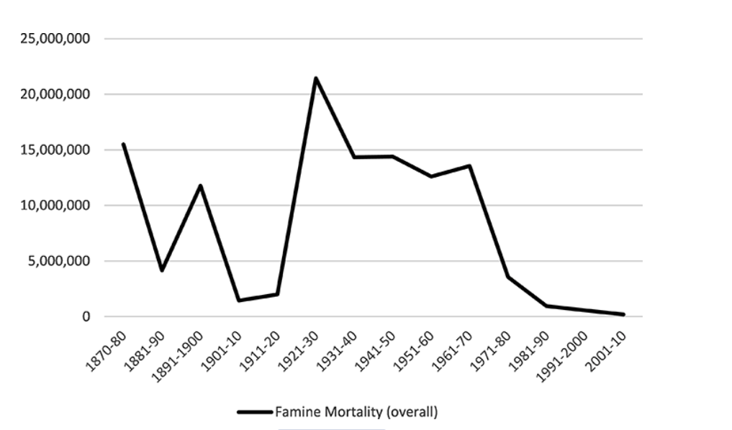
World Famine Data

Slide 11
Matthew 24 – the end-times for the Jews
Of course, we are now making our own plagues, as we have seen during COVID and firing the imaginations of a mostly unbelieving world by exaggerated climate claims.
In this passage we have a single warning about wars, rumours of wars, pestilence, earthquakes and famines but the Lord warns us 4-times about deceit – false Christs, false Prophets (v 5,11,23 & 24).
Examples of such deceit are plentiful, and some have led to large organisations forming.
In the not-too-distant past there were the Moonies whose leader claimed he was Christ returned and deceived many.
We have the Jehovah’s Witnesses – an organisation in which many thousands are deceived, and which is an organisation dedicated to false prophecy.
We have the Mormons – another group that has deceived many.
Currently we have the NAR group propagating satanic nonsense and captivating many.
We have the, so-called, word of faith movement teaching false doctrines and misleading many through individuals like Benny Hinn, Todd Bentley, Kenneth Copeland etc.
Common features of these are the claims to have a ‘special’ anointing and/or having had a ‘special’ visitation (often angelic), giving them a superior gifting or revelation. Often sexual misconduct is a feature too.
The name ‘Messiah’ means ‘anointed one’, so to some extent all of these are claiming to be or preaching doctrines from a false Messiah.
One of the results of this is that many of those deceived continue to spread their message.

Slide 12
Matthew 24 – the end-times for the Jews
In Acts 17 v 11 the Berean Jews were praised for their diligence in the scriptures, which brought them to true belief.
In verse 8 Jesus describes all of these things as, ‘the beginning of birth pangs’.
Metaphors for this period are usually either taken from obstetrics or seismology.
Here the progress is likened unto a woman in labour, and we know that from first twinges (Brackston Hicks) to birth is a steady building of the severity of the contractions until, eventually, the baby arrives.
Verse 9 – then they will deliver you (Jews) to great tribulation – a promise of persecution.
Verse 10 – a great falling away with lots of betrayal – even of family.
Many people being led astray by deceivers and false prophets.
V 12 - A spread of cold-heartedness and even hatred. Cold heartedness indicates indifference, but hatred is active and extreme dislike.
Lastly, we have two awkward and misunderstood statements – those who endure to the end will be saved – this does not refer to spiritual salvation in the Church, but to those who do not take the mark of the beast during the tribulation period. This is not a foundation for Calvin’s doctrine of the perseverance of the saints.
And, this Gospel of the Kingdom will be preached in the whole world etc.
I believe this refers to the enthroning of Jesus on earth on the throne of David, so is relevant to end-time Jews, rather than the Church.

