Slide 1

Why do we give?
1 Corinthians 9:6-15

Slide 2
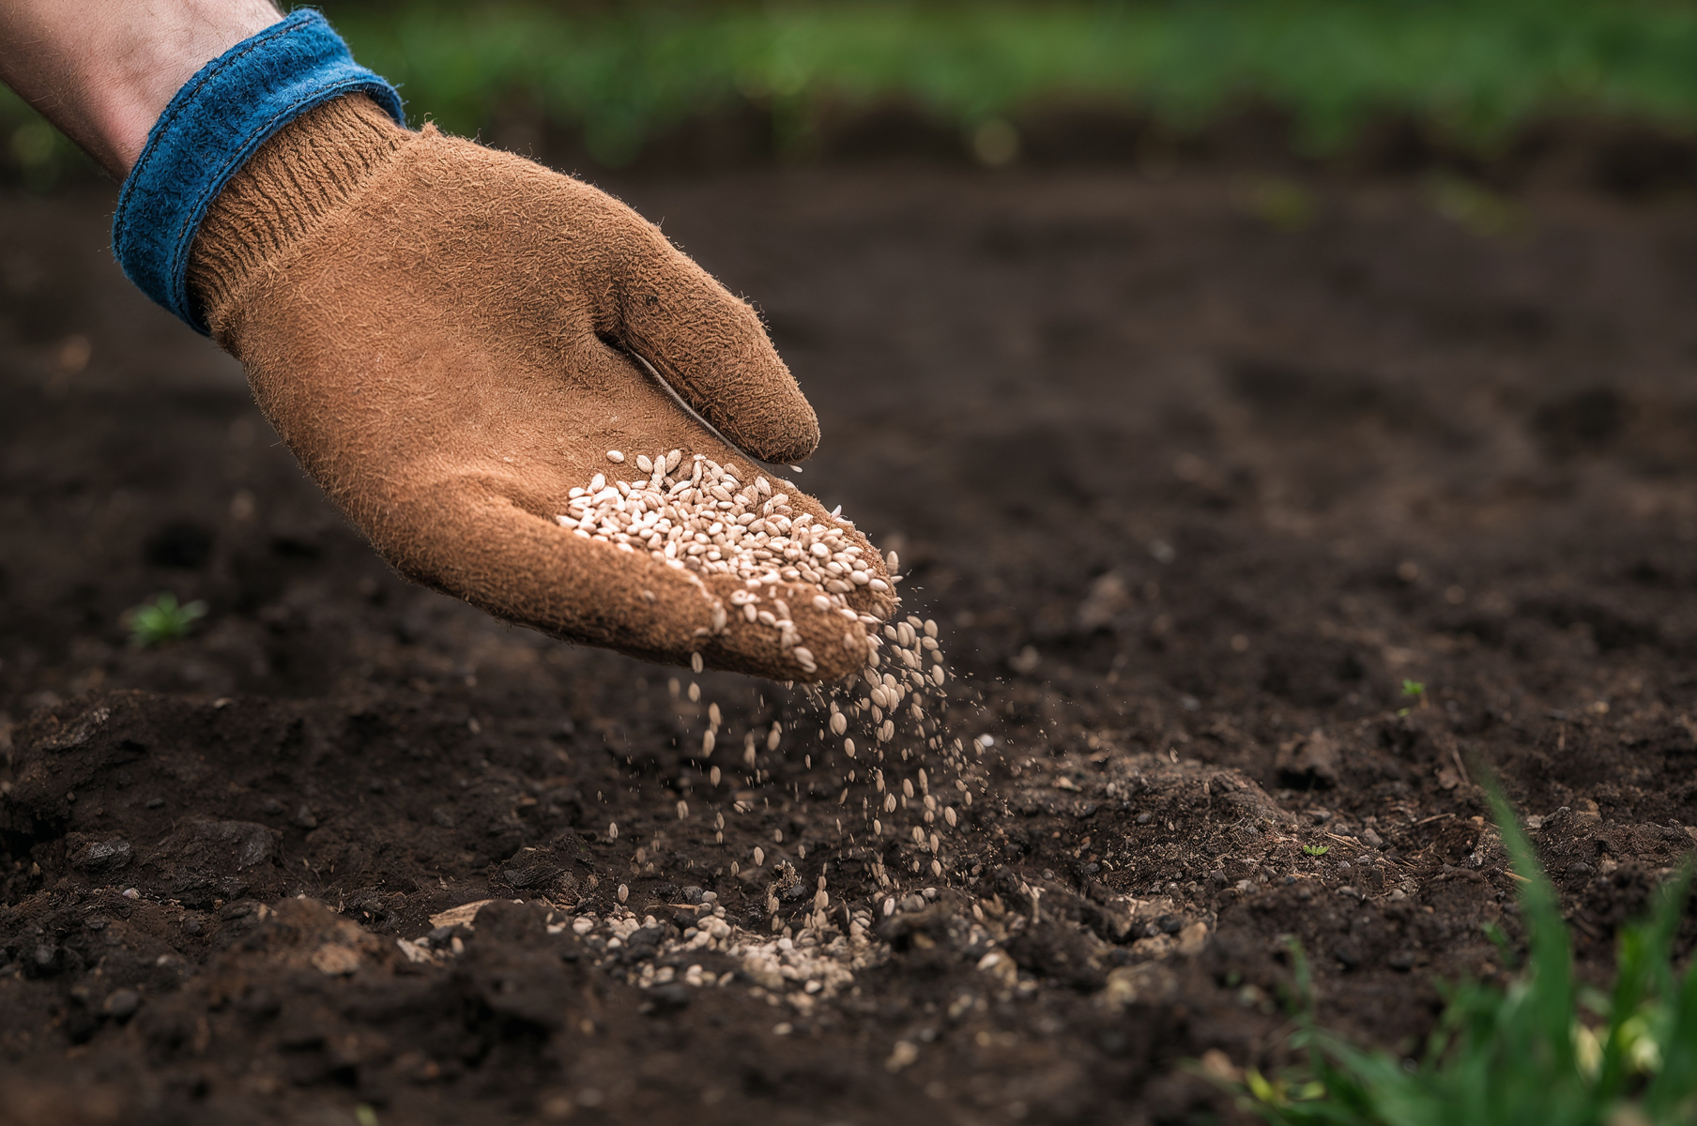
Why do we give?
1) Because of wisdom

Slide 3

A) Farmer Sparing

Slide 4
A) Farmer Sparing
B) Farmer Generous

Slide 5
Why do we give?
1) Because of wisdom

Slide 6
Why do we give?
2) Because we’re free

Slide 7
Why do we give?
3) Because of our God

Slide 8
“Your money can make you an overseas missionary without ever leaving your home town, an evangelist without ever mounting a platform, a broadcaster without ever entering a broadcast studio and a bible teacher without ever writing a book.”
John Blanchard

Slide 9
Why do we give?
3) Because of our God

