Slide 1

BEM KEC SUNDAY SERVICE LIVESTREAM
STREAM STARTS @ 9 AM
STREAM STARTING IN:

Slide 2

^{Starter discussion question:}
How might knowing what the Bible says about the future motivate the way you live now?

Slide 3

Exodus 15:1-18
NIV 2011
NEW INTERNATIONAL VERSION
¹ Then Moses and the Israelites sang this song to the Lord:
“I will sing to the Lord,
for he is highly exalted.
Both horse and driver
he has hurled into the sea.
² “The Lord is my strength and my defense
he has become my salvation.
He is my God, and I will praise him,
my father’s God, and I will exalt him.
ctw

Slide 4
Exodus 15:1-18
NIV 2011
NEW INTERNATIONAL VERSION
³ The Lord is a warrior;
the Lord is his name.
⁴ Pharaoh’s chariots and his army
he has hurled into the sea.
The best of Pharaoh’s officers
are drowned in the Red Sea.
⁵ The deep waters have covered them;
they sank to the depths like a stone.
ctw

Slide 5
Exodus 15:1-18
NIV 2011
NEW INTERNATIONAL VERSION
⁶ Your right hand, Lord,
was majestic in power.
Your right hand, Lord,
shattered the enemy.
⁷ “In the greatness of your majesty
you threw down those who opposed you.
You unleashed your burning anger;
it consumed them like stubble.
ctw

Slide 6
Exodus 15:1-18
NIV 2011
NEW INTERNATIONAL VERSION
⁸ By the blast of your nostrils
the waters piled up.
The surging waters stood up like a wall;
the deep waters congealed in the heart of the sea.
⁹ The enemy boasted,
‘I will pursue, I will overtake them.
I will divide the spoils;
I will gorge myself on them.
I will draw my sword
and my hand will destroy them.’
ctw

Slide 7
Exodus 15:1-18
NIV 2011
NEW INTERNATIONAL VERSION
¹⁰ But you blew with your breath,
and the sea covered them.
They sank like lead
in the mighty waters.
¹¹ Who among the gods
is like you, Lord?
Who is like you—
majestic in holiness,
awesome in glory,
working wonders?
ctw

Slide 8
Exodus 15:1-18
NIV 2011
NEW INTERNATIONAL VERSION
¹² “You stretch out your right hand,
and the earth swallows your enemies.
¹³ In your unfailing love you will lead
the people you have redeemed.
In your strength you will guide them
to your holy dwelling.
¹⁴ The nations will hear and tremble;
anguish will grip the people of Philistia.
ctw

Slide 9
Exodus 15:1-18
NIV 2011
NEW INTERNATIONAL VERSION
¹⁵ The chiefs of Edom will be terrified,
the leaders of Moab will be seized with trembling,
the people of Canaan will melt away;
¹⁶ terror and dread will fall on them.
By the power of your arm
they will be as still as a stone—
until your people pass by, Lord,
until the people you bought pass by.
ctw

Slide 10
Exodus 15:1-18
NIV 2011
NEW INTERNATIONAL VERSION
¹⁷ You will bring them in and plant them
on the mountain of your inheritance—
the place, Lord, you made for your dwelling,
the sanctuary, Lord, your hands established.
¹⁸ “The Lord reigns
for ever and ever.”
ctwend

Slide 11

Time of Reflection and Confession
Almighty God,
Father of our Lord Jesus Christ,
Creator of everything, Judge of everyone,
We admit that we have sinned against you
In thought, speech and action,
And deserve your just punishment.
We truly repent and are sorry for what we have done.
Have mercy on us, merciful Father.
For the sake of your Son Jesus Christ, who died for us,
Forgive us all that is past,
And enable us to serve and please you in a fresh way,
To the glory of your name. Amen.

Slide 12
Time of Reflection and Confession
³ Praise be to the God and Father of our Lord Jesus Christ! In his great mercy he has given us new birth into a living hope through the resurrection of Jesus Christ from the dead, 4 and into an inheritance that can never perish, spoil or fade.
– 1 Peter 1:3-4a

Slide 13
^{Apostles’ Creed}
I believe in God, the Father Almighty,
^{creator of heaven and earth.}
I believe in Jesus Christ, his only Son, our Lord,
who was conceived by the Holy Spirit
^{and born of the virgin Mary.}
He suffered under Pontius Pilate,
was crucified, died, and was buried;
^{he descended to the dead.}

Slide 14
^{Apostles’ Creed}
On the third day he rose again from the dead.
^{He ascended into heaven}
and is seated at the right hand of God the Father Almighty.
From there he will come to judge the living and the dead.
^{I believe in the Holy Spirit,}
^{the holy universal church,}
^{the communion of saints,}
^{the forgiveness of sins,}
^{the resurrection of the body,}
and the life everlasting. Amen.

Slide 15

Upcoming sermon series / Intro to Lamentations

Slide 16
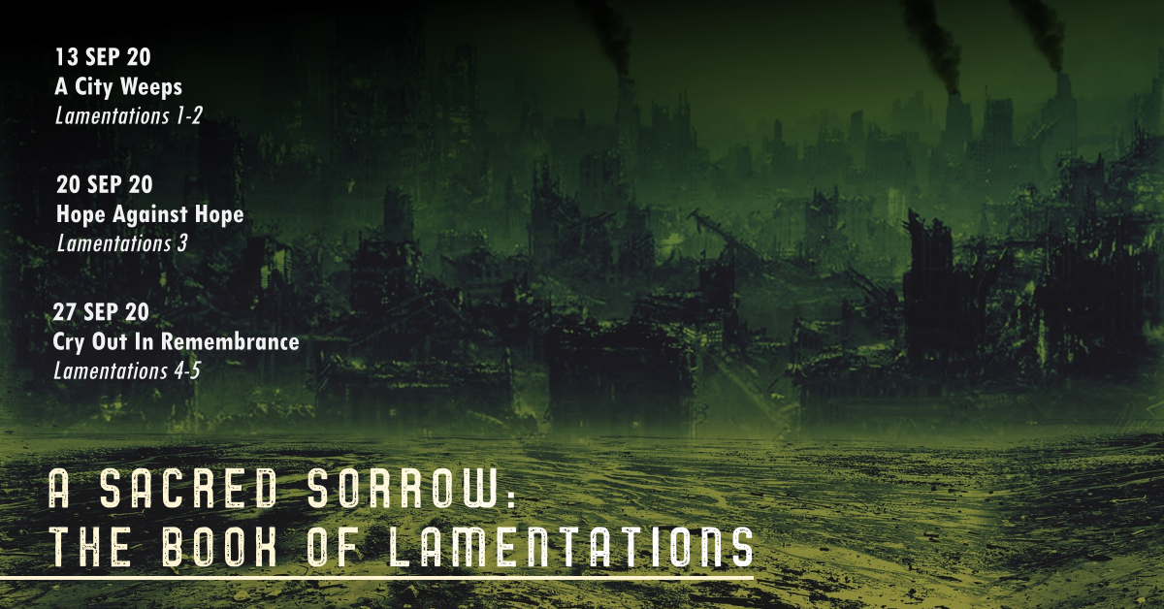

Slide 17


Slide 18
Why go through Lamentations?
Because...
1. 2 Timothy 3:14-17 tells us that all Scripture is profitable for teaching, correcting, rebuking and training in righteousness.
2. Lamentations will teach us the seriousness of sin against a holy God.
3. Lamentations gives us the gift of a voice when life is falling apart.
4. Lamentations has hope.
5. Lamentations doesn't have a resolution.

Slide 19
Prayers
• World
• Nation
• Church

Slide 20


Slide 21
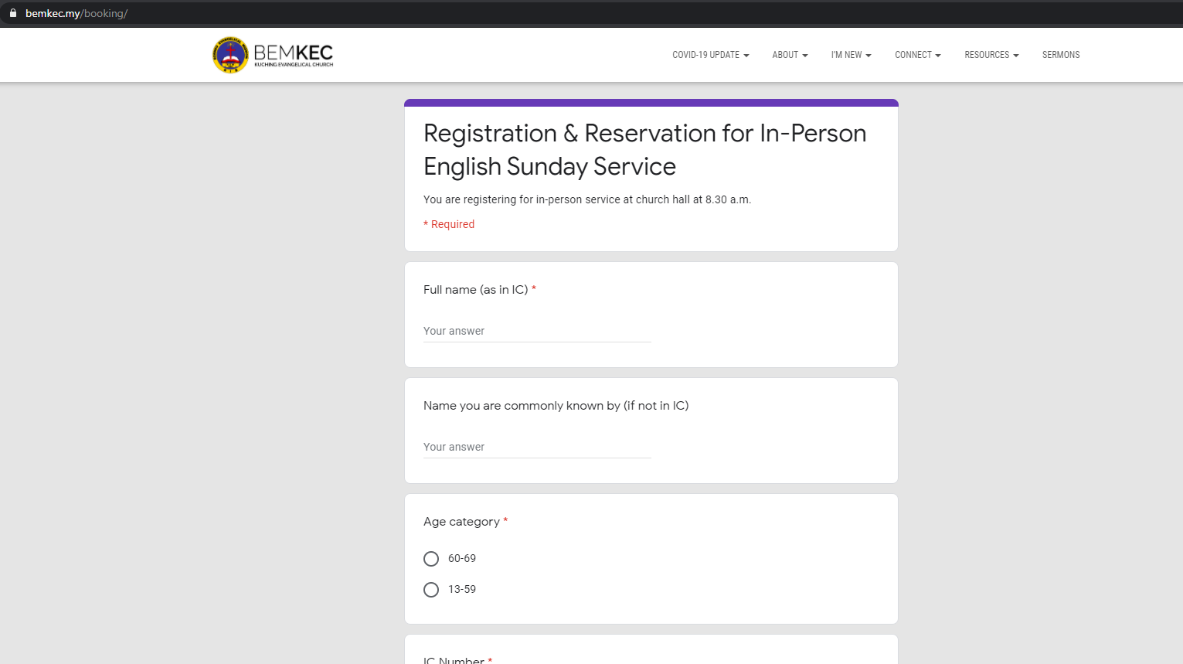
bemkec.my/booking

Slide 22

Announcements
• Connect cards
• Equip Classes – meets Saturday afternoon 2-4pm
just for next week
• Giving
• Prayer Meeting

Slide 23
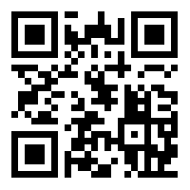
^{Announcements}
^{Connect Card}
^{https://bemkec.my/connect2us}
^{Or QR scan}

Slide 24
Giving Online
Online Payment to BEM-KEC
Maybank
Account No. : 511234114055
Recipient Ref. : Offering / Mission (if giving specifically for Missions)
As of 6 Sept 2020
Giving = RM 10,600
Missions = RM 9,180

Slide 25
BEM KEC Prayer Meeting
Join Our Prayer Meetings on Zoom
Wednesdays @ 8.00 pm
Contact any HFG leader or our Facebook page if you wish to join us

Slide 26

LEAVE A COMMENT ON OUR FACEBOOK PAGE!

Slide 27


Slide 28
