Slide 1
Engaging People with the Scriptures
Thinking about small group Bible Studies

Slide 2
‘We can’t think enough about the people to whom we minister’

Slide 3
What’s my goal for teaching?

Slide 4

Learning!
but what does that mean?
how does it happen?
how can I facilitate it?

Slide 5

A Simple Plan
Helping people to attend
Helping people to engage
to receive information
to process information
To bring about changes….

Slide 6
The first simple idea
People learn sort of the same

Slide 7
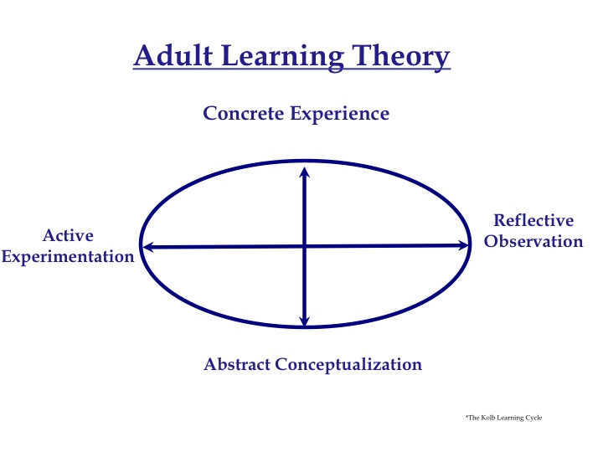

Slide 8




Which part of the cycle do you prefer most?
Notes:
Stereo
Activist…rip open box and get on with it
Theorist: manual, book on electronics
Pragmatist: what do I really need to know…only read that
Refelctor: sit and think, cup of tea, ring mother; then activist will do it for them because it is so frsutating to watch

Slide 9
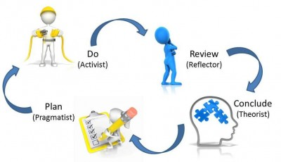
Notes:
Bible Studies: activists can become bored with traditional comprehension questions and long series
Reflectors can frustrate others left behind and return to topic other shave moved on from
Theorists can get bogged down in detail
Pragmatists can get frustrated at never arriving at an outcome
Reflectors tend to withdarw and my need to be invited to particpate

Slide 10
The second simple idea:
People Learn Differently

Slide 11
To start:
Robbing the Egyptians
It’s all about preferences
It’s all about your perception of your preferences

Slide 12
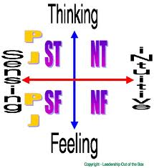
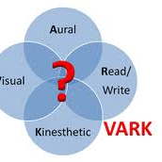
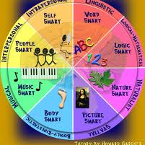
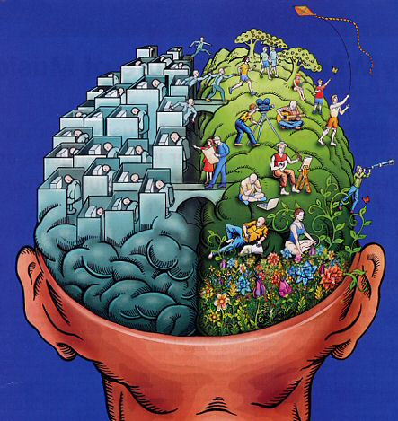
Ways of thinking about differences…

Slide 13
Kinds of Difference
Modality
Mindstyle

Slide 14
Modality:
Receiving Information

Slide 15
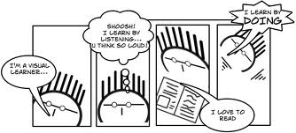
V. A. R. K

Slide 16
Visual
* Visuals
* Maps
* Charts
* Symbols
* Diagrams
* Different Colours
* Word pictures
* Gestures
* Picturesque language
Notes:
I see what you mean
I saw red
The crowd all stood and clapped
I see it now; I need to get it into perspective; I get the picture; I can picture that; That looks right to me; I’m in the dark about; That’s an enlightening answer; I see what you mean; Look, when you…; Let me see…; I can see a solution; Picture this; Show me;

Slide 17
Aural/hearing
* Happy to listen
* Explanations
* Discussion
* Sharing/buzz groups
* Role-play
* Talks
* Repeat aloud
* Debates
* Oral quizzes
Notes:
That sounds right
Something clicked
I heard warning bells
There was thunderous applause
that sounds right; Suddenly it clicked; I get tuned into it; Something tells me that’s the answer; I can hear you are unhappy; That rings a bell; Just listen to me; I hear what you say; That’s music to my ears; Let’s discuss this; Just tell me; Sounds like a good idea

Slide 18
Read/write
Lists
Notes
*Handouts
*Definitions
*Quotes
*Meaningful headings
*Taking notes
*Lots of information
Written responses/diary
Notes:
take note, I’ll put it on my list, write it down for me; put it in writing and we’ll talk about it.

Slide 19
Kinesthetic
Field Trips
Discovery/Trial and Error
Illustrations
Samples
Photographs
Pass things around
Walk and Talk
Real life examples
Implications
Notes:
I feel comfortable with that
That just turned me off
Eveyone was really moved
That feels right; I’m groping for an answer; I find it difficult to handle; It’s an intense problem; Give me a concrete example; I have a firm grip on the subject; I feel that…; Hang in there; Get your head around this; How does that suit; Get a grip on yourself.

Slide 20
Mindstyles
Ordering information
01
Processing Information
02

Slide 21
Perceiving the World
Concrete
Abstract

Slide 22
Ordering the World
Sequential
Random

Slide 23
Putting them together
Abstract Sequential (AS)
1
Concrete Sequential (CS)
2
Abstract Random (AR)
3
Concrete Random (CR)
4

Slide 24
Abstract Sequential
Interested in knowledge, facts
Learns by thinking through ideas
Needs to know what experts think
Intellectual, logical, analytical
Less interested in people than ideas and concepts

Slide 25
AS: Preferred Activities
Reading, writing
Like working alone
Lectures, content
Using theories
Class notes & material
Research, experts
Information gathering, essays

Slide 26
Concrete Sequential
Ordered, practical, linear thinker
Methodical
Seeks useability, a doer
Needs to know how things work
Conservative, perfection-oriented

Slide 27
CS: Preferred Activities
Demonstrations
Hands on experiences
Practical activities
Charts, checklists, flow charts
Short term projects
Like guided practice with an organized person

Slide 28
Abstract Random
Imaginative, perceptive, sensitive, emotional
Learns by listening, sharing ideas
Interested in people and culture
Idea person
Likes the ‘big picture’

Slide 29
AR: Preferred Activities
Group discussion/activity
Role play, music, movies, television, fantasy
Social activities to balance work
Wants an environment that is aesthetically or psychically pleasing
Non-competitive atmosphere
People problems preferred

Slide 30
Concrete Random
An experimenter, risk-taker, trial and error
Inquisitive, independent
Likes to be self-directed
Often reaches accurate conclusions in the absence of logical justification
Intuitive, instinctive, impulsive
Functions by acting and testing experience

Slide 31
CR: Preferred Activities
Experiments
Games/simulations
Likes a busy environment
Group tasks
Open-ended activities

Slide 32
Let’s do the Quiz

Slide 33
How do I do it?

Slide 34
Thinking about Bible study

Slide 35
Engaging the Scriptures

Slide 36
Summarise
Read and present a summary
Good for long passages: allocate sections to people/pairs
Not so good for familiar passages
Notes:
Daniel 9: 4-6; 7-11; 12-14; 15-16; 17-19

Slide 37

Paraphrase
Take the passage phrase by phrase and ‘translate’
Good for familiar passages which are not always understood
Good for passages with ‘theological’ words
Notes:
Col 1:15-23: a really dense passage…work through phrase by phrase and paraphrase

Slide 38
Compare
Compare different passages by same author
Compare passages by different authors on same themes
Compare same incident in different Gospels
Look for similarities, differences, changes in focus. detail
Notes:
The servant songs in Isaiah: 42:1-4; 49:1-6; 50:4-9; 52:13-53:12: contrasts and similarities

Slide 39
Note
Underline and circle particular words or details in the text
Notes:
Romans 1:8-17: circle the I’s’

Slide 40
Organise
Organise ideas/themes of the passage into groups
Use for passages where distinct classifications are present
Notes:
2 Cor 2:14-5:10: organize the series of contrasts Paul makes in the passage

Slide 41
Contrast
Look at a passage to identify contrasts within it
Notes:
Daniel 5: Daniel/Astrologers, real God/Fake Gods

Slide 42
Identify Types
Good for narrative with multiple characters
Identify groups in the passage and work out their reactions
Notes:
Mark 5:1-20: Jesus, the demon possessed man, those tending the pigs, the townspeople, the disciples: action/reaction and reason

Slide 43
Drawing
Occasionally use?
Apocalyptic, descriptions, graphic images

Slide 44
Interview
Formulate journalist questions to ask characters in the passage
Pair up or ‘perform’ in the group
One is journalist, the other is the character
Notes:
Example: Philemon: interview Paul, Onesimus, Philemon

Slide 45
Sentence Analysis
Good for complex argument passages (ie Paul)
Break down the passage into its parts and arrange them in relation to each other

Slide 46
Paul
  A servant of Jesus Christ
  called to be an apostle
  set apart for the gospel of God
    (the gospel) which he promised
      beforehand
      in the holy scriptures
    the gospel concerning his Son
      who was descended from David
        according to the flesh

Slide 47
Mapping
Good for ‘travel’ passages where action moves form one location to another
How does plot develop as action moves?
Notes:
Eg Mark 8:27-11:11
Maybe Exodus wanderings

Slide 48
List
List commands, instructions, words, ideas
Look for repetition and themes
Notes:
Colossians 3:1-17: list what not to do and write a jargon free definition of each word (or an example of an action?

Slide 49
Table
Setting up a table to see details of a passage
Helps with comparisons, contrasts, development of ideas
Notes:
Four soils: soil type/response/meaning/Christian or non-Christian?

Slide 50
Role-play
Variation of interview
Read/explore passage and then ‘be’ a character in the passage
Notes:
Read Daniel 2: divide group in two: Daniel and astrologers: each group to identify and list the components of their world view, their understanding of God, and create a motto for their team: then alternate in telling the other group their findings

Slide 51
Plot
Good for longer narratives
Plot/chart elements in relation to one another
Attitude to God
Trust
Time
Doubt
Notes:
Good for longer narratives
Plot/chart elements in relation to one another
Exxodus 15-17: polt Israel’s response to God

Slide 52
Questions
Default?
Remember open and closed questions

Slide 53


Swedish Method
Notes:
Read passage and think and identify things not clear, thoughts, actions suggested by the passage
Good to help people start to read the Bible for themselves

Slide 54
Manuscript Discovery
Takes a long time
Text with no chapter markings, verse references
Work through to identify themes, ideas, structures
Needs time!

Slide 55
Summary
People learn the same
People learn differently

Slide 56
Implications
People tend to teach I the way that they like to learn
Look out for your least preferred mode

Slide 57
The simple application
In a word:
Variety

Slide 58
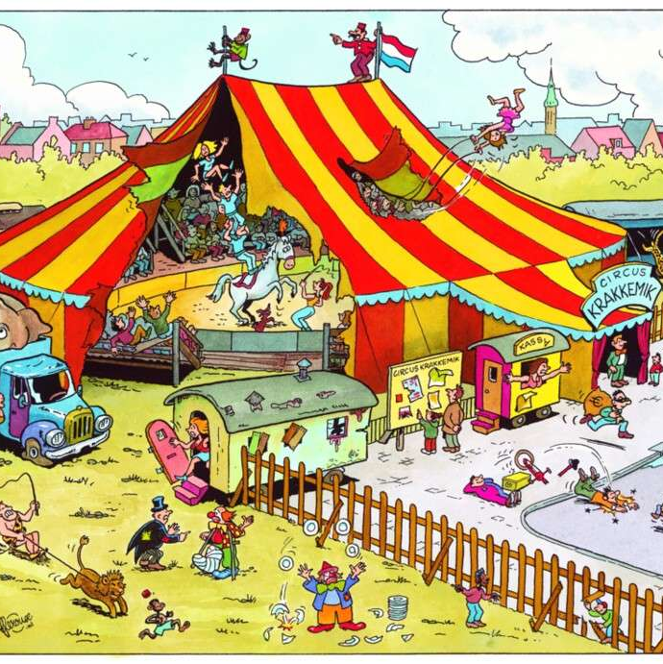
But remember…
You can’t cater
to all of the people
all of the time

Slide 59
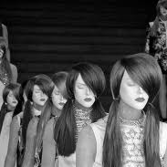
You shouldn’t cater
to some of the people
all of the time

Slide 60
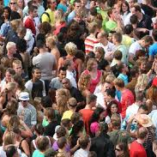
But you can cater
to all (groups) of people
(at least) some of the time

